Slide 1

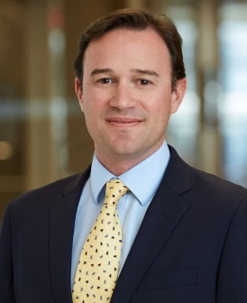

Recyclability Claims and SB 343: Risk Mitigation, Litigation, and the Constitutional Challenge
Joe
O’Connor
Alex
Tablan
May 7, 2026

Slide 2
Agenda
California SB 343
Litigation Trends
Defenses and Risk Mitigation
Constitutional Challenge

Slide 3
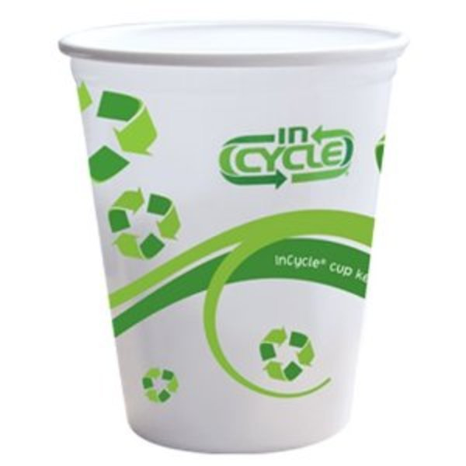
Existing Regulation Under CA law and FTC Green Guides
FTC Green Guides incorporated into California law. B&P Code § 17580.5.
Per the Green Guides, a product or package should not be advertised as recyclable “unless it can be collected, separated, or otherwise recovered from the waste stream through an established recycling program for reuse or use in manufacturing or assembling another item.” 16 C.F.R. § 260.12.
Recyclability claims should be qualified unless recycling facilities are available to a substantial majority of consumers or communities where the item is sold.
  A substantial majority is 60%.
Notes:
“Marketers can make unqualified recyclable claims for a product or package if the entire product or package, excluding minor incidental components, is recyclable. For items that are partially made of recyclable components, marketers should clearly and prominently qualify the recyclable claim to avoid deception about which portions are recyclable.” 16 C.F.R. § 260.12(c).
“An item that is made from recyclable material, but, because of its shape, size, or some other attribute, is not accepted in recycling programs, should not be marketed as recyclable.”
Note: Logos indicating the product is recyclable, such as the chasing arrows logo, will be considered a recyclable claim. 16 C.F.R. § 260.13, Example 8.
California Recyclability Requirement for Chasing Arrows Symbol
SB 343 provides that all products and packaging which display a chasing arrows symbol must meet California’s statewide recyclability criteria. Bus. & Prof. Code § 17580(a)(6). “Chasing arrows symbol” is defined as an “equilateral triangle, formed by three arrows curved at their midpoints, depicting a clockwise path, with a short gap separating the apex of each arrow from the base of the adjacent arrow.” Id. § 17580(f). This definition also includes variants of the symbol that are likely to be interpreted by consumers as an implication of recyclability, such as arrows that arranged in a circular pattern around a globe. Id. SB 343 requires that CalRecycle determine by January 1, 2024 how “recyclability” will be defined for purposes of this requirement. Pub. Res. Code § 42355.51(d). Compliance with this standard is required by January 1, 2024, or 18 months after CalRecycle publishes its first material characterization study for determining the recycling criteria, whichever date is later. Id. § 42355.51(b)(2).

Slide 4

California SB 343 (“Recyclable” Claims Law)
Scope of Law:
Imposes specific criteria for products or packaging bearing a “recyclable” claim, any statement “otherwise directing” consumers to recycle products (e.g., How2Recycle logos), or the use of the three chasing arrows symbol
Exemption for products subject to CA bottle deposit law
“Recyclable” Criteria:
In April 2025, CalRecycle published its Material Characterization Study assessing various packaging materials against the access and sortation criteria (#1 and 2)
Existing CA law requires substantiation for these claims to be documented and made available to public on demand
Compliance Timeline:
Applies to products manufactured after October 4, 2026 (18 months after the final Material Characterization Study was published)

Slide 5
Cal. Pub. Res. Code 42355.51(d)
“Recyclable” Criteria
Access to Recycling: 60% of the California population is served by recycling programs that accept the material type and form
Material Sortation: 60% of recycling programs are covered by large volume transfer or processing facilities that can sort the material.
Basel Convention: The sorted materials are reclaimed at facilities consistent with the Basel Convention requirements.
Design Requirements: Material does not include any components such as inks, labels, adhesives, etc. that would prevent recyclability (for plastic products, see the APR Design Guide published by the Association of Plastic Recyclers)
Composition Requirements: The material does not contain any intentionally added PFAS or any PFAS in a concentration at or above 100 ppm

Slide 6
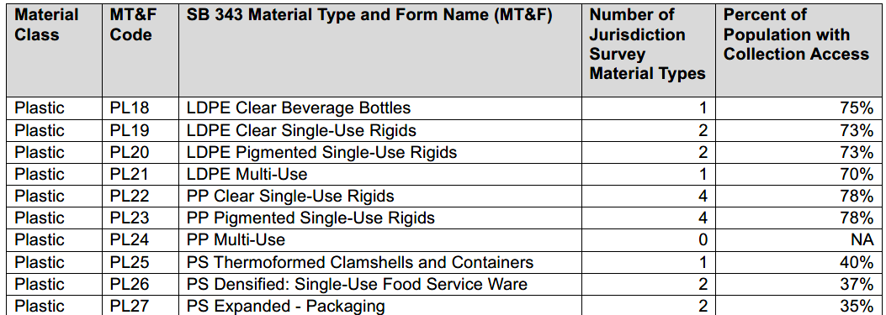
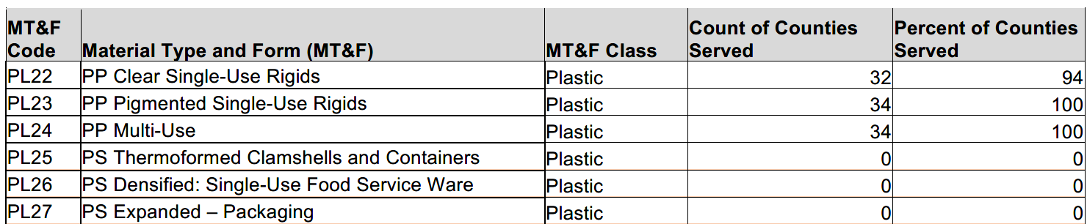
CalRecycle Material Characterization Study
Only provides information on access and sortation; not on Basel Convention, design criteria, or PFAS

Slide 7
Why SB 343 Matters to Your Business
What the Law Does
EFFECTIVE
Oct. 4, 2026
~5 months away
Bans the chasing-arrows symbol, "recyclable," and any statement indicating recyclability
Unless a product meets all criteria in PRC § 42355.51 — a multi-factor test that even CalRecycle admits it cannot fully interpret
Qualified, accurate statements ("Recyclable where facilities exist – check locally") are also prohibited
Overlapping Enforcement Exposure
Criminal Liability
Civil Penalties
Public & Private Enforcement
Up to 6 months imprisonment + $2,500 fine per product sold or imported into California
$500–$2,000/violation (PRC) stacked with up to $2,500/violation (UCL)
Any consumer may sue under FAL/UCL/CLRA; SB 343 creates a per se deceptive labeling hook. 30+ lawsuits already filed.
The AG has also demonstrated intent to use SB 343 to bring deceptive labeling suits.
No safe harbor with Green Guides compliance.

Slide 8
Agenda
California SB 343
Litigation Trends
Defenses and Risk Mitigation
Constitutional Challenge

Slide 9
Recent Lawsuits Against Grocer Defendants
Sullivan & Yaeckel:
Filed | Case Name | Case No. | Court
4/5/24 | Garcia v. Safeway | 37-2024-00016265-CU-BT-CTL | S.D. Superior Court
6/10/25 | Heavey v. Smart & Final Stores, LLC | 25CU030337C | S.D. Superior Court
9/19/25 | Blagoyevic v. Grocery Outlet, Inc. | 25CU050184C | S.D. Superior Court
10/24/25 | Quinn v. Bevmo! Inc. | 25CU057641C | S.D. Superior Court
10/24/25 | Dimino v. Food 4 Less of California, Inc. | 25CU057649C | S.D. Superior Court
10/28/25 | Castillo v. Safeway | ECU004383 | Imperial County Superior Court
1/26/26 | Garcia v. Stater Bros. Markets | 25CU050156C | S.D. Superior Court

Slide 10
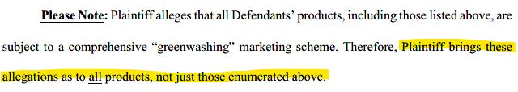
Sullivan & Yaeckel
Taking advantage of lax pleading standard in California state court.
Pled to avoid removal to federal court:
    California only class
    California only defendants
Congestion in San Diego Superior Court
May target wide swaths of products:
Garcia v. Safeway, First Amend. Compl. ¶ 17

Slide 11
Agenda
California SB 343
Litigation Trends
Defenses and Risk Mitigation
Constitutional Challenge

Slide 12
Safe Harbor Defense
SB 343 does not go into effect until October 4, 2026.
At least one court has held that recyclability claims were barred until that time under California’s safe harbor doctrine:
  “Read plainly, it appears that the California Legislature intended to give companies eighteen months after publication of a generally applicable material characterization study to comply with recycling guidelines.” Bhotiwihok v. Fairlife, LLC, 2026 WL 413749, at *7 (C.D. Cal. Feb. 13, 2026).
Safe harbor argument is temporary but may provide basis to limit class exposure for past claims.

Slide 13
Arbitration Agreements
Increased online engagement by consumers with loyalty programs and pick-up and delivery services.
Many terms of service include arbitration agreements.
Arbitration agreements may limit exposure to class actions.
Check to ensure enforceability.
  Assent: Does your terms of service sign-up flow ensure contract formation?
  Scope: Does the arbitration agreement cover anticipated claims?
  Pitfalls: Does your arbitration agreement avoid pitfalls under California law?

Slide 14
Named Plaintiff’s Reliance and Standing
SB 343 does not change that plaintiffs must prove that they suffered injury to have standing to bring claims under California’s consumer protection statues and for fraud. Shaeffer v. Califia Farms, LLC, 44 Cal. App. 5th 1125 (2020)
Check loyalty program information to see if the plaintiff purchased any of the alleged products.
Consider deposing the named plaintiff early in the case before the other side becomes more acquainted with your defenses.
  Did Plaintiff see or rely on the alleged recyclability representations?
  Does Plaintiff care whether a product is recyclable?
  Did Plaintiff pay more money because she thought the product was recyclable?
Notes:
A person has standing to bring a claim under the unfair competition law, the false advertising law, or the CLRA only if she establishes that (1) she “has suffered” “economic injury” or “damage,” and (2) this injury or damage “was the result of, i.e., caused by,” the unfair business practice, false advertising or the CLRA violation “that is the gravamen of [her] claim.”
Shaeffer v. Califia Farms, LLC, 44 Cal. App. 5th 1125, 1137, 258 Cal. Rptr. 3d 270, 278 (2020)

Slide 15
Agenda
California SB 343
Litigation Trends
Defenses and Risk Mitigation
Constitutional Challenge

Slide 16
Argument 1: SB 343 Is Unconstitutionally Vague
A law that criminalizes speech must give businesses fair notice of what is prohibited. SB 343 fails on four independent grounds.
1
"Routinely Becomes Feedstock" — Undefined
2
Basel Convention Criterion — Unverifiable
The key threshold term has no definition. More than half the time? 75%? 90%? No business can know. Mirrors the fatal defect in AB 3994, SB 343’s predecessor that was partially struck down in Lungren.
Requires materials to be reclaimed consistent with the Basel Convention — a treaty the U.S. never ratified. CalRecycle admits it cannot determine compliance. No guidance exists.
3
APR Design Guide — Shifting Private Standard
4
"Ensures" or "Prevents" Recyclability — Indeterminate
SB 343 incorporates a privately published guide updated dozens of times (last: March 2026). No specified edition. CalRecycle guidance conflicts with the Guide.
Whether a component prevents recyclability depends on individual MRF operations — factors entirely outside business control. CalRecycle will not make that determination.
Precedent: Ass'n of Nat'l Advertisers v. Lungren, 44 F.3d 726 (9th Cir. 1994)

Slide 17
Argument 2: SB 343 Fails First Amendment Scrutiny
Commercial speech may only be restricted if it passes the Central Hudson test. SB 343 fails prongs 3 and 4.
Prong 1
Is Speech Unlawful or Inherently Misleading?
Prong 2
Substantial State Interest?
Prong 3
Directly Advances?
Prong 4
No More Extensive
Than Necessary?
✓ Plaintiffs Pass
✓ Conceded
✗ State Fails
✗ State Fails
Recyclability claims are only "potentially misleading" — not inherently false.
The State cannot use its own definition to bootstrap an inherent-deception finding.
Plaintiffs do not dispute that reducing consumer confusion and improving recycling rates are substantial interests.
But interest alone does not justify speech suppression.
SB 343 chills accurate claims (even qualified ones, like “Recyclable where facilities exist – check locally”).
Drives consumers to assume items are non-recyclable.
Suppressing truthful info does not advance recycling or reduce consumer confusion.
Obvious less-restrictive alternatives exist:
qualified labels,
state-maintained lookup tools,
regulate products and packaging directly,
enforce existing deceptive-advertising laws

Slide 18
Scenario A1: Court Grants the Preliminary Injunction
Hearing: June 1, 2026 | Current Compliance Deadline: October 4, 2026
Immediate Operational Impact
What Happens Next
Enforcement of SB 343’s labeling restriction is temporarily enjoined — products/packaging manufactured after October 4 can be labeled recyclable (without violating SB 343) even if criteria are not met
Existing recyclability labels (chasing arrows, "recyclable," store drop-off) remain lawful pending full merits decision
Private litigation filed as SB 343 predicates may stall or be stayed
Businesses may pause costly packaging redesigns and SKU audits
Case proceeds to merits (summary judgment or trial)
State may appeal and seek emergency stay from 9th Circuit – unlikely
CalRecycle may attempt to promulgate clarifying rules to fix vagueness
Legislature could amend SB 343 to address constitutional defects
What Members Should Do
Consult counsel before launching new packaging lines or making compliance commitments to vendors
Monitor: the State may appeal and seek stay; the injunction is not a final merits ruling

Slide 19
Scenario A2: Preliminary Injunction is Granted in part and Denied in part
Hearing: June 1, 2026 | Current Compliance Deadline: October 4, 2026
What Happens Next
What a Partial Victory Would Look Like
Certain recyclability criteria are struck down as unconstitutionally vague and/or failing First Amendment scrutiny
Case proceeds to merits (summary judgment or trial)
Plaintiffs or State may appeal to the 9th Circuit
Legislature could amend SB 343 to address constitutional defects
Immediate Operational Impact
Depending on which provisions of SB 343 the Court finds are likely constitutional, the restrictions on recyclability labeling will still take effect on October 4 but just be narrower
  e.g., one or more of the recyclability criteria would not operate to disqualify a product or packaging from being labeled recyclable, but the remaining criteria would

Slide 20
Scenario B: Court Denies the PI — Responding Strategically
A full denial (unlikely) would not spell the end. Plaintiffs could appeal or move straight to seeking Summary Judgment
Track 1: Emergency Appeal
Track 2: Compliance Planning
Track 3: Merits Continue + Policy Track
Promptly file interlocutory appeal to 9th Circuit
Seek emergency stay pending appeal (serious questions + irreparable harm standards already developed in record)
Timeline: a motion for stay can be filed within days of denial
Prioritize private label SKU audit: identify highest-risk labels (unqualified chasing arrows on plastics)
Preserve litigation budget: private enforcement wave could begin Oct. 4
Document good-faith compliance with SB 343 recyclability criteria
Denial of a PI does not resolve the merits — case continues toward summary judgment
Coalition advocacy: work with Legislature and/or CalRecycle on SB 343 reform to create qualified-statement safe harbor, provide more clarity, or address problems in other ways

Slide 21
Questions?

Slide 22
Contacts
Joe O’Connor
Alex Tablan
Senior Associate, Los Angeles
  +1 310 785 4771
  joe.oconnor@hoganlovells.com
  Litigation, Arbitration, and Employment
Associate, San Francisco
  +1 415 374 2311
  alexander.tablan@hoganlovells.com
  Litigation, Arbitration, and Employment
Joe O’Connor is a talented litigator who handles complex litigation for some of the nation’s largest companies in forums across the country. Joe has considerable experience litigating consumer class actions and formidable trial experience, which allows him to bring a unique approach to advising his clients while also being prepared to fight some of their most challenging issues.
Alexander Tablan is a litigation associate who represents clients in complex disputes and regulatory matters arising under California’s unique and ever-evolving environmental and consumer product laws. He has extensive experience advising and defending companies across the food and beverage, apparel, and dietary supplement sectors in matters involving Proposition 65, greenwashing, chemical disclosures, product labeling, and violations of California’s consumer protection statutes. Alex regularly counsel clients through every stage of Proposition 65 enforcement actions—from pre-suit investigations and risk mitigation to litigation strategy and settlement negotiations.

