Slide 1
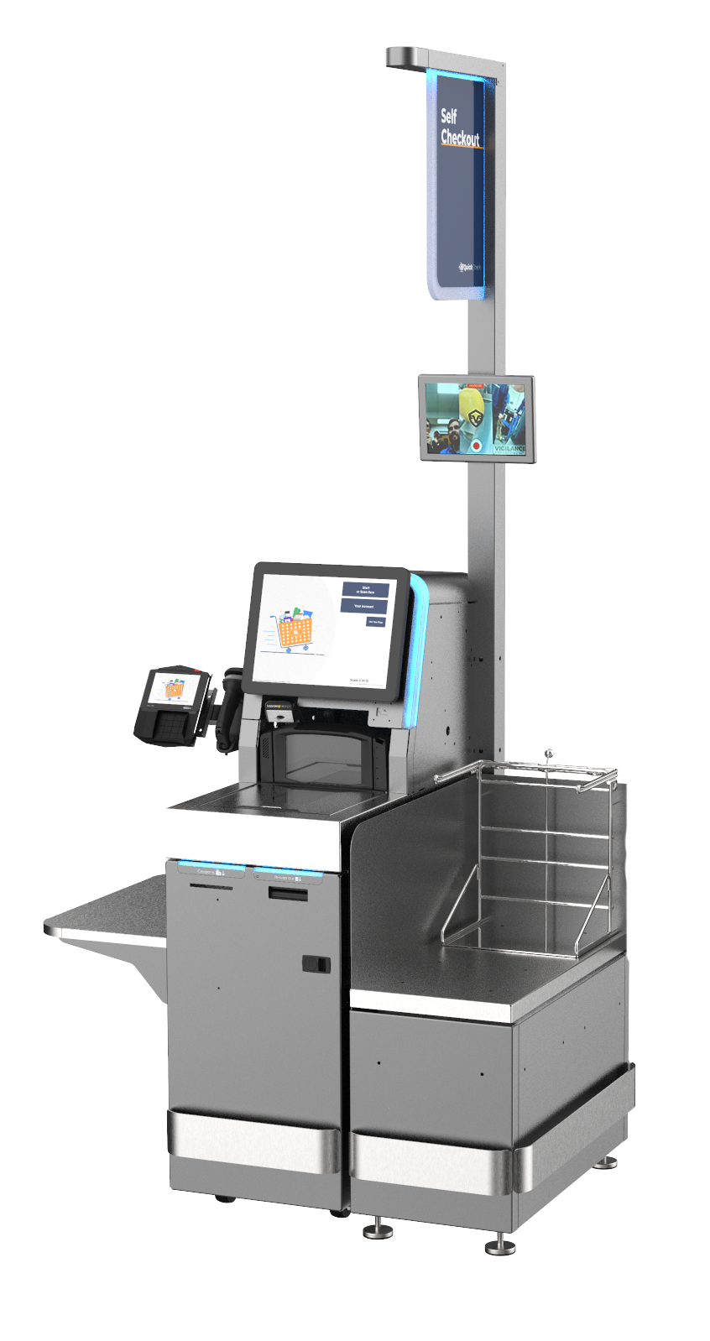
Self-Checkout History
State Proposals
  SB 1446 - Intro 2/24; DIED 11/24
  SB 442 – Intro 2/25; ABANDONED 8/25
UFCW CBA addressing SCO - 5/25
Local Proposals
  Long Beach – Intro 6/25; PASSED 8/25
  Costa Mesa – Intro 11/25; PASSED 2/26
  Los Angeles – Pending
  Anaheim - Pending
  Glendale - Pending
  Santa Ana - Pending

Slide 2
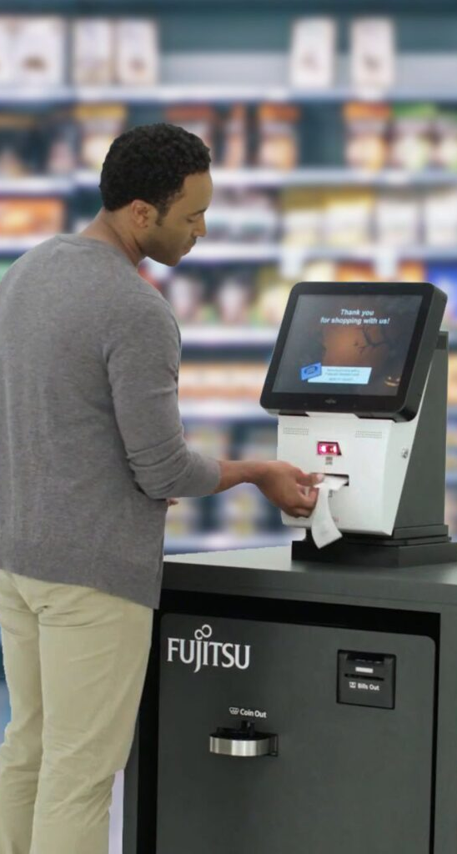
Self-Checkout Issues
  Ratio
  Dedicated Employee
  Staffed/Full Service Lane
  Item Limit
  Restricted/Locked Items
  Covered Establishments
  Enforcement/PRA
  Right to Cure
  State Preemption

