Slide 1
Proposition 65:
May 5, 2026
Retailer Obligations, Enforcement Trends and the New Frontier of
Non-Traditional Retail
PRESENTED BY
Naoki Kaneko | Partner, Shook, Hardy & Bacon
Lauren Haas | Associate, Keller & Heckman

Slide 2
Today’s Agenda
Frequently Targeted Products and Chemicals
Current Enforcement Data: Q3 2025 – Q1 2026
Top Private Enforcers and Plaintiffs’ Counsel
Who is Filing Notices and Driving Litigation Volume?
Welcome to the Party
Non-traditional Retailers: Delivery Platforms and Gig Marketplaces
The Grocery-Delivery Supply Chain Problem
How Traditional Retailers are Exposed Through
Third-party Platforms
Takeaways
Key Points and Practical Action Steps

Slide 3
Frequently Targeted Products and Chemicals
1

Slide 4
Frequently Targeted Product Categories + Chemicals at Issue
PRODUCT / CATEGORY | CHEMICAL(S) AT ISSUE
Food and Dietary Supplements (>50% of Notices in Q4 2025; 64% in Q1 2026)
Protein Powders | Lead, Cadmium
Herbal Supplements (turmeric, mushroom, green blends) | Lead, Cadmium, Mercury
Chocolate / Cacao Products | Lead, Cadmium
Spices and Seasonings | Lead, Cadmium
Baked Goods / Dough Products (bread, crackers, pizza dough, grain products) | Lead, Cadmium
Rice Products (rice, rice paper) | Lead, Cadmium, Arsenic
Flour (cassava, rice) | Lead
Seaweed | Lead
Baby Foods / Infant Formula | Lead, Cadmium, PFAS
Seafood (clams, mussels, oysters, scallops, shrimp— refrigerated, frozen, canned) | Lead, Cadmium
Instant Noodles | Lead, Cadmium
Thermal Paper / Packaging (~20% of Notices in Q4 2025)
Thermal Receipt Paper | BPS
Shipping Labels / Stickers | BPS
Packaging Materials | BPS, Phthalates
PRODUCT / CATEGORY | CHEMICAL(S) AT ISSUE
Bags, Cases and Accessories
Totes, Backpacks, Luggage | Phthalates (DEHP, DINP, DBP)
Diaper Bags, Cooler Bags | Phthalates, PFOA
Decorated Glass and Ceramics
Mugs, Plates, Bowls | Lead (glazes, decorative paint, enamel)
Beauty and Personal Care
Shampoos, Conditioners, Cleansers | Cocamide DEA
Skin Creams, Lotions, Sunscreen | Cocamide DEA, PFAS
Eyeliners, Mascaras | Lead, Cadmium
Footwear and Apparel
Shoes / Boots (synthetic soles or uppers) | Phthalates, Hexavalent Chromium
Rain Jackets / Pants | PFOA, PFOS
Tools and Hardware
Soft-Grip / PVC Tools | BPS

Slide 5
Food + Dietary Supplements In Detail:
Products, Chemicals and Settlement Data
PRODUCT / CATEGORY | CHEMICAL(S) AT ISSUE
Protein Powders | Lead, Cadmium
Herbal Supplements (turmeric, mushroom, green blends) | Lead, Cadmium, Mercury
Chocolate / Cacao Products | Lead, Cadmium
Spices and Seasonings | Lead, Cadmium
Baked Goods / Dough Products (bread, crackers, pizza dough, grain products) | Lead, Cadmium
Rice Products (rice, rice paper) | Lead, Cadmium, Arsenic
Flour (cassava, rice) | Lead
Seaweed | Lead
Baby Foods / Infant Formula | Lead, Cadmium, PFAS
Seafood (clams, mussels, oysters, scallops, shrimp— refrigerated, frozen, canned) | Lead, Cadmium
Instant Noodles | Lead, Cadmium
Alcoholic Beverages | Ethyl Alcohol (emerging―Q1 2026)
Settlement Data: 2025–Q1 2026
Q1 2025
Food/Supps: 34% of settlements
Metals: 61%
Q2 2025
Food/Supps: leading category
Phthalates: 17%
Q3 2025
Food/Supps: largest category
BPS: growing rapidly
Q4 2025
Food/Supps: 49% of settlements
BPS Receipts: 13%
Q1 2026
Food/Supps: 38% of settlements
BPS Receipts: 23%
Metals: 50% (171 lead + 20 cadmium)

Slide 6
Top Private Enforcers and Plaintiffs’ Counsel
2

Slide 7
Top Private Enforcers by 60-Day Volume
# | ENFORCER / COUNSEL | FOCUS AREA / NOTES
1 | Environmental Health Advocates, Inc. (Entorno Law) | 1,200+ notices in 2025; food, dietary supplements, retail products
2 | Center for Environmental Health (CEH) | High volume; food, personal care, consumer products
3 | As You Sow | Food/beverage; heavy metals in consumer products
4 | Consumer Advocacy Group (CAG) | Broad consumer products; frequent filer
5 | Mateel Environmental Justice Foundation | Food/beverage; broad retail
6 | Ecological Rights Foundation | Retail, personal care, consumer products
7 | The Chanler Group (Cliff Chanler) | Serial filer since early 1990s; 46 notices in 2025; targets same defendants repeatedly
8 | Stacy Bain / Bayou City Environmental | Food, beverages, health supplements
9 | DiCello Levitt / various plaintiff firms | Increasingly active; target large national retailers
10 | Various small law offices / solo filers | Dozens+ notices per quarter; opportunistic filing patterns

Slide 8
Enforcer Spotlight: The Chanler Group―
Enforcement Economics
What This Means for You
Cluster Targeting is a Core Strategy
Chanler files against all similarly situated defendants once he identifies a product category. One notice signals others are coming—for you and your competitors.
Settlements are Mostly Attorneys’ Fees
Penalty risk is modest, but litigation cost risk is real. The typical settlement runs low-to-mid five figures—almost entirely legal fees and costs.
Consent Judgments Cost ~2x More
Private settlement is nearly always preferable. Speed of response directly affects your economics.
Delivery Platforms are Now Identified Targets
Food delivery platforms have significant exposure across their product catalogs. Enforcement will scale as plaintiffs see opportunity.
Grocery Retailers Have Indirect Exposure
If your products are on these platforms without Prop 65 warnings, your supply chain compliance posture is only as strong as the weakest link.
Clifford Chanler: Enforcer Profile
Active Since | Early 1990s
2025 Notices Filed (YTD) | 46 60-Day Notices
Avg. Settlement (Last 12 Months) | $41,500
Largest Recent Settlement | $546,800 (2024)
Second Largest | $250,000 (2024)
Notices to Walmart (since 2020) | 30+
Product Cluster – Moth Balls (2025) | 10 Notices Across Multiple Retailers

Slide 9
Welcome to the Party
3
Non-traditional Retailers: Delivery Platforms and Gig Marketplaces

Slide 10
Why Delivery Platforms Face Prop 65 Exposure
The Legal Hook
Unique Compliance Challenges
“Retailer” is Broad
Prop 65 applies to any “person in the course of doing business” who sells or offers products in CA—no physical store required.
Lee v. Amazon (2022)
Court held Amazon's role facilitating sales ‘at minimum’ makes it analogous to a retail seller. The same logic applies directly to delivery platforms.
Strict Liability Framework
Warning obligations attach once the platform has actual or constructive knowledge of a duty to warn—even without knowing the specific chemical content.
In-Store/On-Product Warnings ≠
Platform Compliance
In-store/On-Product Prop 65 warning does not protect the delivery platform's app or website. Separate compliance is required.
No Product Control
Platforms don't manufacture or source products—they have limited ability to test or reformulate.
Massive SKU Volume
A delivery app may facilitate 100,000+ items. Product-by-product warning review is not feasible without automated systems.
Internet Warning Rules Apply
OEHHA regulations require specific placement on product display pages—a generic footer does not comply.
Low Notice Volume ≠ Low Risk
Once a settlement becomes public, delivery platforms become identified targets for follow-on notices across their entire catalog.

Slide 11
The Grocery-Delivery Supply Chain Problem
4
How Traditional Retailers are Exposed Through
Third-party Platforms

Slide 12
Grocery Retailers + Delivery Platforms:
A New Prop 65 Liability Nexus
Traditional Prop 65 supply chain: Manufacturer / Co-Packer → Distributor → Retailer → Consumer
New reality: Manufacturer / Co-Packer → Distributor → Grocery Retailer → Delivery Platform → Consumer
The Grocery retailer’s exposure
The affirmative notice question
Strategic considerations
Traditional Defense Still Applies
Grocery retailers typically tender Prop 65 claims upstream to manufacturers or co-packers. That remains the primary line of defense.
New Vector: Delivery Platform Liability
When a grocery retailer's products are sold via a delivery platform (Uber Eats, DoorDash, Instacart), the platform may be targeted—but the retailer is in the chain.
Constructive Knowledge Risk
If the retailer knows products require Prop 65 warnings in-store but hasn't notified the delivery platform, it may face constructive knowledge exposure.
Should Grocery Retailers Notify Delivery Platforms?
Under Cal. Code Regs. § 25600.2(b), upstream entities can formally notify a downstream retail seller of Prop 65 obligations—shifting compliance responsibility.
Written Notice Protects the Upstream Party
If a grocery retailer provides written Prop 65 notice to a delivery platform (identifying products, chemicals, and warning content), the retailer reduces its own exposure.
Traditional Defense Still Applies
As enforcement evolves, plaintiffs may argue that a grocer—aware of Prop 65 obligations in-store—should have affirmatively notified downstream platforms.
Review Delivery Platform Contracts
Do existing agreements with Uber Eats, DoorDash, or Instacart address Prop 65 warnings? Most do not. This is a gap to close.
Implement a Written Notice Program
Consider proactively providing written Prop 65 notice to all delivery platform partners for product categories where warnings are already required.
Monitor Enforcement Evolution
Delivery platform enforcement is early-stage. Getting ahead of it—while enforcement is still low—is far cheaper than responding reactively.

Slide 13
The Retailer Defense: And Why It’s Not Enough
The retailer defense―what it gives you
Where the defense falls short
Statutory Protection (§ 25600.2)
Retail sellers are responsible for warnings only if they receive written notice from an upstream entity OR have actual/constructive knowledge.
Absent Notice, No Liability
Without notice or knowledge, a retail seller should not be liable for failing to warn—manufacturer is primarily responsible.
Tender Upstream
Traditional retailers tender Prop 65 claims to manufacturers, producers, co-packers. This remains viable and important.
Good Faith Credit
Acting promptly after notice—updating warnings within 5 business days—is explicitly a factor courts consider in assessing penalties.
Constructive Knowledge is a Low Bar
Lee v. Amazon (2022): courts apply constructive knowledge — “what a reasonable party should have known.” Retailers that know products have Prop 65 issues in-store may be deemed to “know” the same for their delivery channel.
Delivery Platforms Change the Math
If your products are on Uber Eats, DoorDash, or Instacart without Prop 65 warnings, and you haven't notified those platforms, your defense is weaker than you think.
Evolving Enforcement Targeting
As delivery platforms become enforcement targets, plaintiffs will trace liability up the chain. Grocery retailers are a logical next link.

Slide 14
Takeaways
5
Key Points and Practical Action Steps

Slide 15
Takeaways: Points + Practical Action Steps
Food and dietary supplements now represent 64% of all Prop 65 60-day notices (Q1 2026)—heavy metals are the dominant chemicals.
4
Traditional retailers are exposed through
delivery platform channels—the retailer defense may not protect you if your products are sold without Prop 65 warnings.
1
2
A handful of serial enforcers drive most notice volume; receiving one notice signals you’re an identified target for follow-on claims.
5
Give notice to mitigate liability?
3
Delivery platforms are “retail sellers” under
Prop 65?—Lee v. Amazon (2022) confirmed
that facilitators of sales bear warning obligations.
6
The 5-business-day response to mitigate liability?

Slide 16
Today’s Agenda
Short-Form Warnings
Warnings must be compliant by 2028
Updated Prop 65 List
Substances added in 2025
Intersection of Prop 65 and SB 54
How SB 54 may penalize producers with Prop 65-listed chemicals in their products
Intersection of Prop 65 and AB 1200
Increased risk of Prop 65 liability because of AB 1200?
Proposed Legislation
Impact on Prop 65 compliance and implementation

Slide 17
Short-Form Warnings
1
Amendments Finalized in 2024

Slide 18

Consumer Product Warnings (Incl. New Short-Form)
Long-Form Warning (on product, shelf tag or electronic)
WARNING [or] CA WARNING [or] CALIFORNIA WARNING: This product can expose you to chemicals including di(2-ethylhexyl)phthalate (DEHP), which is known to the state of California to cause cancer and birth defects or other reproductive harm. For more information go to www.P65Warnings.ca.gov.
Short-Form Warning Option #1 (on product only)
WARNING [or] CA WARNING [or] CALIFORNIA WARNING: Risk of cancer and reproductive harm from exposure to di(2-ethylhexyl)phthalate (DEHP). See www.P65Warnings.ca.gov.
Short-Form Warning Option #2 (on product only)
WARNING [or] CA WARNING [or] CALIFORNIA WARNING: Can expose you to di(2- ethylhexyl)phthalate (DEHP), a carcinogen and reproductive toxicant. See www.P65Warnings.ca.gov.

Slide 19
Food Warnings (Incl. New Short-Form)
Long-Form Warning (on product, shelf tag or electronic)
WARNING [or] CA WARNING [or] CALIFORNIA WARNING: Consuming this product can expose you to chemicals including lead, which are known to the State of California to cause cancer and birth defects or other reproductive harm. For more information go to www.P65Warnings.ca.gov/food.
Short-Form Warning Option #1 (on product only)
WARNING [or] CA WARNING [or] CALIFORNIA WARNING: Risk of cancer and reproductive harm from exposure to lead. See www.P65Warnings.ca.gov/food.
Short-Form Warning Option #2 (on product only)
WARNING [or] CA WARNING [or] CALIFORNIA WARNING: Can expose you to lead, a carcinogen and reproductive toxicant. See www.P65Warnings.ca.gov/food.
Must be enclosed in a black box if on the product label

Slide 20
Updates to Prop 65 List
2

Slide 21
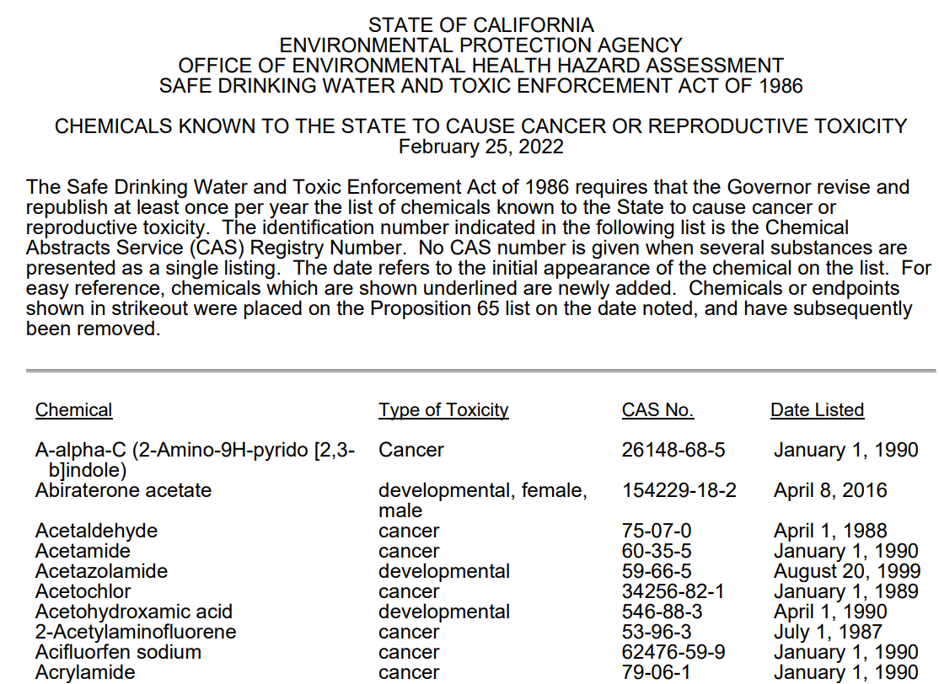

Prop 65 Lead Agency and Chemical Lists
Administered by the Office of Environmental Health Hazard Assessment (OEHHA)
Publishes and updates list of chemicals known to cause cancer, birth defects, and/or reproductive harm
Over 1,000 substances now listed
  Some listings are associated with safe harbor levels (NSRLs and/or MADLs)
  Many more listings are not

Slide 22
Substances Added to Prop 65 List
Chemical | CAS Reg. No. | Type of Toxicity | Date Listed
Bisphenol S (BPS) | 80-09-1 | Developmental | 12/8/25
N-Methyl-N-Formylhydrazine | 758-17-8 | Cancer | 12/8/25
Bisphenol S (BPS) | 80-09-1 | Male reproductive toxicity | 1/3/25
Vinyl acetate | 108-05-4 | Cancer | 1/3/25

Slide 23
Prop 65 and SB 54
3

Slide 24
Intersection of Prop 65 and SB 54
SB 54 regulations (§ 18980.7.6(h))
  As part of its plan, the PRO must charge a malus fee to producers who use covered materials that contain a Prop 65-listed substance.
  Determine who is the “producer”
This is broader in scope than Prop 65, which focuses on exposure, rather than content.

Slide 25
Prop 65 and AB 1200
4

Slide 26
Intersection of Prop 65 and AB 1200
AB 1200 (Cal. Health & Safety Code § 109010 et seq.) requires disclosure of DTSC-listed chemicals on food-contact surface of cookware or its handles.
Cookware defined broadly (encompasses durable products rather than disposables)
Disclosure must be on physical product and on product website.
This can signal to plaintiff attorneys what chemicals to test for to support a Prop 65 Notice of Violation.

Slide 27
Proposed Legislation
5
California Bills that May Impact Prop 65 Implementation

Slide 28
Proposed Legislation
Assembly Bill (AB) 2577
  Would create more court scrutiny in Prop 65 settlements.
AB 1604
  Would ban bisphenols in paper receipts.
AB 2302 and Senate Bill (SB) 1033
  Would require testing and disclosure of heavy metals in infant formula and protein products.

Slide 29


Naoki Kaneko
Partner | Shook, Hardy & Bacon
Orange County
nkaneko@shb.com
Questions?
We’re here to help you navigate these risks proactively.
Lauren Haas
Associate | Keller & Heckman
San Francisco
haas@khlaw.com

