Slide 1
Preparing for PAGA
Practical Guidance, Litigation Trends, Defense Strategies
May 7, 2026
Disclaimer: Although this presentation may provide information concerning potential legal issues, it is not a substitute for legal advice from qualified counsel. This presentation is not created nor designed to address the unique facts or circumstances that may arise in any specific instance. You should not, nor are you authorized to, rely on this content as a source of legal advice. This material does not create any attorney-client relationship between you and CDF Labor Law LLP.

Slide 2

PRESENTER
Corey J. Cabral
  Partner & Chair of CDF’s PAGA Litigation Practice Group
  Sacramento Office
  ccabral@cdflaborlaw.com

Slide 3

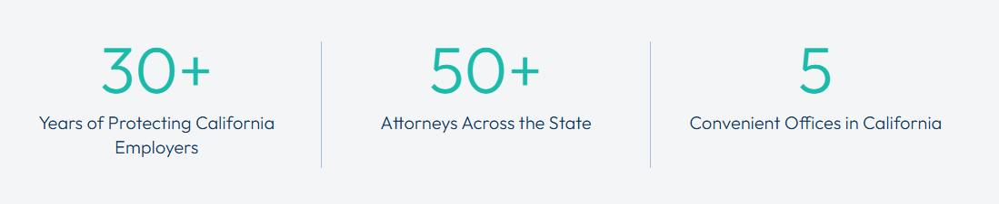
CDF Represents California Employers Exclusively in Labor, Employment & Immigration Matters
  We cover the full spectrum of labor and employment law - from guiding employers on policies and training to prevent litigation, to defeating individual lawsuits and class action threats with claims from thousands of plaintiffs

Slide 4

PAGA Basics: Nature and Scope of Action
PAGA Plaintiff
  Employee representing CA seeks penalties on behalf of the state for Labor Code (LC) violations they and others experienced
  Agent of the state; not a representative of a putative class
Civil Penalties
  Generally, $100 for one violation against one employee in one pay period, but violations aggregate:
    5 LC violations against 100 employees in each of 26 pay periods = $1.3 M
  Caps for “good behavior”
Scope of PAGA Claim
  Temporal: Appx. 14 months before complaint, and continuing throughout the case
  Substantive: Any LC violation alleged in the plaintiff’s pre-lawsuit notice letter

Slide 5

PAGA Basics: Pre-Lawsuit Notice Period
Notice Requirement
  PAGA Plaintiff must send employer notice of alleged violations by certified mail
  Notice must specify each LC provision allegedly violated, with supporting “facts and theories of liability”
State Involvement
  Limited, if any
Employer Options
  Employer may submit a response or seek to cure alleged violations

Slide 6
PAGA Basics: Nature of Litigation
Allegations in Complaint
  Boilerplate, conclusory claims are sufficient in most cases
  Not a class action; no class certification requirements
Scope of Discovery
  Think “IRS Audit” of business records
  Free access to the contact information of all alleged “aggrieved employees”— those who also experienced the alleged violations
Early-Out Opportunities
  Few and far in between

Slide 7

PAGA Litigation Trends
Strong Attacks on Arbitration Agreements + Renewed Judicial Hostility Against Arbitration
  CA state trial courts excessively scrutinizing and refusing to enforce arbitration agreements
Efforts to Maintain “Headless” PAGA Claims
  Key Case to Watch: California Supreme Court review in Leeper v. Shipt
Abuse of Employee Contact Information
  Plaintiff attorneys using info to generate new clients, create settlement leverage

Slide 8

Common PAGA Claims Against Grocers
Break Violations & Off-the-Clock (OTC) Work
  Non-compliant policies
  Inadequate staffing
  Interruptions caused by work duties/customers
  Security/Bag checks OTC
  Store opening/closing duties OTC
Rate of Pay Violations
  Regular rate calculation excluded bonuses, differentials, or other earnings
  OT, DT, Paid Sick Leave, missed break premiums, not paid at the regular rate
Unlawful Timekeeping
  Not recording meal periods
  Rounding/manipulating time entries
Failure to Provide Suitable Seating

Slide 9

Practical Guidance: Avoid Common Compliance Pitfalls
Robust Wage and Hour Policies and Procedures
  Ensuring adequate staffing levels
  Prohibit OTC work
  Require workers to accurately record all work time, including WFH, travel, and off-site work
  Provide for overly-compliant breaks; cover the common theories of liability
  Prohibit use of personal electronic devices to perform work duties
  Procedure for requesting business expense reimbursement; provide stipends (carefully)
  Require reporting of any violation, efforts to coerce non-compliance, and efforts to discourage compliance
  Extra time for opening/closing shifts, if needed

Slide 10
Practical Guidance: Avoid Common Compliance Pitfalls
Timekeeping Redundancies
  Multiple reporting channels: electronic, paper, and more
  Break and time attestations → break premium payments
  Time and pay correction request process
Payroll Compliance Audits
  Use correct calculations for regular rate, OT, DT, Paid Sick Leave, break premiums, and reporting time pay
  Evaluate bonus programs and calculations with counsel
    Use a percent of earnings bonus when possible
  Pay codes for missed meal periods and missed rest periods (and use them)

Slide 11
Practical Guidance: Avoid Common Compliance Pitfalls
Training
  Pre-employment wage and hour training and exam
  Cover channels for reporting violations
  Provide “continuing education” – simple quizzes
Take Corrective Action
  Take corrective action for policy violations
  Formal disciple for supervisors who cause violations
  Follow up with training
Regularly Update & Reinforce Policies
  Do not let wage and hour policies become stagnant

Slide 12
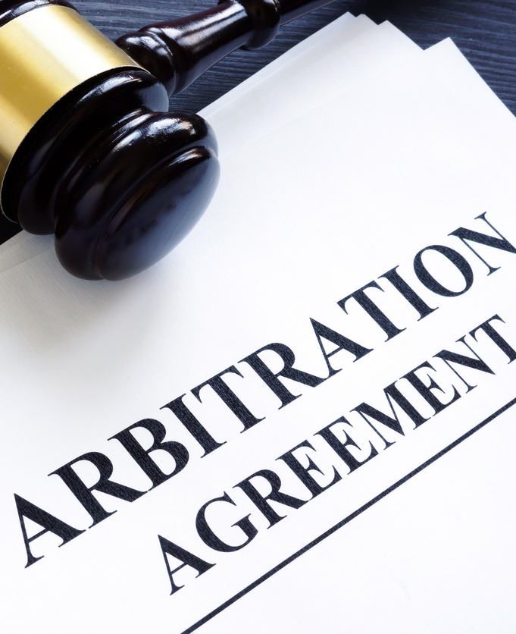
Practical Guidance:
Implement Enforceable Arbitration Agreements
Critical Provisions to Avoid Substantive Unconscionability
  Expressly limited to claims arising from the employment
  Bilateral/Mutual arbitration of claims
  Class action waiver
  Require arbitration of individual portion of PAGA claims
  Omit confidentiality and similar provisions that may be deemed unconscionable
  Employer pays all but filing fee amount required in court
  Stay of non-arbitrable claims pending arbitration
  Severance provision
  Name all entities on company-side, but don’t overreach
  If the Company has a signature line, sign it!

Slide 13
Practical Guidance:
Implement Enforceable Arbitration Agreements
Critical Procedures to Avoid Procedural Unconscionability
  Limit face-to-face presentation of arbitration agreements
  Keep arbitration agreements out of full onboarding process
    Provide mandatory arbitration agreements with conditional offer of employment
  Provide employees with time to review
Other Procedures to Ease Enforcement & Benefit from Arbitration Program
  Maintain meta-data for electronic signatures
  Secondary sources to verify wet signatures
  Consistent presentation and signing process
  Regularly update and roll-out new agreements

Slide 14
Practical Guidance: Be Litigation/Discovery Ready
Be Ready and Able to Easily Provide the Following to Your Counsel
  Employee Handbooks (PDF)
  Other Wage and Hour Policies and Procedures (PDF)
  Wage and Hour Training Materials (PDF)
  Payroll Data (Excel Format)
    All data reflected on wage statements
  Timekeeping Records (Excel Format)
    Including time and break attestations
  Employee Rosters (Excel Format)
    Name, Location, Position, Start/End Dates, Contact Information, SSN

Slide 15
Practical Guidance: Plan of Action for PAGA Notices
Immediate evaluation of PAGA notice
  Usually mailed to agent for service of process registered with CA Secretary of State
Issue litigation hold (complete within 7-10 days after notice)
  Detailed analysis of PAGA claimant’s time, pay, and personnel records, and company’s policies, procedures, and practices (complete within ~14 days after notice)
Identify and address potential violations; buttress written policies and procedures (complete within ~21 days after notice)
  Evaluate scope of identifiable violations and evaluate cure procedures
Respond to PAGA notice letter, implement cure procedures, and/or request early resolution procedure (complete within ~28 days after notice)

Slide 16
Benefit of Taking “All Reasonable Steps” to Comply
If employer took all reasonable steps before PAGA notice/records request → 15% cap
If within 60 days after notice employer takes all reasonable steps to prospectively comply → 30% cap
“Reasonable Steps”
  Statute gives examples: audits (compliance checks) + action, lawful policies, supervisor training, corrective action for policy violations
  Courts evaluate reasonableness under totality of circumstances

Slide 17

PAGA Litigation Strategy: When to Fight
Overly-Compliant Written Policies
No Pattern and Practice Violations Reflected in Time or Pay Data
Payment of Break Premiums
Employee Time and Pay Attestations
PAGA Plaintiff Signed Enforceable Arbitration Agreement

Slide 18
Q&A
?
?
?

Slide 19


LEADING THE CONVERSATION
LEADING THE CONVERSATION
ON CALIFORNIA LABOR & EMPLOYMENT LAW
Stay Ahead with CDF’s Blog
Subscribe for practical solutions and updates on the latest developments impacting California employers.
https://www.cdflaborlaw.com/blog

