Slide 1

Dealer Cooperatives:
Retailer Options

Slide 2

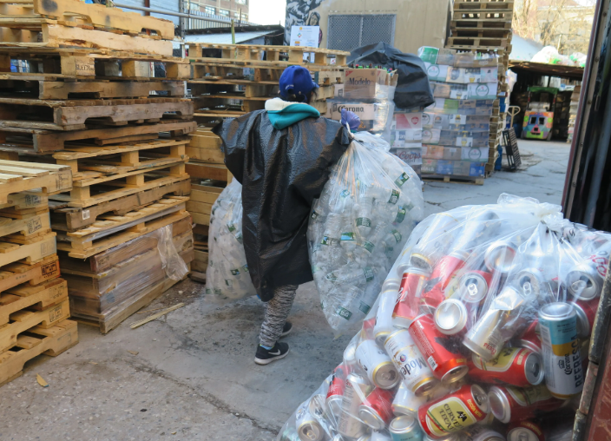
New Redemption Landscape SB 1013
Pre 2025
In-store redemption
On-premise Recycling Center (or “Served”)
$100/day
Post 2025
In-store redemption
On-premise Recycling Center (or “Served”)
Dealer Cooperative

Slide 3
Dealer Cooperatives: Overview
Nonprofit 501(c)(3)
Funded by member beverage dealers
Approved Stewardship Plan
Store flexibility
Avoids in-store redemption
Avoids minimum 30 hours/week requirement
Can be located within convenience zone (not on premise)
Mobile, Bag Drop, RVMs, Kiosks
Shared responsibility – can ‘cover’ other stores
Dealer Cooperatives - CalRecycle Home Page

Slide 4
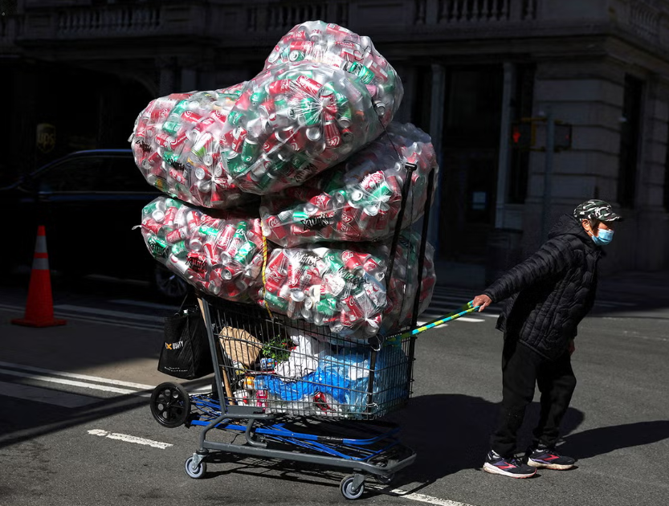
Option 1: In-Store Redemption
‘Hidden’ costs
Labor costs
Implied costs: security, cleaning, loss of sales space, shopping carts, disposal costs
Ever-increasing volume of redemption
Sanitation concerns
Viable option in low-volume redemption areas

Slide 5
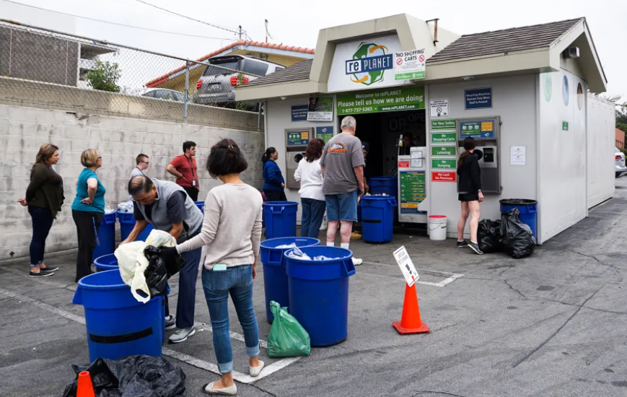
Option 2: On-Premise Recycling Center
Minimum operating hours/days
  30 hours / 5 days per week
Implied costs: security, CAM, shopping carts, prohibited disposal
Landlord and permitting approvals
RC becomes the recycling ‘hub’ for the community
Managed by recycler, potential rental income
New Regulations – Bag Drop!
  Placement of bag drop serviced by off-site RC
  Mobile does not serve a store

Slide 6
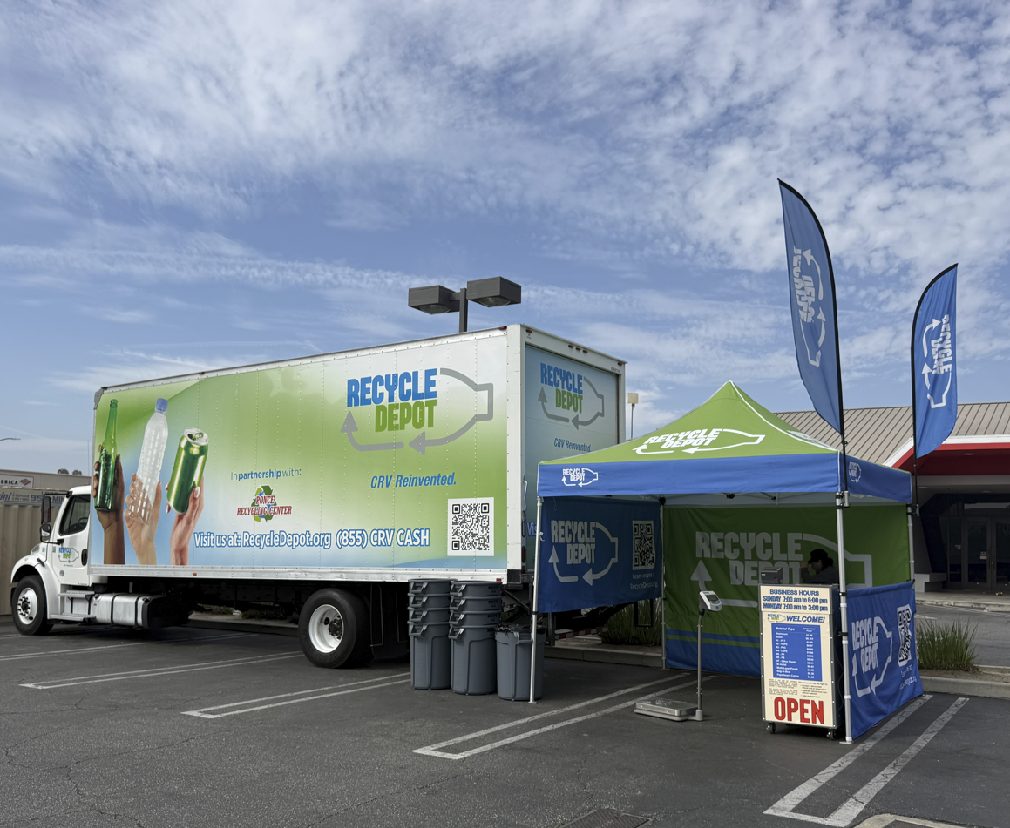
Option 3: Dealer Cooperative
Join a Dealer Cooperative
  Hosting a solution
    Mobile, bag drop, mobile bag drop, etc
    Abridged hours / days
    Does not cover any other store unless that store is a member of the Cooperative
  Covered by existing Dealer Cooperative solution
    Membership covers the store
Costs tied to operation of the Cooperative: 501(c)(3)

Slide 7


Circular CRV Association / Recycle Depot
Only approved Dealer Cooperative
150+ members / 14 retailers
Contracts with existing operators
Oversight by Cooperative staff
Designed to meet grocer’s needs
Operator responsible for permitting
16 operating sites, 7 more by end of May
35 convenience zones
Cost tied to CRV volume sold: equitable
Partnership with CGA

Slide 8
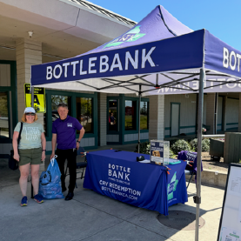
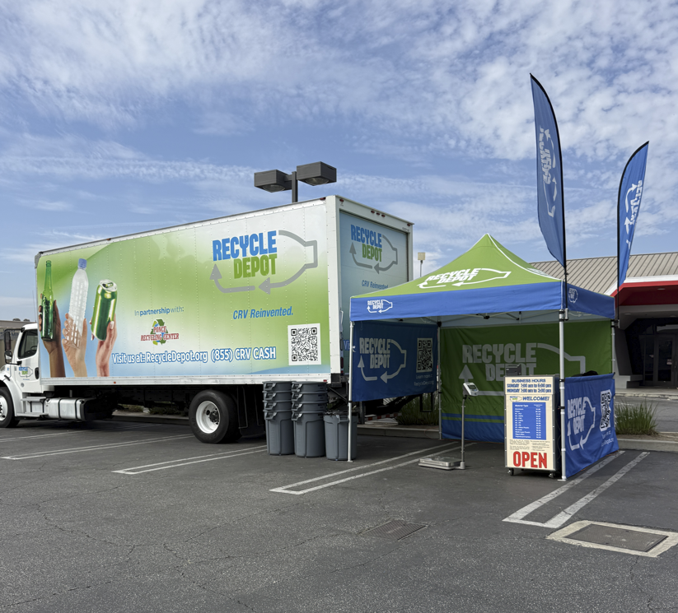
Recycle Depot
Existing operations
Mobile and Mobile Bag Drop
Limited days / times
Branded, uniform operations
Cooperative oversight / audits
Focused on retailer expectations
Continuing organic ramp-up through July 2026
www.RecycleDepot.org

Slide 9
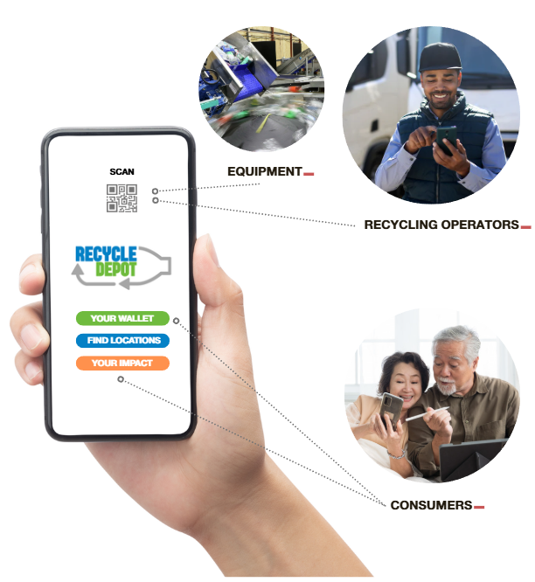
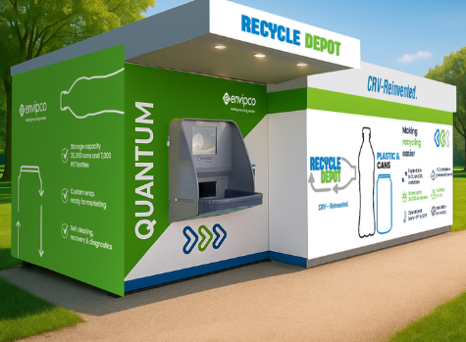
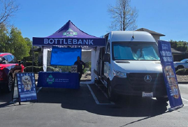
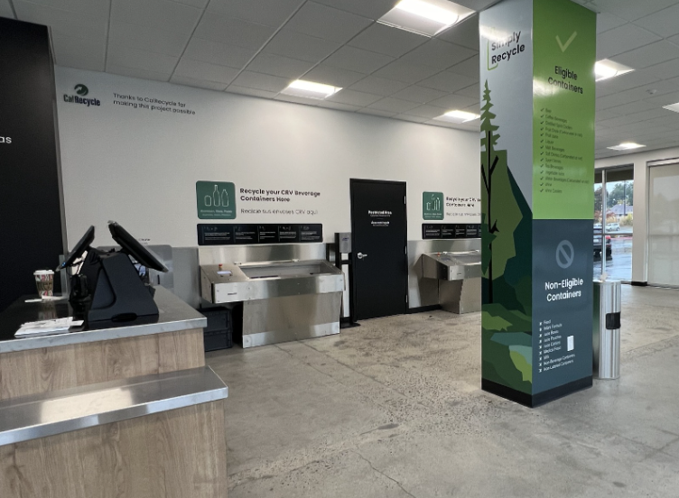
Recycle Depot: 2026 and Beyond
Grant Funding
  Unified software
  Branded equipment to grow unified operations
  Expand mobile, bag drop, mobile bag drop to maximize flexibility
Partnership with Manufacturers and Suppliers
Expanded service offerings in rural areas

Slide 10

Challenges Ahead
“Touch & Feel” Does it Work?
Establishing presence in several parts of the State
Landlord Pushback
Lease Agreements
City/County Pushback
Grocer obligations to the Bottle Bill
Zoning and permitting
Partnerships with CSAC / Cal League
Expense of Outreach
Volume = Success!

Slide 11

Q & A
Circular CRV Association (Recycle Depot)
Brian Phillips – Executive Director
(714) 713-1867
brian@circularcrv.com
Frank Williams – Operations Manager
(424) 789-2959
frank@circularcrv.com

