Slide 1
Understanding New Packaging Requirements
Under the California Plastic Pollution Prevention and Packaging Producer Responsibility Act (SB 54)

Slide 2
Final Statement of Reasons, Page 15
“The express intent behind the Act, as explained in section 42040, and the policy priorities referenced in section 42050 make clear that the Act concerns materials that reach their end of life in the state, not materials that merely move through it.”
CalRecycle, August 2025

Slide 3
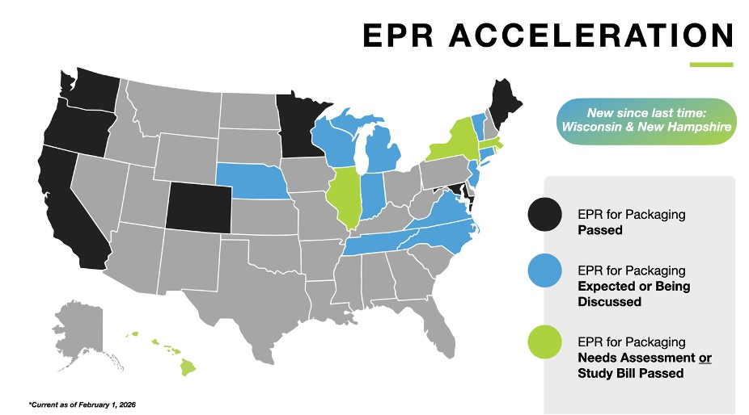
Source: https://www.atlanticpkg.com/deep-dive-extended-producer-responsibility-epr-for-packaging-explained/

Slide 4
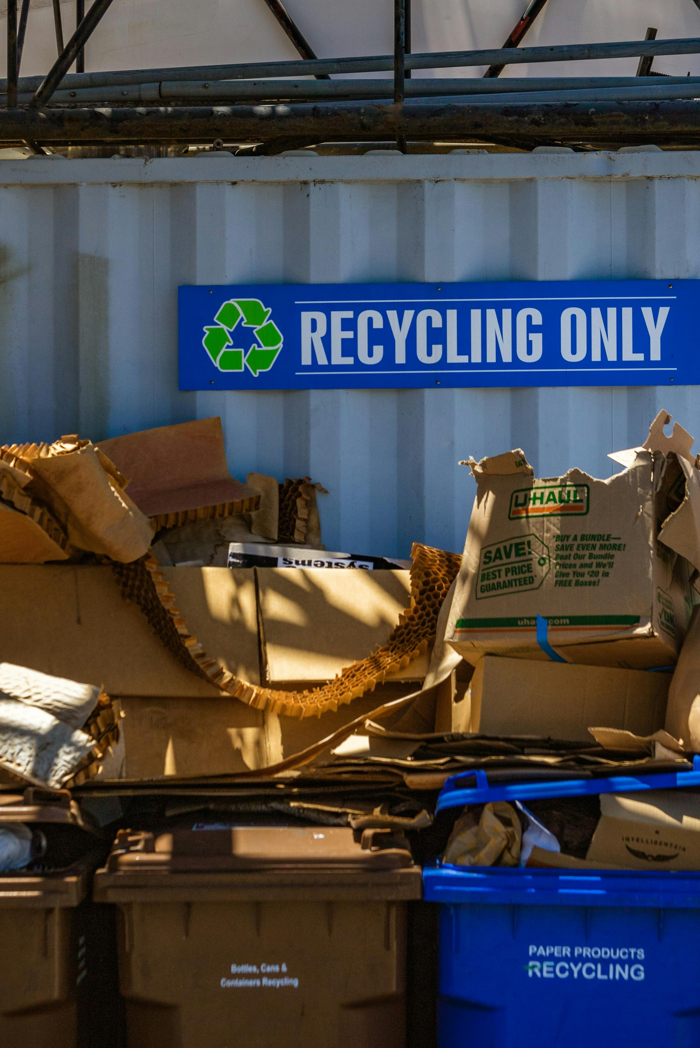
The Bottom Line
SB 54 establishes a new Extended Producer Responsibility (EPR) program that requires producers selling packaged product (covered material) into California to fund and meet statewide recycling and plastic-reduction targets.
Producers must register within 30 days of the regulation’s effective date, May 1, 2026. Registration and data submission is due JUNE 1, 2026. The first producer fees will be assessed soon after registration.
By 2032, the law requires:
  100% of single-use packaging to be recyclable or compostable
  25% reduction (collectively, among all producers) in the total amount of plastic packaging sold in California, compared to the 2023 baseline.
  65% recycling rate for single-use plastic packaging

Slide 5
Covered Material
Material classes include:
Glass
Ceramic
Metal
Paper and Fiber
Plastic
Wood and other Organics
This definition includes:
Single-use packaging that is routinely recycled, disposed of, or discarded after its contents have been used or unpackaged, and typically not refilled or otherwise reused by the producer.
Plastic single-use food service ware.

Slide 6
Packaging Definition
This could include:
Sales packaging or primary packaging
  Individual serving or unit of the product and most closely containing the product, food, or beverage
Grouped packaging or secondary packaging
  Intended to bundle, sell in bulk, brand, or display the product
Transport packaging or tertiary packaging
  Intended to protect the product during transport
Packaging components and ancillary elements integrated into packaging:
  Ancillary elements directly hung onto or attached to a product and that perform a packaging function
Any separable and distinct material component used for the containment, protection, handling, delivery, or presentation of goods by the producer for the user or consumer, ranging from raw materials to processed goods.

Slide 7
Producer Examples from a Grocer Perspective
A Producer Under this Definition Could Include:
An entity that packs a commodity into a covered material, depending on who owns or licenses the brand (not including producer, harvester, packager on-site).
An entity that that applies pallet wrap or a modified atmosphere packaging system and/or utilizes cardboard containers for shipping
A retailer or distributor of a covered material, depending on relationship to the covered material when it is imported, sold, distributed or used in California.
A producer or retailer of agricultural inputs including seed, plant containers, or feed sold in CM.
Essentially, the hierarchy for determining the producer is:
(1) A person who manufactures a product using covered material and owns or is the exclusive licensee of the brand/trademark under which it is used in a commercial enterprise, sold, offered for sale, or distributed in the state.
(2) If no such person exists in-state, the producer is the brand or trademark owner (if in the state).
(3) Third, a licensee of the designated brand/trademark (under certain conditions)
(4) Fourth, the first person who sells, offers for sale, or distributed the product using the CM in or into the state.
Producer does not include a person who produces, harvests, and packages an agricultural commodity on the site where the agricultural commodity was grown or raised.

Slide 8
Producer Exemptions
Exemptions May Include:
  Small producers, retailers, or wholesalers (gross annual sales of less than $1 million)
  Covered material that cannot comply for health and safety reasons, or because it is unsafe to recycle
  Reusable or refillable packaging
  Packaging designed to protect or store products that have a lifespan of five years or longer
  De minimis exclusions may be considered if it a plastic component is not independent and does not affect recyclability
  Producers of specific materials with demonstrated recycling rates

Slide 9
Categorical Exclusion
The current regulation draft includes a framework for entities to notify CalRecycle of categorical exclusions for packaging or packaging components used with food or agricultural commodities, if it is not reasonably possible for other packaging material to comply with regulations, rules, or guidelines issued by the United States Department of Agriculture (USDA) or the United States Food and Drug Administration (FDA) or other applicable food or agricultural regulations, rules, or guidelines.
Potential to justify continued use of packaging materials that cannot currently meet regulatory requirements, due to various factors, which could include:
  Food Safety
  Transportation/Quality
  Shelf-Life/Food Waste
January 2026 revision to draft regulation made this option much more challenging.
Applies to regulations, rules, or guidelines issued by USDA, FDA, or other applicable to food and ag.

Slide 10

Producer Responsibility Organization
SB 54 prohibits a producer from selling, offering for sale, importing, or distributing covered materials in the state unless the producer is approved to participate in the producer responsibility plan of a producer responsibility organization (PRO).
A PRO is a non-profit organization formed for the purpose of implementing a plan to meet these regulatory requirements.
Independent producer eligibility is based on a high recycling rate requirement.
Fee Collection
Source reduction
Collection
Processing
Recycling of covered material

Slide 11
Producer Requirements
Reporting Requirements:
  Must report total weight of CM and plastic components sold, distributed or imported in or into the state
  Following submission of the preliminary supply data in the reporting portal, CAA will request that producers provide qualitative data about their company or organization. This includes:
    List of brands for all covered materials submitted in the supply report
    List of corporate affiliates, including Tax ID/EIN, affiliate legal name, and a declaration of affiliate inclusion in the supply report
    Disclosure of all methodologies used to prepare supply data
Additional Requirements:
Must register and report 2023 baseline data by June 1, 2026. 2025 reporting is also due 5/31/26
Will be required to pay fees to the program administrator, or Producer Responsibility Organization (PRO)
Will be subject to CalRecycle’s enforcement for failure to report, register or meet other obligations, which could include a fine of up to $50,000/day, as well as PRO penalties
Report
Register
Label
Pay Fees
Subject to Enforcement

Slide 12
Time Frame and Cost
Plastic Pollution Mitigation Fund
5B over 10 years @ $500M/year beginning in 2027
Producer Membership Fees to PRO
Administrative fees paid to Circular Action Alliance include cost of running the program and fulfilling the obligations of the plan (draft to be released summer 2026) which will include meeting costs identified in the needs assessment (e.g., statewide recycling infrastructure)
Circular Economy Fund
CalRecycle Admin Costs, paid by fees to the PRO
Includes costs incurred beginning January 1, 2023
Through FY 2031-32, the total cost of the Circular Economy Fund is anticipated to be $76.8 million
Fee Schedule
Eco-Modulated Fees
Eco-modulation bases fees on design elements such as percentage of recycled content, weight of material, shift from low to easily recyclable materials, etc.
Fees likely to be based on quantity of packaging introduced into California and % of packaging mix that is recyclable/compostable.
On May 1, CAA published an illustrative fee schedule to help producers and other stakeholders understand how program costs are translated into fee rates across covered material categories. An updated fee schedule will be in place by January 1, 2027, based on the approved PRO plan.
13,615 Producers (fee-payers) estimated
2,000 registered as of February 2026

Slide 13
Compostable/
Recyclable Schedule
Requirement Timeframes:
30% of single-use plastic packaging and food service ware is recycled by 2028.
40% of single-use plastic packaging and food service ware is recycled by 2030.
65% of single-use plastic packaging and food service ware is recycled by 2032.
25% less single-use plastic packaging and food service ware is sold by 2032.
  First source reduction milestone of 10% by 1/1/27
100% of single-use packaging and plastic food service ware sold in the state is expected to be recyclable or compostable by 2032.
The law requires producers to ensure that all covered material that is plastic and offered for sale, distributed, or imported in or into the state meets the specific expectations in the timeframes identified.

Slide 14
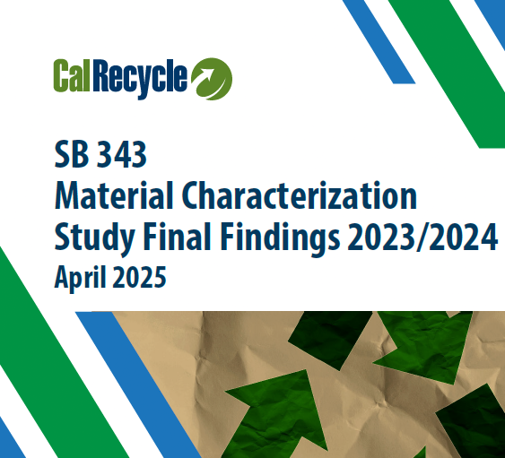
SB 343
The basis of what is “recyclable” is dependent upon language in another state law: SB 343
Notes:
Attached find the current SB 343 findings report, which shows the current recyclability status of different packaging materials and how they measure up to SB 54's 2032 requirement that 100% of single-use packaging be recyclable or compostable. You can determine whether your packaging is currently considered recyclable by reviewing the definition on page 9 and referring to Tables 1 and 2 in the report. A current challenge with SB 343 is that CalRecycle can amend this report at any time, meaning the recyclability status of packaging materials can change unexpectedly. This creates uncertainty for producers, as a package considered recyclable today could lose that status with a future report update or an issued addendum, potentially creating sudden compliance exposure under SB 54.

Slide 15
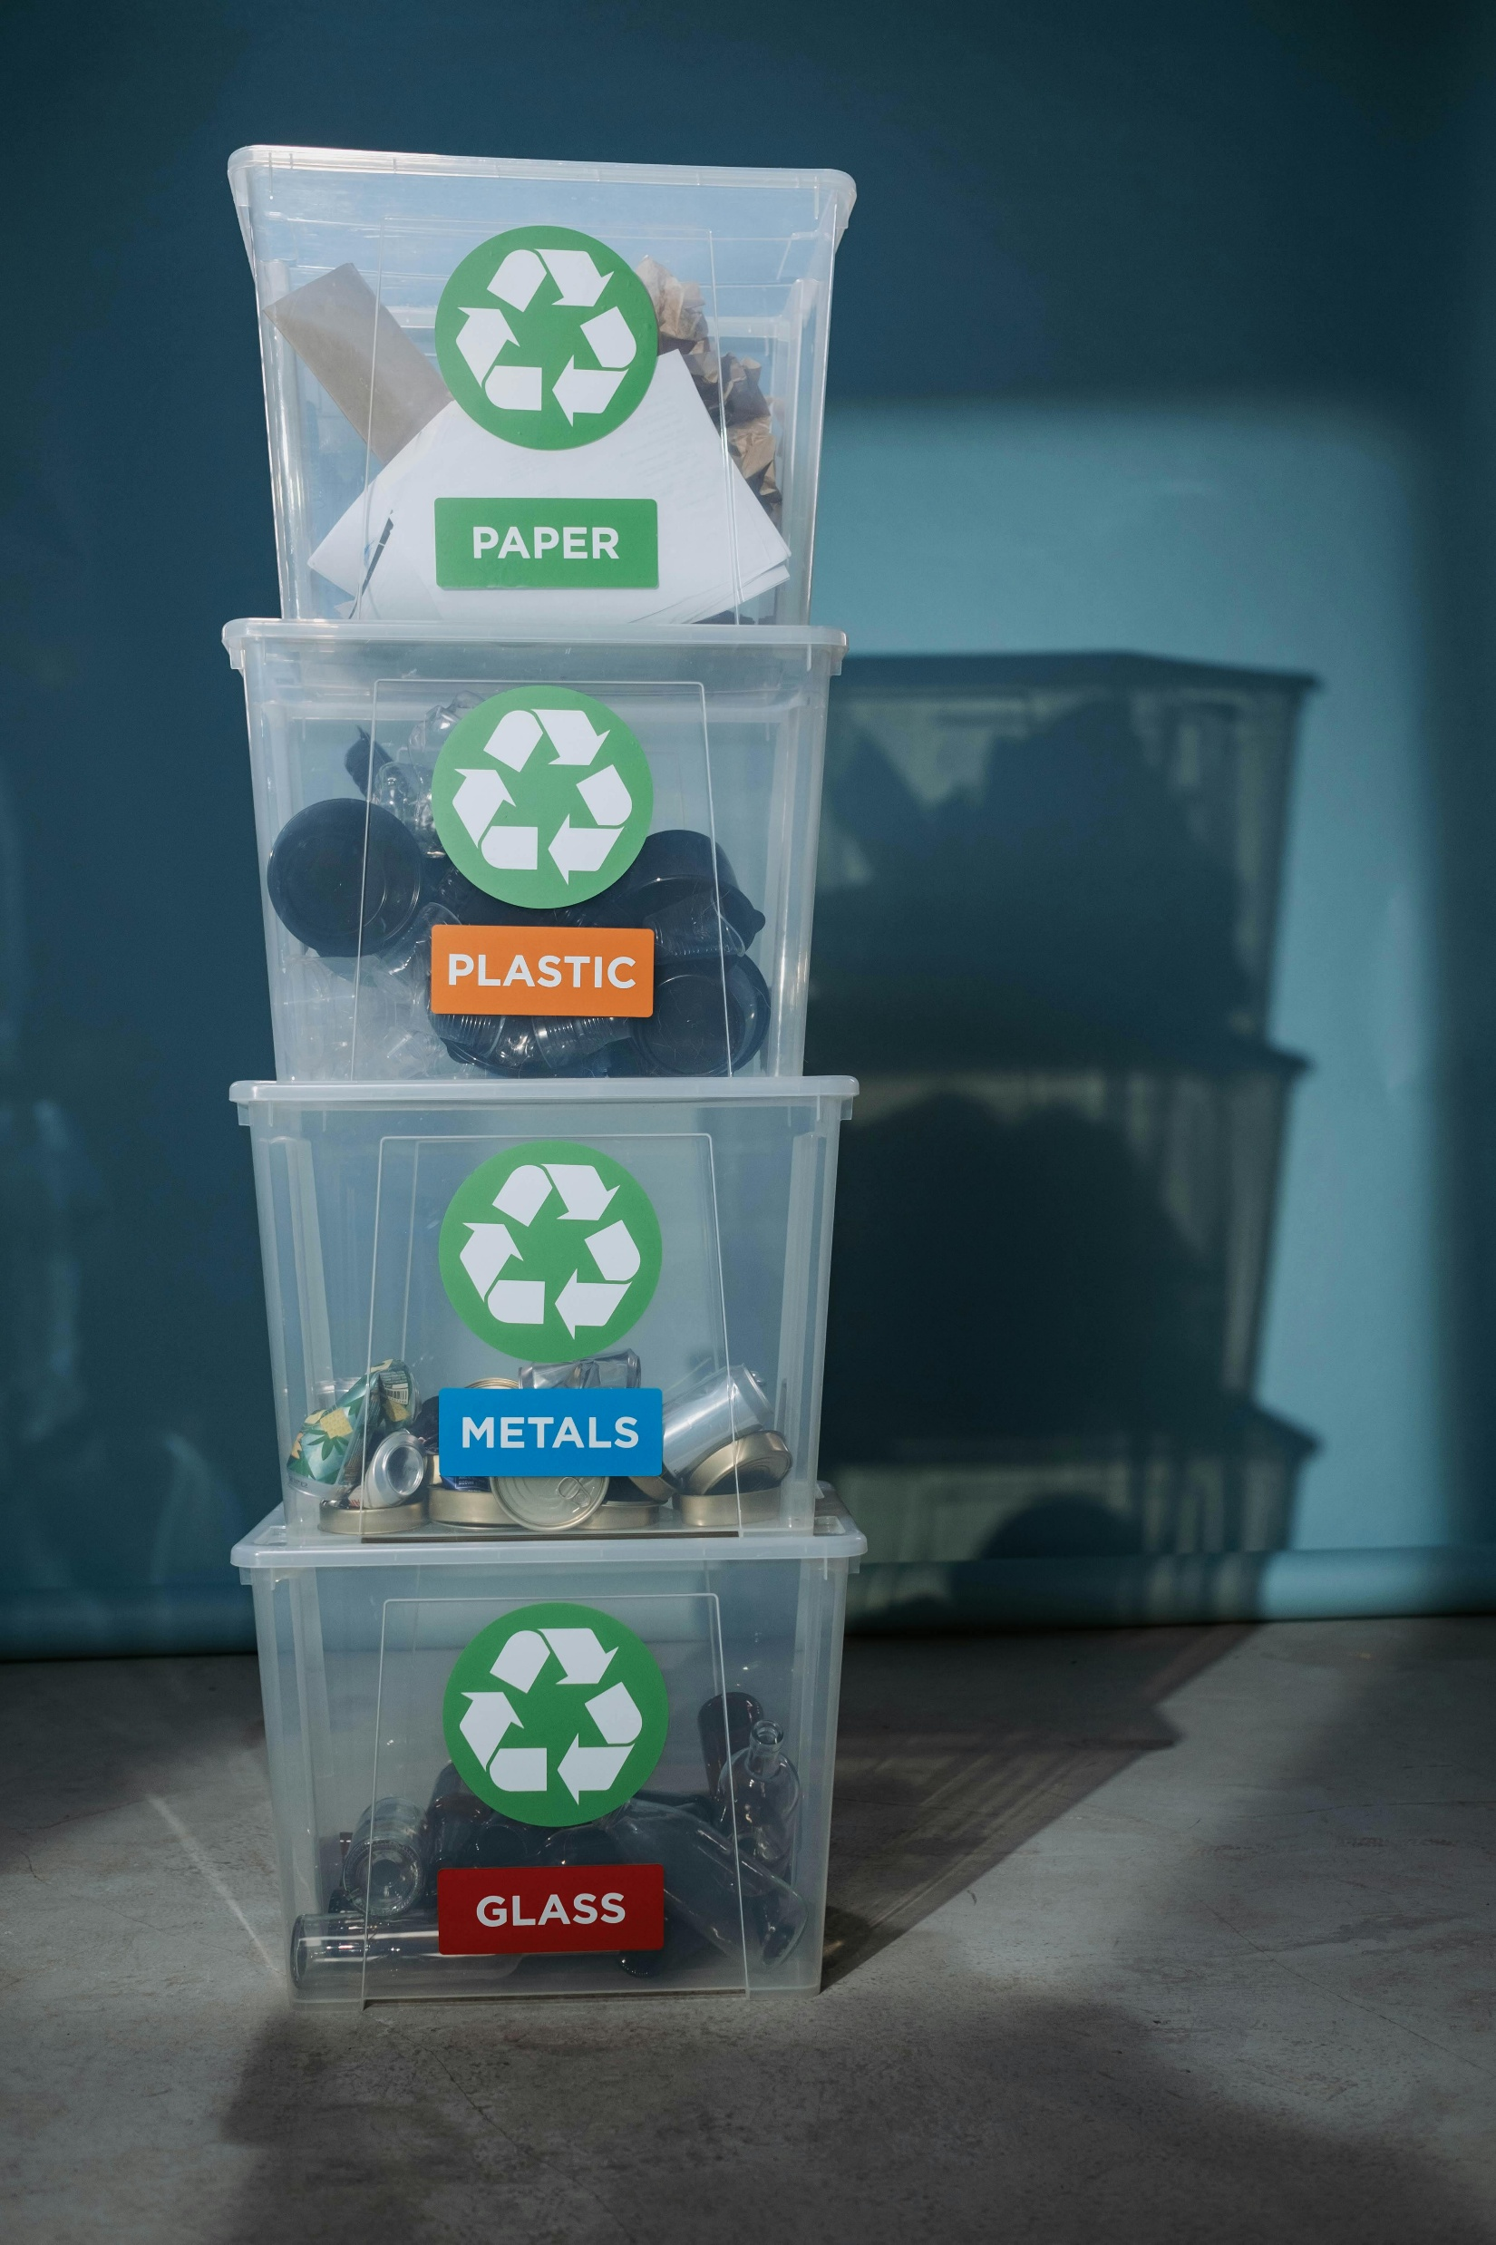
Questions & Discussion
Abby Taylor-Silva, Kahn, Soares & Conway, LLP
(831) 332-0584
ataylorsilva@ksclawyers.com

