Slide 1

2026
New Laws Impacting CGA
November 12, 2025

Slide 2
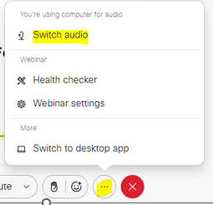
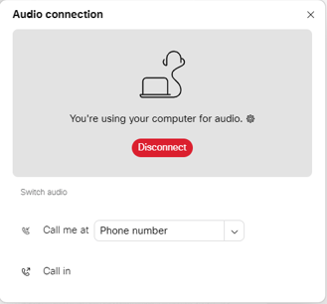
  CAN’T HEAR THE PROGRAM?
Click the three dots at the bottom of the screen, and select Switch Audio.
Select your preferred method of connection for the webinar.

Slide 3
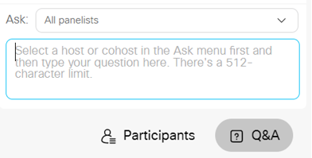
QUESTIONS DURING PROGRAM
Use the Q&A Box on the right side of your screen to send questions during the presentation.
Send questions to
All Panelists

Slide 4
WEBINAR DISCLOSURE
By hosting this Webinar, California Grocers Association (CGA) and the CGA Educational Foundation (CGAEF) are providing an opportunity for their members and attendees to obtain general information that may be of interest to your company. The Webinar is designed to provide practical and useful information on the subject matter covered. However, CGA /CGAEF is not engaged in rendering legal, accounting or other professional advice or services.
CGA/CGAEF does not review or approve the content of the webinar presented by guest speakers and others, and makes no representations or warranties about the accuracy or legality of any compliance or other recommendations provided during the webinar. If legal advice or other expert assistance is required, the services of a competent professional should be sought.

Slide 5
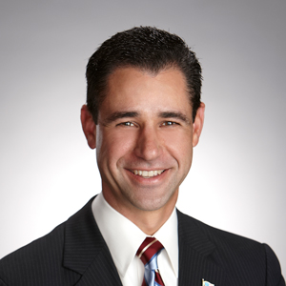

ABOUT OUR PRESENTERS
Louie Brown
Kahn, Soares & Conway, LLP
(916) 448-3826
lbrown@ksclawyers.com
www.ksclawyers.com
Michel LeClerc
North State Grocery
(530) 377-7137
mleclerc@nsgrocery.com

Slide 6
New Laws
SB 22 – Gift Cards
SB 753 – Shopping Carts
AB 578 – Food Delivery Platforms
Refresher course…..
SB 54 – Single use packaging
SB 1053 – Bags
AB 660 – Date labeling
AB 2991 – Retailer payments

Slide 7
SB 22: Gift certificates
This bill would make a gift certificate with a cash value of less than $15 redeemable in cash for its cash value, with certain exceptions.
Expiration dates are allowed, if the expiration date appears in capital letters in at least 10-point font on the front of the gift certificate:
(1) A gift certificate distributed by the issuer to a consumer pursuant to an awards, loyalty, or promotional program without any money or other thing of value being given in exchange for the gift certificate by the consumer.
(2) A gift certificate donated or sold below face value at a volume discount to an employer or to a nonprofit or a charitable organization for fundraising purposes if the expiration date on that gift certificate is not more than 30 days after the date of sale.
(3) A gift certificate that is issued for perishable food products.
Effective date: April 1, 2026

Slide 8
SB 753: Shopping Carts
The bill would amend state law to remove protections for grocers which limits the amount a local jurisdiction can fine a grocer for recovery of stolen property and subsequently abandoned shopping cart.
(1) Authorizes a city, county, or city and county, by ordinance, to retrieve and return shopping carts to the retailer or premises identified on the carts’ affixed sign.
(2) Permits local jurisdictions to recover actual retrieval and return costs, not to exceed $100 per cart, from the retailer or cart owner.
(3) Requires “actual notice” to include proof of delivery to the owner or agent and mandates that the local agency maintain a record of that proof.
(4) Raises the maximum find from $50 to $100 per occurrence for failure to retrieve carts beyond three violations within six-month period.
Effective date: January 1, 2026

Slide 9
AB 578: Food Delivery Platforms
This bill would make it unlawful for a food delivery platform to maintain a payment model that uses any amount designated as tips or gratuity to offset the base pay to the person delivering the food or beverage.
(1) Prohibits a food delivery platform from charging a customer a purchase price higher than the price posted by the food facility at the time of order.
(2) Makes it unlawful for a food delivery platform to maintain a payment model that uses any amount designated as tips or gratuities to offset the base pay of delivery persons.
(3) Requires food delivery platforms to provide an itemized cost and breakdown, including base pay, gratuity, and promotional bonuses to the customer, food facility, and delivery person.
(4) Mandates that food delivery platforms include a clear and conspicuous customer service feature allowing contact with a real person if automated systems fail to resolve concerns.
(5) Requires platforms to issue full or partial refunds, including gratuities, for undelivered or incorrect orders, without deducting refunded gratuities from the delivery driver.
Effective date: January 1, 2026

Slide 10
SB 54: Single Use Packaging
This bill would prohibit a producer from selling, offering for sale, importing, or distributing covered materials in the state unless the producer is approved to participate in the producer responsibility organization (PRO), for the source reduction, collection, processing, and recycled material.
(1) Retailers, distributors, or grocers acting as brand-owners or licensees of “covered material” may be designated as “producers” under the bill, assuming compliance obligations for single-use packaging or food service ware sold in CA.
(2) Applies to single-use packaging (primary, secondary, tertiary) and plastic food service ware (e.g., trays, clamshells, utensils, cups) that are not refilled or reused by the producer
(3) By January 1, 2032, all covered materials must be recyclable or compostable, meet a recycling rate of at least 65% for single-use plastics, and reduce the volume of single-use plastics by at least 25% relative to 2023 levels.
(4) Producers must join an approved PRO and fund collection, recycling, and processing of covered materials, shifting costs from local governments and retailers to producers.
(5) Producers must provide supply chain transparency, material documentation, and reporting volumes, recyclability, and source-reduction progress.
Effective date: June 30, 2022

Slide 11
SB 54: Single Use Packaging
Issues for grocers to consider:
Packaging vs. Food service ware
Store labels
Calculations will be comprehensive and time consuming – start now.
Regulations will be final soon….

Slide 12
SB 1053 : Bags
This bill would prohibit a store form providing, distributing, or selling a “carry-out bag” at point of sale, eliminate the exemption allowing thicker plastic film bags as reusable bags, and require paper bags to contain 50% postconsumer recycled materials beginning January 1, 2028.
(1) Redefines “single-use carryout bag” as “carry-out bag” including plastic, paper, or other materials provided at point of sale, excluding recycled paper bags.
(2) Allows bags provided before point of sale, or designed to protect items or contain unwrapped food, to be exempt.
(3) Requires recycled paper bags to contain a minimum of 50% postconsumer recycled materials starting January 1, 2028, eliminating prior exemptions.
(4) Prohibits stores from providing, distributing, or selling carryout bags at point of sale, except as specifically allowed.
Effective date: January 1, 2026

Slide 13
AB 660: Date Labeling
This bill updates and standardizes labeling requirements for milk and other food products to improve clarity of quality and safety dates and aligns shelf-life limits with updated safety standards.
(1) Requires that package or container display the “use by” date established by the processor to indicate when the product should normally be consumed for optimal quality.
(2) Mandates starting July 1, 2026, food manufacturers, processors, and retailers use specified uniform terms for quality and safety dates, prohibiting the use of “sell by” labels on items manufactured on or after that date.
(3) Updates California Retail Food Code to limit refrigerated shelf life or reduced-oxygen packaged foods to 30 days from packaging to consumption (except frozen time), using the original safety date instead of the prior “sell by” date.
(4) Allows grocery stores to display a “packed on” label on prepared foods if a compliant quality or safety date is also displayed; exempts infant formula, eggs, pasteurized in-shell eggs, beer, and wine/spirits form these labeling requirements.
Effective date: July 1, 2026

Slide 14
AB 2991: Alcohol Electronic Payment
Payment from a retailer licensee to a wholesaler licensee for delivery of beer, wine, or distilled spirits shall be made by electronic funds transfer.
A payment may be made using cash, check, or money order only in the following instances:
(1) If accepting payment following an electronic funds transfer of insufficient funds.
(2) If the retailer licensee holds an interim operating permit or a temporary permit.
(3) During temporary service interruption of the third-party payment processor.
(4) During the first 30 days following the issuance of a license to the retailer licensee.
A wholesaler may choose to accept credit card payments. If payment is made using a credit card, the retailer shall bear the cost of the transaction, so as to mitigate the value of secondary benefits realized by the retailer using the credit card.
Effective date: January 1, 2026

Slide 15
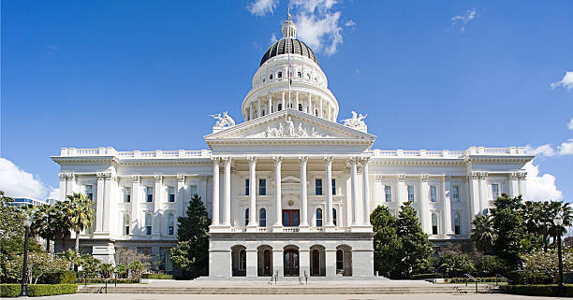
Questions?

Slide 16

Louie Brown
Kahn, Soares & Conway, LLP
916-448-3826
lbrown@kscsacramento.com
www.ksclawyers.com

