Slide 1

PAGA REFORM: COMPREHENSIVE OVERVIEW, TRAINING, AUDITS, AND CURES
Hosted by: CGA Educational Foundation
Presented by: Michael J. Nader (Sacramento) Ogletree, Deakins, Nash, Smoak & Stewart, P.C.
© 2024, Ogletree Deakins

Slide 2
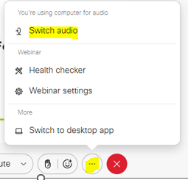
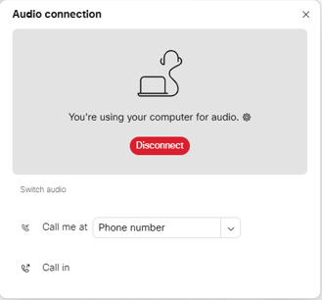
Can’t Hear the Program?
Click the three dots at the bottom of the screen and select Switch Audio.
Select your preferred method of connection for the webinar.

Slide 3
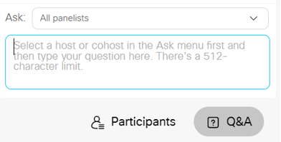
Questions During the Program
Use the Q&A Box on the right side of your screen to send questions during the presentation.
Send questions to All Panelists

Slide 4
Webinar Disclosure
By hosting this Webinar, California Grocers Association (CGA) and the CGA Educational Foundation (CGAEF) are providing an opportunity for their members and attendees to obtain general information that may be of interest to your company. The Webinar is designed to provide practical and useful information on the subject matter covered. However, CGA /CGAEF is not engaged in rendering legal, accounting or other professional advice or services.
CGA/CGAEF does not review or approve the content of the webinar presented by guest speakers and others, and makes no representations or warranties about the accuracy or legality of any compliance or other recommendations provided during the webinar. If legal advice or other expert assistance is required, the services of a competent professional should be sought.

Slide 5
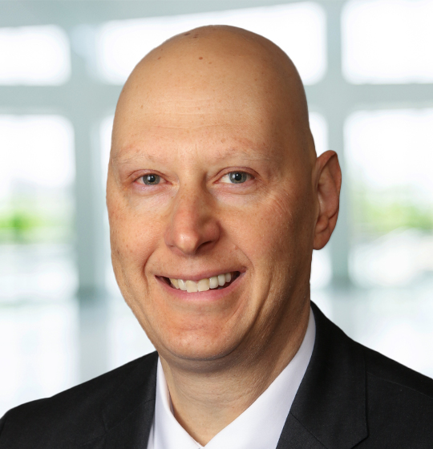
About our Presenter
Ogletree, Deakins, Nash, Smoak & Stewart, P.C.
Tel.: 916-840-3151
Email: michael.nader@ogletree.com

Slide 6
Introduction and Disclaimer
These materials are prepared by Ogletree Deakins to inform clients of important developments in California labor law, specifically regarding the Private Attorneys General Act of 2004 (PAGA), Labor Code §§ 2698 – 2699.8. They are not intended as specific legal advice. For actual or potential business problems, seek specific legal counsel.

Slide 7
Why more PAGA actions?
PAGA filings up 16% from 2023 to 2024
Why?
Paradigm shift
Better targeted solicitations by Plaintiffs’ bar

Slide 8
Summary of New PAGA Statute
Applies to LWDA letters filed on or after June 19, 2024.
Narrows the standing of an "aggrieved employee": Plaintiff must have suffered each violation within the year before filing the PAGA complaint (§2699(c)).
Expands cure opportunities, including early evaluation and settlement.
Bases penalties on biweekly pay period (§2699(o)).
Early evaluation conference available.

Slide 9
Summary of New PAGA Statute
Potential penalty caps for "reasonable steps."
Mostly does not change penalty structure: $100/$200 per employee, per pay period, per violation.
Greater opportunities to reduce PAGA penalties.
No derivative wage statement, Section 203, or Section 204 penalties based on claims for wages (§2699(i)).
Applies to violations that are neither willful nor intentional where civil penalties have been collected on the underlying wage violation.
But check new Bill – SB 310

Slide 10
Standing and Litigation Impact
Plaintiff must have suffered each violation within the year before the PAGA complaint.
If compelled to individual arbitration, Plaintiff can proceed with PAGA court representation only on claims where Plaintiff prevailed.
Will make it easier to use a motion to dismiss or a motion for summary judgment to narrow claims and reduce settlements.

Slide 11
Penalty Structure and Reductions
Penalties based on biweekly pay period.
For weekly pay, maximum value of any PAGA action is cut in half.
Default penalty is $100 unless exceptions apply (§2699(f)(2)(A),(B)).
$200 penalties only if violation repeated within 5 years or intentional.
But must be based on prior Court order or Labor Commissioner finding
Employers who take all reasonable steps reduce penalties by 85% if before notice or by 70% if within 60 days after notice (LC § 2699(g),(h)).
No penalties if the employer takes all reasonable steps and cures the violation (LC § 2699(j)).
Penalties can be further reduced (below the 15% and 30% caps) if they would be unjust, oppressive, or confiscatory.

Slide 12
What Are PAGA Lawsuits Most Often About? Common Theories and Claims:
Unpaid Wages:
Off-the-clock work (pre-shift, post-shift, security checks, donning/doffing, training).
Working during meal and rest breaks.
Rounding for pay purposes.
Owed reporting time wages not received or paid at incorrect rate.
Split-shift premium not paid.
Controlled standby without pay.
Unpaid Overtime:
Overtime not paid at regular rate.
Shift premiums, bonuses not included

Slide 13
What Are PAGA Lawsuits Most Often About? Common Theories and Claims:
Meal and Rest Breaks:
Working during meals and rest breaks.
Short, late, missed, or interrupted breaks.
Failure to waive meals on shifts lasting 5-6 or 10-12 hours.
Rounding for meal compliance.
Incorrect rate for meal/rest premiums.
Keeping employees on premises during breaks
Wage Statements:
Missing required information (pay period dates, employer name/address).
Incorrect total hours worked.
Inaccurate wage statements due to unpaid hours/premiums.
Time worked doesn’t correspond to rates paid

Slide 14
What Are PAGA Lawsuits Most Often About? Common Theories and Claims:
Paid sick leave
Failure to provide paid sick leave
Failure to provide notice of accrual
Failure to pay at the regular rate

Slide 15
What Are PAGA Lawsuits Most Often About? Common Theories and Claims:
Failure to Timely Pay Wages:
Irregular paydays.
Late final wages.
Unpaid hours/premiums causing late wage payment.
Expense Reimbursement:
Unreimbursed work-related calls/texts on personal cell phones.
Required use of mobile apps on personal phones without reimbursement.
Insufficient reimbursement for internet or mileage.
Required uniforms not provided.

Slide 16
What Are PAGA Lawsuits Most Often About? Common Theories and Claims:
Suitable seating claims
Seating Policy?
Duties permit use of seats?
Suitability of seats?
Sufficient number of seats?
Visibility of seats?
Communications about seats?
Documentation?

Slide 17
What Are PAGA Lawsuits Most Often About? Common Theories and Claims:
Indoor Heat Regulations
Employers must have a written plan for temperatures at or above 82 degrees Fahrenheit that provides:
Procedures for the provision of water
Cool-down areas
Preventative cool-down rest periods
Emergency response procedures
Acclimatization
Training (with some supervisor-specific training)
High heat procedures for temperatures at or above 87 degrees

Slide 18
Good Faith Compliance Defense
Naranjo v. Spectrum Sec. Servs., Inc., 15 Cal. 5th 1056 (2024):
Good faith and reasonable belief defenses to civil penalties.
Not applicable if conduct is malicious, reckless, or intentionally flouts the law.
Best Practice: Aim to meet the “all reasonable efforts” standard to manage the risk of PAGA penalties.
First 60 days after receipt of LWDA Letter

Slide 19
Training: Requirements and Best Practices Is Employee Training Required?
Not technically required (unlike sexual harassment or workplace violence training).
Strongly recommended to lessen employee confusion, increase compliance, and improve defenses against class and PAGA claims.
Statutory Guidance:
Penalties are reduced when an employer takes "reasonable efforts" (LC § 2699(g), (h)).
"All reasonable steps" may include training supervisors on Labor Code and wage order compliance, or taking corrective action with supervisors.

Slide 20
Training: Requirements and Best Practices
Key Subjects for Training:
Appropriate use of timekeeping systems.
Accurately recording all time; no off-the-clock work.
Meal period and rest break rules.
Use of meal/rest period attestations.
Expense reimbursement expectations.
Other topics as relevant to the business (e.g., heat illness prevention).
Who Should Attend:
Hourly employees.
Managers of hourly employees.
Personnel who control payroll for California employees.
Frequency and Proof:
At hire.
At appropriate intervals during employment (e.g., annually, with policy/statute changes).
Maintain proof of attendance.

Slide 21
Audits: Requirements and Best Practices Are Audits Required?
Not required, but highly advisable.
PAGA has a one-year statute of limitations; past liability disappears quickly.
Some wage-and-hour issues are easy to identify and remediate.
Improves defenses to class and/or PAGA claims, or prevents them.
Reduces PAGA penalties under the amended statute.
Statutory Guidance:
"All reasonable steps" may include conducting periodic payroll audits and taking action in response, disseminating lawful written policies (LC § 2699(g)).

Slide 22
Audits: Requirements and Best Practices
Audit Approach:
Stage 1: Review written policies and wage statements.
Stage 2: Review timekeeping/payroll practices.
Stage 3: Review meal/rest period compliance.
Stage 4: Review other practices and related documentation.

Slide 23
Audits: Requirements and Best Practices
Common Class/PAGA Claims to Audit:
Meal and Rest Break Policies: Policy compliance, waiver process, on-duty meal period agreements.
Wage Statements: Required information, sick leave balance.
Unpaid Wages: Pay for all time worked, rounding, reporting time, controlled standby, split-shift premiums.
Regular Rate: Overtime, meal/rest premiums, sick leave, reporting time paid at correct rate.
Meal Periods: Compliance, timekeeping, rebutting presumed violations, meal premiums.
Rest Breaks: Authorization, premiums – attestation?
Untimely Payment: During employment and at termination
Expense Reimbursement: Sufficient reimbursement for job-related expenses.

Slide 24
Early Evaluation Conference (LC § 2699.3(f)):
Eligible: All employers.
Timing: Before or with responsive pleading in court.
File request for early evaluation conference.
Court stays proceedings absent good cause.
Defendant submits statement on cure/dispute; plaintiff submits supporting statement.
If resolved, treated as a settlement; if not, the employer can ask the court to approve a cure.

Slide 25
Curing Non-Wage Statement Claims (LC § 2699(d)(1)):
For unpaid wages:
Pay all unpaid wages for 3 years.
Pay 7% interest.
Pay any required liquidated damages.
Pay reasonable lodestar attorneys' fees and costs as determined by agency or court.
If wage amount is disputed, pay sufficient amounts to reasonably cover wages owed (no specific guidelines).

Slide 26
Cure Provisions: Methods and Procedures Three Primary Cure Methods:
Cure Wage Statement Claims with LWDA (LC § 2699(d)(2)):
Eligible: All employers.
Timing: 33 days from PAGA notice postmark.
Cure: Provide 3 years of compliant wage statements for all current and former employees.
LWDA reviews and determines cure; plaintiff can appeal in superior court.
If successful, no PAGA penalties or claim; if not, civil action may proceed.

Slide 27
Cure Plan for Small Employers (LC § 2699.3(c)(2)):
Eligible: Employers with fewer than 100 employees during the period covered by the notice (LC § 2699.3(f)(1)(A)).
Timing: Within 33 days of PAGA notice receipt.
Submit confidential cure plan to LWDA.
LWDA may set a conference to assess the plan.
If sufficient, no PAGA penalties or claim (plaintiff can appeal in superior court).
If insufficient or no action, plaintiff may bring claim in court.

Slide 28
Claims Susceptible to Cure:
Claims not based on available records (off-the-clock work, meal/break premiums due to work interruptions).
Non-curable claims listed in LC § 2699.5 (e.g., waiting time penalties, wage deductions, day of rest).
Cannot cure more than once in 12 months for same provisions in first PAGA notice.

Slide 29
Additional Strategic Considerations
Arbitration agreements and their impact on PAGA claims.
How to show “all reasonable compliance efforts” at the early conference
Use of early evaluation conference and strategic disclosure.

Slide 30
Ogletree Deakins Support
Wage-and-hour training (including timekeeping, meal/rest period rules, and attestation).
Attorney review of meal/rest policy, timekeeping policy, and wage statement formatting.
Self-audit questionnaire for in-house counsel.

Slide 31
THANK YOU!
Please contact Ogletree Deakins for further information or assistance with PAGA compliance, training, audits, and cure strategies.
Ogletree, Deakins, Nash, Smoak & Stewart, P.C. Michael Nader
Tel.: 916-840-3151
Email: michael.nader@ogletree.com

