Slide 1

Traceability is Here Insights from real world traceability that will help you avoid failure
The ReposiTrak Traceability Network®
Hosted by: CGA Educational Foundation
March 19, 2025

Slide 2
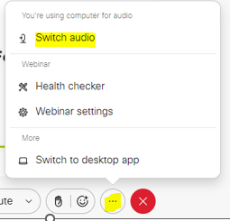
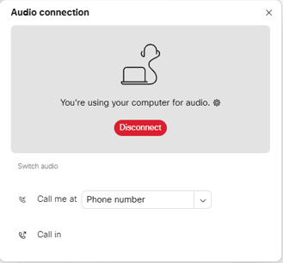
Can’t Hear the Program?
Click the three dots at the bottom of the screen and select Switch Audio.
Select your preferred method of connection for the webinar.

Slide 3
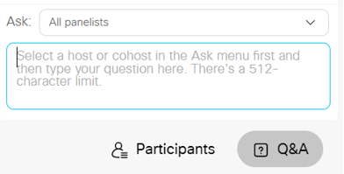
Questions During Program
Use the Q&A Box on the right side of your screen to send questions during the presentation.
Send questions to All Panelists

Slide 4
Webinar Disclosure
By hosting this Webinar, California Grocers Association (CGA) and the CGA Educational Foundation (CGAEF) are providing an opportunity for their members and attendees to obtain general information that may be of interest to your company. The Webinar is designed to provide practical and useful information on the subject matter covered. However, CGA /CGAEF is not engaged in rendering legal, accounting or other professional advice or services.
CGA/CGAEF does not review or approve the content of the webinar presented by guest speakers and others, and makes no representations or warranties about the accuracy or legality of any compliance or other recommendations provided during the webinar. If legal advice or other expert assistance is required, the services of a competent professional should be sought.

Slide 5

About Our Presenter
Derek Hannum
Chief Customer Officer
ReposiTrak

Slide 6
Topics
Intro to ReposiTrak and our traceability work
Stop focusing on the FDA…food traceability is now a reality
What it takes to avoid traceability failure
ASNs and labels alone are not the answer
Do you want traceability data or ACCURATE traceability data?

Slide 7







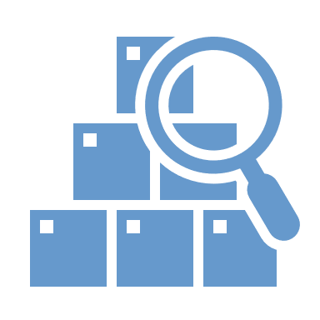

Who is ReposiTrak?
1,052
Seafood Companies
1,219
Dairy, Soft Cheese & Shell Eggs
ReposiTrak (NYSE:TRAK) is the world’s largest connected network of suppliers, distributors and retailers with 30,000+ suppliers and 110,000+ facilities across all product categories.
Financially strong company (NYSE:TRAK)
2+ years of cash on the balance sheet
Seasoned executive leadership
Compliance and risk management
Traceability
Supply chain optimization
3,029
Produce Companies
100,000+
Invoices generated DAILY
350,000+
Supplier/retailer/distributor connections on the platform
9,000,000
Store/SKU forecasts & orders generated DAILY
55,000,000
Item/store perpetual inventories maintained

Slide 8









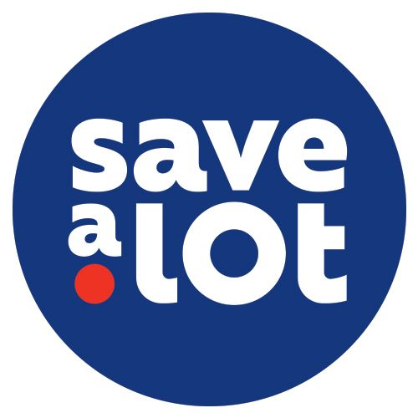
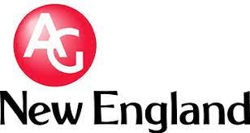
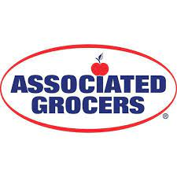

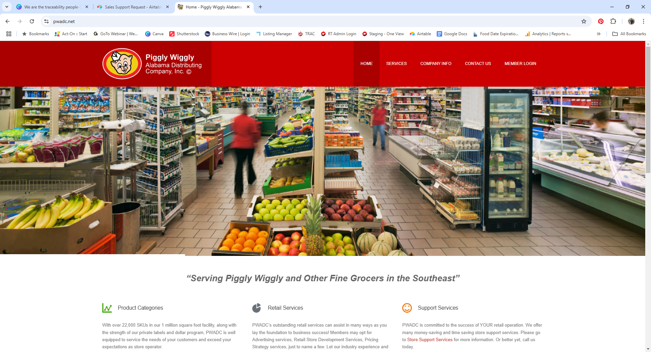
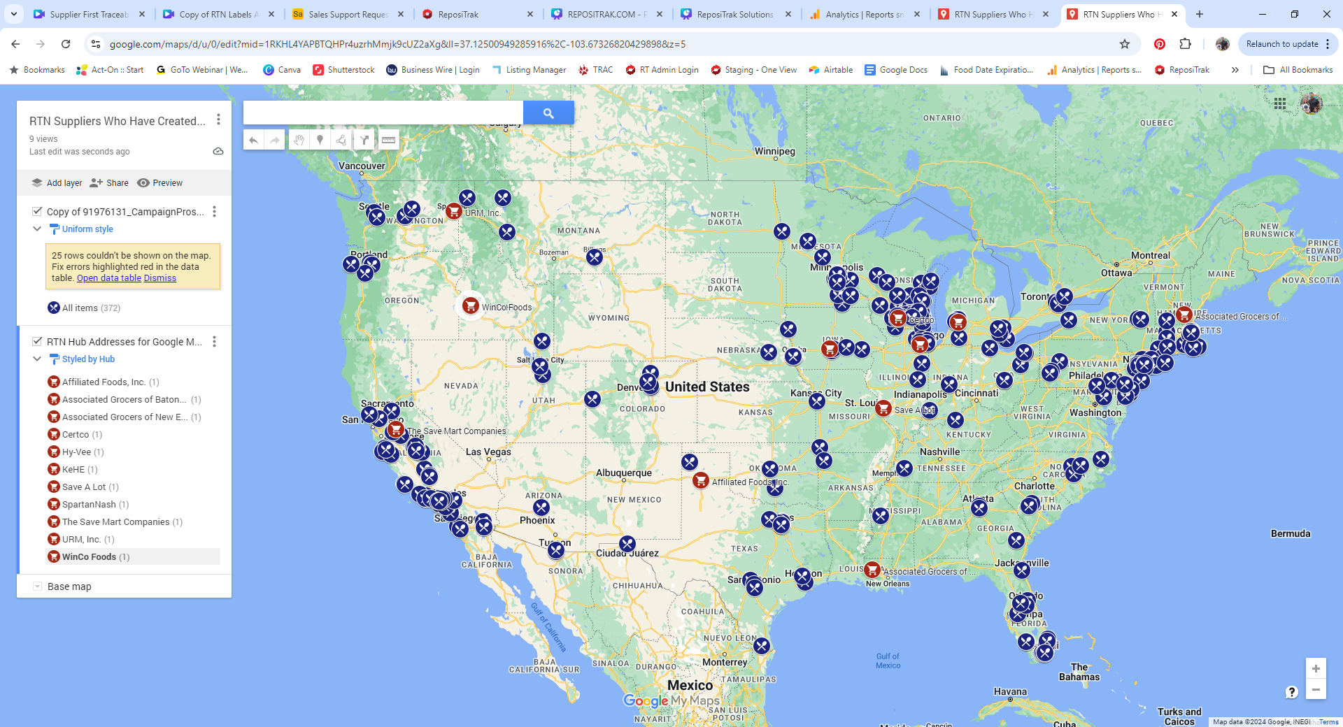
The ReposiTrak Traceability Network
The ReposiTrak Traceability Network®
5,000+
Suppliers
41+
DCs/Warehouses
12,000+
Retail Locations
In-network suppliers
In-network retailers and wholesalers
Notes:
Like I said before, we’re already doing traceability and have been handling the exchange of complex data between trading partners for 20+ years. Right now, the ReposiTrak Traceability Network is the largest in the world and it’s growing. Many of your customers might already be here. Certainly some of your peers are…and you might even be a part of RTN already, too.

Slide 9
Stop Focusing on the FDA…It Doesn’t Matter.
The industry is moving faster than the FDA.
Large chains and distributors have established programs with earlier deadlines and more robust data requirements than the FDA.
Distributors and retailers are realizing that traceability for a subset of foods is more operationally challenging than tracing all food items.
How would you determine which products have nut butters as an ingredient?
How would you determine which foods qualify as Food Traceability List (FTL) items vs. non-FL items at your DCs and stores?
All food suppliers are being informed of the requirement to do traceability…this is happening now.
It’s no longer the FDA deadline that matters.
Traceability is a reality and you need to stay competitive.
Notes:
You might be asking…does the regulation still matter? In short, no, not as much.

Slide 10
Where Can Your Traceability Program Fail?
It’s more than just capturing data, its capturing ACCURATE data.
You can’t accurately determine which suppliers should be doing traceability.
You don’t have a robust system for gathering and storing data.
The data you have is dirty and inaccurate.

Slide 11

Suppliers Need Hand Holding…Can You Handle That?
Traceability is completely new to them. ReposiTrak helps.
Tens of thousands of companies who were not planning for traceability are now trying to deal with it.
70% of suppliers have no IT department and have varying levels of technical capabilities.
They don’t share shipping data electronically today, and they don’t know how.
When they can send data, it’s not accurate.
Notes:
Here’s what we mean when we say “traceability is complicated.” <EXPLAIN SLIDE>…ReposiTrak can help.

Slide 12
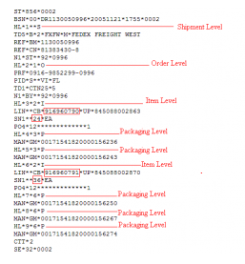

Advance Shipping Notices Are a Problem.
ASNs are a good tool for planning, but not for traceability.
They aren’t standardized, even though there is a “standard” template.
They often don’t have data for what is actually being shipped.
They are a temporary document when what you need is something permanent…where will you save your traceability records?
The biggest issue, and the one you aren’t thinking about…
ASNs are loaded with data errors that you can’t see.

Slide 13
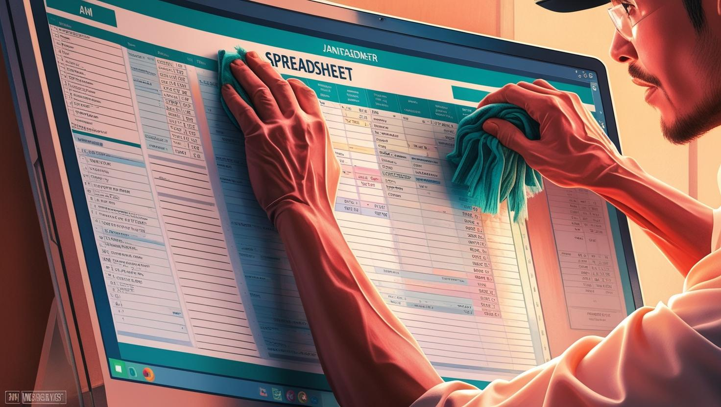
Data Errors - Traceability Data is Very, Very Messy
Over 30% of traceability data files contain errors!
Suppliers send inconsistent, incomplete and error-filled data…even in Advance Shipping Notice 856 files!
Common errors include:
Mis-keyed identifiers for a distribution center, such as typing “DC1” instead of “DC01”
Data fields that are left empty, are partially completed or contain inaccurate information
Shipment files that are missing completely
How do we know this? We’ve processed tens of thousands of supplier data files
Why do errors occur? Traceability is new and it’s hard. Suppliers have the data in different places and have different levels of technical abilities
This is a big problem. Bad data leads to FSMA 204 compliance risk, recall inefficiencies and operational headaches.
You need a way to clean up the mess BEFORE it ripples through your records!

Slide 14


How Much Do You Need To Worry About Data Errors?
Suppliers can’t consistently generate accurate files.
Why do errors occur? Traceability is new and it’s hard. Suppliers have the data in different places and have different levels of technical abilities
Is this a big problem?
Yes. Bad data leads to FSMA 204 compliance risk, recall inefficiencies and operational headaches.
You need a way to clean up the mess BEFORE it ripples through your records!
Only 22% of suppliers can generate traceability data files that are accurate at least 95% of the time.
Files are WRONG more than half the time.
More than 60% of suppliers send traceability data files that are wrong more than half the time.
Big and small companies have trouble with data accuracy.
Large suppliers are NOT significantly better at data accuracy than small suppliers.

Slide 15







Bad Data Exposes You to RISK: Regulatory, Legal & Competitive
Data errors lead to FSMA 204 problems, recall inefficiencies and operational headaches.
ASNs don’t do data validation. Do you have a plan for this?
Even if you could find the errors, how will you follow up with suppliers for hundreds of thousands of records?
Bad receiving record into a DC creates bad shipping and receiving data downstream…the problem multiplies as the product moves.
Bad data goes into the Shipping Record from the supplier
Bad Receiving Record at the DC or Warehouse
Bad Receiving Record at the store

Slide 16
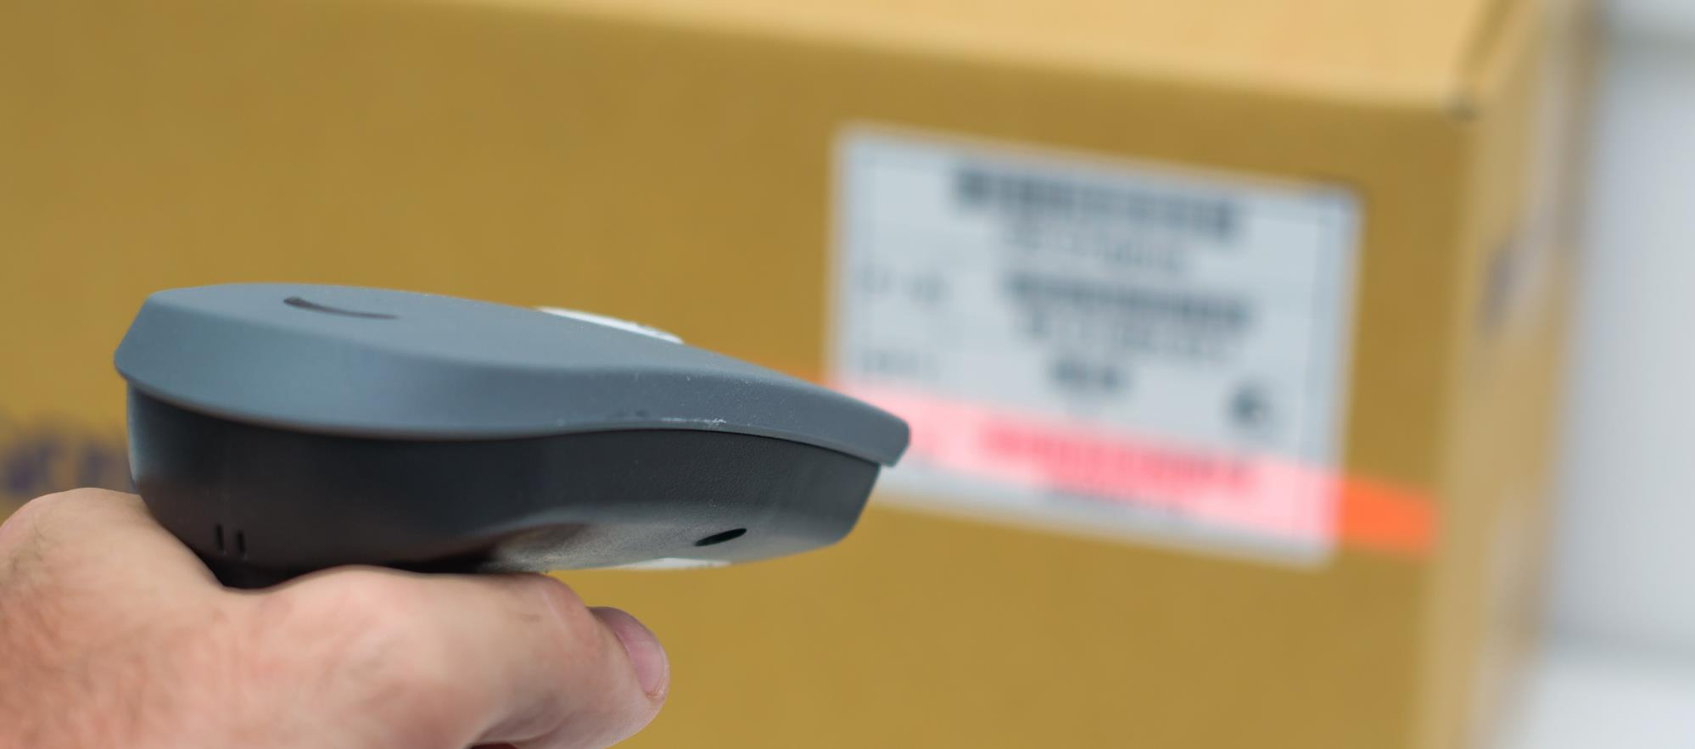
Labels are a problem.
Some traceability data isn’t available when the label is printed.
Some traceability data can be printed on a label.
The traceability lot code (TLC)
The product description
The location description for the TLC source, or the TLC reference
Some traceability data cannot be printed on a label.
The location description for where food was received
The location description for the immediate previous source (other than transporter) for the food
The reference document type and number
The quantity and unit of measure of the food
The date the food was received

Slide 17



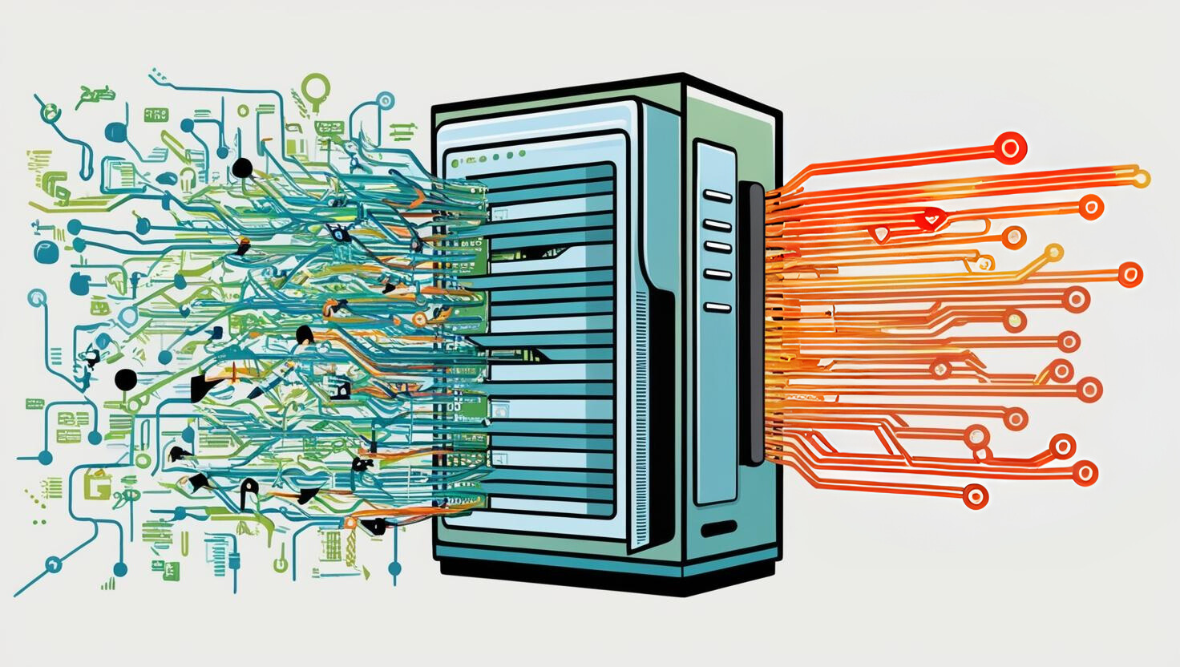


The Solution: ReposiTrak Can Clean the Data
Here’s how it works:
2. We detect errors, fix what we can, and work with the supplier to clarify inconsistencies and make corrections.
1. Suppliers send ReposiTrak the data – in any format.
(We walk them through an automated, step-by-step process.)
3. We create clean, accurate data files for you – the retailer – based on your unique traceability rules.
You save time and reduce risk.

Slide 18
Building a Fail-Safe Traceability Program
Supplier Implementation to Enable Data Sharing
This is the most time-consuming aspect of establishing a traceability program.
It requires intense, repetitive communication with suppliers to establish their data sharing protocols.
Must include education for suppliers who are not up to speed on FSMA 204.
Distribution Center (DC) / Warehouse Traceability
Achieving compliance with the minimal amount of new work is the challenge.
Current warehouse management systems must be augmented with other technology to capture lot codes at outbound shipping.
Distribution Center (DC) / Warehouse Traceability
Retailers are expecting major suppliers to provide FDA-required Key Data Elements (KDEs), but will still need the capability to collect TLCs on deliveries from suppliers who can’t provide the data.
Scanning labels at store receiving can create other positive retailer benefits, such as automated invoice reconciliation.
Good Data Is Required At Each Step!

Slide 19
Summary
You need to go fast, but don’t cut corners on data quality.
Traceability is a reality…you aren’t first, and you can’t afford to be last.
All food suppliers will be doing traceability, so why limit your program to the FDA Food Traceability List?
The BIG problem that you aren’t even thinking about is data accuracy…if you can’t find and resolve all the data errors, you can’t do traceability.

Slide 20

Questions?
Derek Hannum
Chief Customer Officer
dhannum@repositrak.com
407-558-9829

