Slide 1
Understanding Immigration Policy:
Compliance and Best Practices for California Employers
Hosted by: CGA Educational Foundation
Presented by: Vance Piggott & Kate Zemlo Rivas
Attorneys at Law
March 26, 2025
Notes:
Questions in the chat -

Slide 2
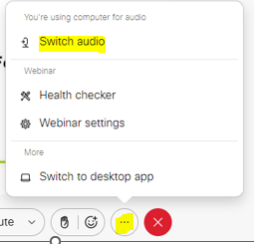
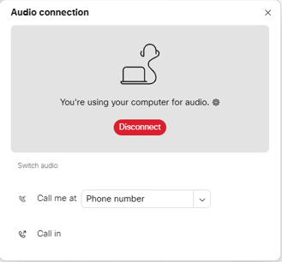
Can’t Hear the Program?
Click the three dots at the bottom of the screen and select Switch Audio.
Select your preferred method of connection for the webinar.

Slide 3
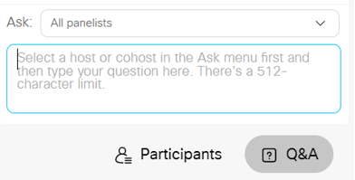
Questions During Program
Use the Q&A Box on the right side of your screen to send questions during the presentation.
Send questions to
All Panelists

Slide 4
Webinar Disclosure
By hosting this Webinar, California Grocers Association (CGA) and the CGA Educational Foundation (CGAEF) are providing an opportunity for their members and attendees to obtain general information that may be of interest to your company. The Webinar is designed to provide practical and useful information on the subject matter covered. However, CGA /CGAEF is not engaged in rendering legal, accounting or other professional advice or services.
CGA/CGAEF does not review or approve the content of the webinar presented by guest speakers and others, and makes no representations or warranties about the accuracy or legality of any compliance or other recommendations provided during the webinar. If legal advice or other expert assistance is required, the services of a competent professional should be sought.

Slide 5


About Our Presenter
Vance Piggott
Senior Counsel
vpiggott@kmtg.com
Kate Zemlo Rivas
Associate
kzemlorivas@kmtg.com

Slide 6
What We’ll Cover Today
Understanding the I-9 form and its requirements.
Best practices for maintaining accurate and compliant records.
Legal implications of non-compliance with I-9 regulations.
HR staff best practices on I-9 compliance.
Steps to take during a federal I-9 audit.
Steps to take during a “raid.”
California-specific regulations- AB 450.
Immigration Retaliation- California law.

Slide 7

Immigration Enforcement
On March 1, 2003, the authorities of the former Immigration and Naturalization Service (INS) were transferred to three new agencies in the U.S. Department of Homeland Security (DHS) which all have some role in the enforcement of immigration laws:
U.S. Citizenship and Immigration Services (USCIS).
U.S. Customs and Border Protection (CBP).
U.S. Immigration and Customs Enforcement (ICE).
The DOJ’s Civil Rights Division and the Executive Oﬀice for Immigration Review (EOIR)

Slide 8
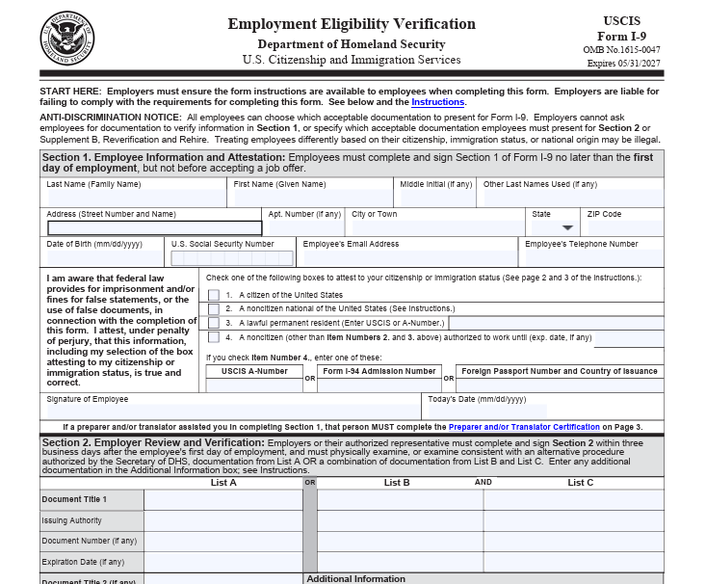



What is the I-9 Form?

Slide 9
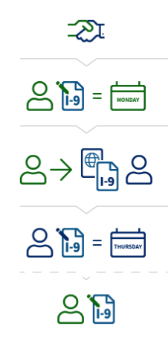
I-9 COMPLIANCE: Timeline
At the time of Hire:
Employees must Complete Section 1: Employee Information and Attestation. Note that providing an SSN is voluntary unless the employer participates in E-Verify.
Employers must ensure form instructions are available to employees when completing the Form.
Within 3 days of Hire: Employer must complete Section 2 (Verification). Use the Employee Manual (M-274) for guidance on how to enter less typical names/addresses and documents.
During Employment: Employer must make their forms available for inspection if requested by authorized U.S. government officials from the Department of Homeland Security, Department of Labor, or Department of Justice.
Reverification: When applicable.
Notes:
Note difference between Noncitizen National of the US vs. Noncitizen Authorized to Work.

Slide 10

I-9 Section 2
mandatory under the Immigration Reform and Control Act (IRCA)
Employer must review 1 document from List A or a combination of documents from List B and List C.
Employer cannot ask an employee to show specific documents.
Copies are not acceptable, except for certified copies of birth certificates.
Some documents are considered automatically extended for the purposes of I-9. E.g. if an employee with EAD check codes if the documents are subject to automatic extension; the Federal Register notices, notices sent by DHS e.g Temporary Protective Status.
Receipts are sometimes acceptable for certain categories (e.g. refugee; lost documents).

Slide 11
Section 4 Reverification and Rehire
Reverification is never required for U.S. citizens or noncitizen nationals.
Reverification is never required when the following documents expire U.S. passports, U.S. passport cards, Permanent Resident Cards (also known as Green Cards), and List B documents.
Reverification is required no later than the date the employee’s employment authorization expires.
Employees rehired within three years from the date you completed their previous Form I-9, you may complete a block on Supplement B, Reverification and Rehire, or you instead complete a new Form I-9.
In cases where an employee has worked for you using a false identity but demonstrates current authorization to work in the United States, Form I-9 rules do not require termination of employment.

Slide 12
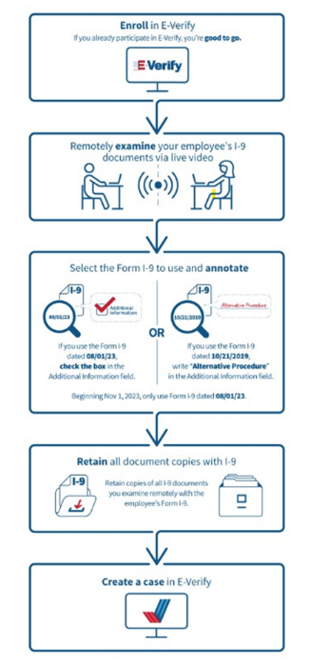
E- Verify
E-Verify is a web-based system that allows employers and other participants to confirm the eligibility of their newly hired employees to work in the U.S. by electronically matching information on the employee’s Form I-9 against records available to the Social Security Administration (SSA) and DHS.
When an employer enrolls to use E-Verify:
Must be used for all hires and cannot be used selectively;
Cannot be used retroactively;
Voluntary for most employers and states (not required in California).

Slide 13

Storage of I-9 forms and documents
Original forms are not required to be kept.
Copies of documents used are not required to be kept.
They can be signed electronically, but documents need to be inspected in person unless E-Verify.
Federal regulations state you must retain a Form I-9 for each person you hire for three years after the date of hire, or one year after the date employment ends, whichever is later.
Forms can be stored electronically OR you may retain completed paper forms with original handwritten signatures on-site or at an off-site storage facility for the required retention period, as long as you are able to present Forms I-9 within three business days of an inspection.
They should be kept separately from personnel files but securely and with limited access.

Slide 14
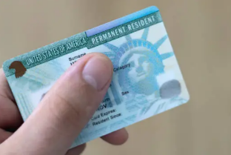
Citizenship Status Discrimination
Citizenship or immigration status discrimination is unlawful.
This occurs when an employer treats someone diﬀerently when hiring, firing, or recruiting because of the person’s real or perceived citizenship or immigration status.
Note:
There are very rare situations where an employer can take an individual’s citizenship or immigration status into account, such as when a law, executive order, regulation, or government contract requires employers to limit a position to a particular citizenship status (i.e. positions involving national security).

Slide 15

Unlawful Employment Civil Penalties
DHS or an administrative law judge may impose penalties if an investigation reveals that you knowingly hired or knowingly continued to employ an unauthorized immigrant.
DHS will issue a Notice of Intent to Fine (NIF) when it intends to impose penalties. If you receive an NIF, you may request a hearing before an administrative law judge. If DHS does not receive your hearing request within 30 days, DHS will impose the penalty and issue a Final Order, which cannot be appealed.
If DHS or an administrative law judge determines that you have knowingly hired unauthorized immigrants (or are continuing to employ immigrants knowing they are or have become unauthorized to work in the United States), they may order you to cease and desist from such activity and pay a civil money penalty for each oﬀense.
Repeated violations- If the attorney general has reasonable cause to believe you engaged in a pattern or practice of employment, recruitment, they may bring civil action in the appropriate U.S. District Court requesting relief, including a permanent or temporary injunction, restraining order, or other order against you or your business.

Slide 16

Unlawful Employment Criminal Penalties
Employers Engaging in a Pattern or Practice of Knowingly Hiring or Continuing to Employ Unauthorized Immigrants
If you or your business are convicted of having engaged in a pattern or practice of knowingly hiring unauthorized immigrants (or continuing to employ immigrants knowing they are or have become unauthorized to work in the United States), you may face fines and/or six months imprisonment.
Employees Engaging in Fraud or False Statements, or Otherwise Misusing Visas, Immigration Permits, and Identity Documents
Employee may be fined and/or imprisoned for up to five years if they:
Make a false statement or attestation to satisfy the employment eligibility verification requirements;
Use fraudulent identification or employment authorization documents; or
Use documents that were lawfully issued to another person.
Other federal criminal statutes may provide higher penalties in certain fraud cases.

Slide 17

HR PRACTICES and I-9 – Summary
Fully follow I-9 instructions.
Maintain and store correctly.
Tracking expirations (alerts; compliant audits).
Conduct proper re-verification only when required.

Slide 18

Inspection by Federal Agents
The INA specifically authorizes DHS, IER, and DOL officers to inspect Forms I-9, including any copies of employees’ documents retained with the corresponding Form I-9.
Officers will give you a minimum of three business days’ notice before starting an inspection.
They need to present you with an official Notice of Inspection (NOI).
Officials may also use subpoenas and warrants to obtain the forms without providing three days’ notice.

Slide 19

RESPONDING TO A FORMAL I-9 Audit
Contact Legal Counsel Immediately.
Gather the requested I-9 forms and supporting documents for current employees and those separated in the last year.
Review records to determine whether corrections are necessary or appropriate.
Submitted requested documents to ICE.
Ensure compliance with California- specific regulations as to I-9 Audits (AB450).

Slide 20
RESULTS OF I-9 Audit Outcomes
Following an I-9 Audit, generally one of four outcomes:
Compliance Letter – no violations
Notice of Technical or Procedure Violation – minor, correctable errors
Notice of Suspect Documents – identifies employees who have questionable work authorization and gives employers 10 days to resolve.
Notice of Intent to Fine – identifies violations which may result in civil or criminal penalties.

Slide 21

PREPARING FOR UNANNOUNCED IMMIGRATION VISIT (ICE RAID)
Develop Raid Response Plan, to include:
  Provide training for managers and frontline employees on how to address ICE
  Identify who will be point of contact for ICE and who will contact legal counsel
  Have plan for compiling and checking documents.

Slide 22
DURING UNANNOUNCED IMMIGRATION VISIT (ICE RAID)
Follow the Raid Response Plan.
Request identification to ensure they are not impersonators.
Request a copy of the warrant to verify content.
Accept the warrant, but do not consent to search.
Limit access to public areas and those mentioned in the warrant.
Only allow access to documents mentioned in the warrant.
Do not interfere with agents’ attempts to speak with employees.
Can tell employees that it is their choice whether to speak to agents or to refuse.
Record or document what the agents are doing.
Document any items taken and ask to make copies before they are taken.

Slide 23

AB 450 (2018)– California Immigrant Worker Protection Act (I-9 Audits and ICE Raids)
No “voluntary consent” to the entry of an immigration enforcement agent to “any nonpublic areas of a place of labor” unless judicial warrant.
No “voluntary consent” for an immigration enforcement agent to access, review or obtain employer’s employee records unless: judicial warrant or subpoena or I-9 audits for which NOI has been provided.
Employers that violate this provision are subject to civil penalties of $2,000 to $5,000 for a first violation, and $5,000 to $10,000 for each subsequent violation.
Employer must provide a notice to employees of Notice of Inspection of I-9 forms or other employment records to employees within 72 hours.
Provide affected employees notice of results and obligations within 72 hours of notice.
Prohibits re-verification of the employment eligibility of any current employee at a time or in a manner that is not required by Section 1324a(b) of Title 8 of the United States Code. Violation of this prohibition subjects the employer to a civil penalty up to $10,000.

Slide 24

Immigration-Related Retaliation
California law (Labor Code section 1019) forbids employers from retaliating against non-citizen employees just because they raise legitimate concerns about illegal employment practices, wage and hour violations, or unsafe workplaces.
Law Prohibits:
Threatening to contact immigration authorities such as ICE about the employee.
Requiring you to produce documents that are not required under current law for I-9 purposes.
Threatening to file a false police report.
Rejecting your documents that otherwise appear to be genuine and accurate; and
Any misuse of the E-Verify system.
Denying employee’s request to update their SSN: Under California Labor Code § 1024.6, the employer cannot fire, discriminate, retaliate, or take any adverse action against an employee who wants to update or try to update your personal information based on a lawful change of name, Social Security number, or federal employment authorization document.

Slide 25
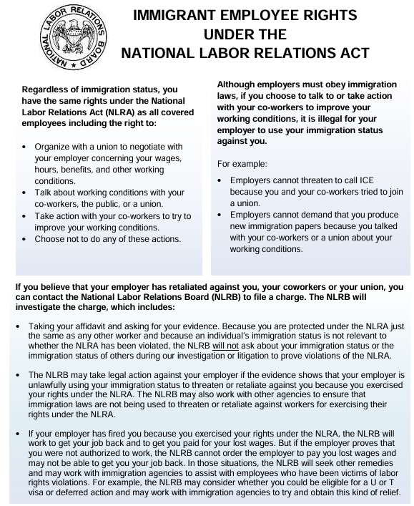
Interaction with Labor Law
Employers should review the applicable collective bargaining agreements proactively to determine whether they require any additional conduct by the employer in the event of an ICE visit.
Section 7 of the National Labor Relations Act: Protects employees engaged in concerted activity.
NLRB has generally extended protections to employees irrespective of their immigration status, including undocumented workers.

Slide 26
Questions?

