Slide 1

  March 2023
Cal/OSHA
‘Permanent’ COVID-19 Regulation and 2023 Enforcement Update
Hosted by:
CGA Educational Foundation
Presenters:
Karen F. Tynan (Sacramento)
Robert Rodriguez (Sacramento)

Slide 2
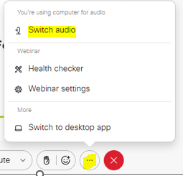
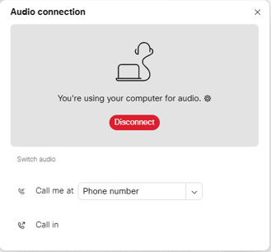
Can’t Hear the Program?
Click the three dots at the bottom of the screen, and select Switch Audio.
Select your preferred method of connection for the webinar.

Slide 3
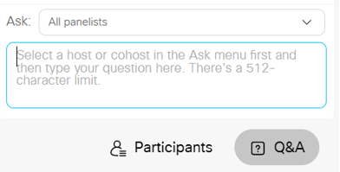
Questions During Program
Use the Q&A Box on the right side of your screen to send questions during the presentation.
Send questions to
All Panelists

Slide 4
Webinar Disclosure
By hosting this Webinar, California Grocers Association (CGA) and the CGA Educational Foundation (CGAEF) are providing an opportunity for their members and attendees to obtain general information that may be of interest to your company. The Webinar is designed to provide practical and useful information on the subject matter covered. However, CGA /CGAEF is not engaged in rendering legal, accounting or other professional advice or services.
CGA/CGAEF does not review or approve the content of the webinar presented by guest speakers and others, and makes no representations or warranties about the accuracy or legality of any compliance or other recommendations provided during the webinar. If legal advice or other expert assistance is required, the services of a competent professional should be sought.

Slide 5
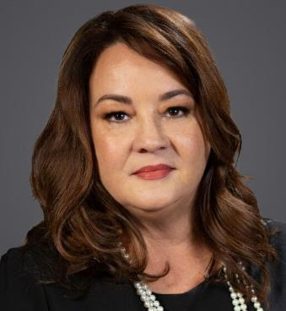
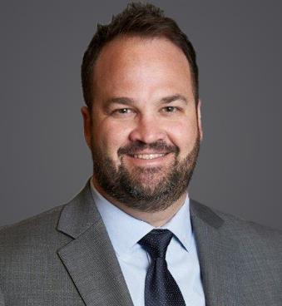
Speakers
Karen F. Tynan
Sacramento
karen.tynan@ogletree.com
Robert C. Rodriguez
Sacramento
rober.trodriguez@ogletree.com

Slide 6

Agenda
Covid-19 New Permanent Regulation - Status
CDPH Definitions
Notices
Scenarios and FAQs
Cal/OSHA Enforcement and Other Regs
Action Items
Update to Your COVID-19 Prevention Plan

Slide 7
Part 1
Covid-19
Regulations

Slide 8
Overview – Emergency Reg Compared to New Reg
Changes
Must address COVID-19 hazards consistent with IIPP
Must investigate COVID-19 cases consistent with IIPP
Training requirements – 3203(a)(7)
Employees working with others will be considered potentially exposed
Major Outbreaks report to Cal/OSHA
Exclusions (working from home, etc.)
COVID-19 case and COVID-19 hazard
Symptoms and COVID-19 test
Face covering … (kind of)
Respirator
Worksite

Slide 9
Biggest Change of All . . .
NO MORE EXCLUSION PAY!
Employees can use paid time off (PTO) or sick days, file a workers’ compensation claim, file for state disability, or use other employee benefits.
“But Robert … what will employees do?”

Slide 10
Changes: Close Contact & Infectious Period
CDPH issued Order on March 3, 2023
The Order supersedes the Cal/OSHA regulation and becomes the new definition of close contact – Section 3205(b)
No Cal/OSHA FAQ update yet
Order becomes effective March 13, 2023
https://www.cdph.ca.gov/Programs/CID/DCDC/Pages/COVID-19/Order-of-the-State-Public-Health-Officer-Beyond-Blueprint.aspx

Slide 11
Section 3205 – Changes: Close Contact (CDPH)
"Close Contact" means the following:
  ​ In indoor spaces 400,000 or fewer cubic feet per floor (such as home, clinic waiting room, airplane etc.), a close contact is defined as sharing the same indoor airspace for a cumulative total of 15 minutes or more over a 24-hour period (for example, three separate 5-minute exposures for a total of 15 minutes) during a confirmed case's infectious period.
  ​In large indoor spaces greater than 400,000 cubic feet per floor (such as open-floor-plan offices, warehouses, large retail stores, manufacturing, or food processing facilities), a close contact is defined as being within 6 feet of the confirmed case for a cumulative total of 15 minutes or more over a 24-hour period during the confirmed case's infectious period.

Slide 12
Section 3205 – Changes: Close Contact
EXCEPTION: Employees have not had a close contact if they wore a respirator required by the employer and used in compliance with section 5144, whenever they shared the same indoor airspace as the COVID-19 case for a cumulative total of 15 minutes or more over a 24-hour period during the COVID-19 case’s infectious period.

Slide 13
Section 3205 – Infectious Period (CDPH)
Infectious Period is defined as:
  ​​For symptomatic confirmed cases, 2 days before the confirmed case had any symptoms (symptom onset date is Day 0) through Days 5–10 after symptoms first appeared AND 24 hours have passed with no fever, without the use of fever-reducing medications, and symptoms have improved, OR
  For asymptomatic confirmed cases, 2 days before the positive specimen collection date (collection date is Day 0) through Day 5 after positive specimen collection date for their first positive COVID-19 test.
For the purposes of identifying close contacts and exposures, symptomatic and asymptomatic confirmed cases who end isolation in accordance with CDPH Isolation and Quarantine Guidance are no longer considered to be within their infectious period.

Slide 14
Section 3205 – Changes: Returned Case
“Returned case” means a COVID-19 case who was excluded from work but returned pursuant to subsection 3205(c)(5)(A) and did not develop any COVID-19 symptoms after returning. A person shall only be considered a returned case for 30 days after the initial onset of COVID-19 symptoms or, if the person never developed COVID-19 symptoms, for 90 days after the first positive test. If a period of other than 90 days is required by a CDPH regulation or order, that period shall apply.

Slide 15
Section 3205 – Changes: “Potentially Infectious”
An employee is potentially exposed to COVID-19 hazards when near other persons, whether or not the employee is performing an assigned work task. The employer shall treat all persons as potentially infectious, regardless of symptoms, vaccination status, or negative COVID-19 test results. COVID-19 shall be considered a hazard specific to an employee’s job assignments and job duties if those assignments and/or duties bring the employee near other persons.

Slide 16
Section 3205 – Changes: Training
Employees shall receive training regarding COVID-19 in accordance with subsection 3203(a)(7).
No longer requires specific subjects or details.
Practice Pointer – Update training program to make sure topics are relevant and have updated definitions.

Slide 17
Section 3205 – The Same (or Very Close)
“Infectious period” means the following time period, unless otherwise defined by CDPH regulation or order, in which case the CDPH definition shall apply: (A) For COVID-19 cases who develop COVID-19 symptoms, from two days before the date of symptom onset until: (1) Ten days have passed after symptoms first appeared, or through day five if testing negative on day five or later; and (2) Twenty-four hours have passed with no fever, without the use of fever-reducing medications, and symptoms have improved.
For COVID-19 cases who never develop COVID-19 symptoms, from two days before the positive specimen collection date through 10 days (or through day five if testing negative on day five or later) after the date on which the specimen for their first positive test for COVID-19 was collected.

Slide 18
Continue to . . .
Employers shall review applicable orders and guidance related to COVID-19 from the State of California and the local health department with jurisdiction over the workplace and shall treat COVID-19 as an airborne infectious disease.

Slide 19
AB 1751
Extends to January 1, 2024
Maintains current rebuttable presumption that an employee’s illness resulting from COVID-19 was sustained in the course of employment for purposes of workers’ compensation benefits

Slide 20
NOTICES – Section 3205(e)
Notice of COVID-19 cases to employee and independent contractors who had a close contact, as well as any employer with an employee who had a close contact.
Notice should be provided as soon as possible, no longer than time to ensure exclusion requirements are met.

Slide 21
NOTICES – Labor Code 6409.6
Extended to January 2024
Changes to COVID-19 notification requirements by amending California Labor Code section 6409.6
Give employers the option to post a notice of potential COVID-19 exposure at the worksite (and on existing employee portals) instead of providing written notice
The Notice shall be posted within one business day from when the employer receives a notice of potential exposure and remain posted for not less than 15 calendar days.

Slide 22
Cal/OSHA FAQ Update (November 8, 2022)
Q: How does an employer determine the cubic feet (volume) of an indoor space?
A: Multiply the square footage by the average ceiling height. Or, follow the general formula for calculating the cubic feet of an indoor space:
Length of space X (multiplied by) Width of space X (multiplied by) Height of space = Volume of space
Examples:
  A store is 60 feet long and 40 feet wide, and has a 24-foot high ceiling.
  The cubic feet of the indoor space of the store is:
  60 feet X 40 feet X 24 feet = 57,600 cubic feet
  A warehouse is 200 feet long and 150 feet wide, and has a 24-foot high ceiling.
  The cubic feet of the indoor space of the warehouse is:
  200 feet X 150 feet X 24 feet = 720,000 cubic feet

Slide 23
Scenario #1 – Part 1
Savory Selects Stores, Inc. has small retail grocery stores and distribution centers across California. Retail stores have 15-25 employees per store, and the distribution centers have 40-50 employees per distribution center.
The Fresno retail store reports: On March 9th, 4 employees call in before morning shift to report Covid positive test results. What is your action plan and next steps?
The Patterson distribution center reports: On March 9th, 2 employees become sick and report covid symptoms at lunch time. What is your action plan and next steps?

Slide 24
Scenario #1 – Part 2
QUESTIONS
What information will you gather?
How will you determine the infectious period?
How will you evaluate the possible close contacts?
Will you exclude anyone from work?
Are you dealing with an outbreak?

Slide 25
Scenario #1 – Part 3
QUESTIONS
How will you manage any notices?
What will your recordkeeping entail?

Slide 26
Part 2
Reporting and Recordkeeping

Slide 27
Employer Responsibilities
Report COVID-19 cases and outbreaks at the worksite to the local health department whenever required by law;
Report major outbreaks to Cal/OSHA;
Keep a record of and track all COVID-19 cases with the employee’s name, contact information, occupation, location where the employee worked, the date of the last day at the workplace, and the date of the positive COVID-19 test and/or COVID-19 diagnosis;
Retain the notices required by subsection 3205(e) in accordance with Labor Code section 6409.6(k) or any successor law; AND
Keep all information CONFIDENTIAL!

Slide 28
OSHA 300 Log – Please Be Careful!
COVID-19 can be a recordable illness
Is the COVID-19 case work-related?
Meets the recording criteria
You must consider an injury or illness to meet the general recording criteria, and therefore to be recordable, if it results in any of the following: death, days away from work, restricted work or transfer to another job, medical treatment beyond first aid, or loss of consciousness. You must also consider a case to meet the general recording criteria if it involves a significant injury or illness diagnosed by a physician or other licensed health care professional, even if it does not result in death, days away from work, restricted work or job transfer, medical treatment beyond first aid, or loss of consciousness.

Slide 29
Part 3
California Specific Info

Slide 30
Scenario #2 - Fresh Pick Market
You are the Vice President of People and Talent at Fresh Pick Market, a specialty grocery store chain. John, your administrative assistant, brings you an official looking letter from Kelly Tatum, District Manager of the Fremont District Office. The letter states that there has been a complaint regarding:
“Fresh Pick Market Inc. is not following COVID-19 protocols by allowing COVID-19 cases to continue to work.”
The letter demands a response within ten business days.
What do you do?

Slide 31
FAQs #1 – Training
We have been training on COVID-19 for the last two and a half years. Will I need to do more training for this January 1, 2023 regulation?
How long should I keep COVID-19 training records?
Can I send out an email with updated COVID-19 information and count that as training?

Slide 32
FAQs #2 – Screening
Can we require employees to “self screen” for COVID-19 symptoms prior to coming to work?
What should we do with all the old (i.e., 2020, 2021) screening records when we were writing down employee temperatures and symptom checks?

Slide 33
FAQs #3 – Outbreaks
For the 3 positive cases outbreak, what does it mean to “make COVID-19 testing available” compared to a major outbreak where employers are directed that testing “shall be required of all employees in the exposed group”?
If we are in outbreak, do we have to implement face coverings in the exposed group?

Slide 34
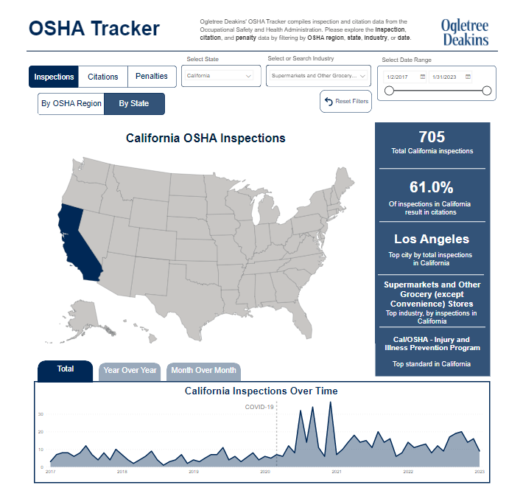
Cal/OSHA Enforcement and Other Regulations
OSHA Tracker available at:
  https://ogletree.com/data-visualizations/osha-tracker/
Enforcement in Supermarkets and other Grocery Stores
From 2017 to present – 705 OSHA inspections in California
61% resulted in Citations
Most Cited Regulations?
  IIPP

Slide 35
Cal/OSHA Enforcement and Other Regulations
Things to remember about IIPP:
  In writing
  Procedures for identifying, evaluating, and correcting workplace safety issues and hazards
  Periodic safety inspections
  Training (including documentation)
  Investigate workplace incidents / injuries
  Employee access to IIPP

Slide 36
Cal/OSHA Enforcement and Other Regulations
Heat Illness Prevention Plan
Increased Enforcement – Spring and Summer
Basics:
  Outdoor places of employment
    Some employers have been cited for heat illness in warehouses
  Training
  Water
  Shade
  Planning

Slide 37
Cal/OSHA Enforcement and Other Regulations
Foot Protection
Hot button issue
Do employers have to pay for non-specialty safety shoes, such as generic steel toe boots or non-slip shoes?
Conflicting case law leave employers confused?
In certain circumstances, there may be a duty to pay for required safety shoes
We have seen Cal/OSHA enforcement on this issue – Citations for not paying for shoes
Civil liability? PAGA / Class Action

Slide 38
Cal/OSHA Enforcement and Other Regulations
Workplace Violence Prevention
With recent tragic incidents in news, we expect further Cal/OSHA enforcement
Current Regulation → Health Care Industry
Labor Code 6400 – General Duty / IIPP
  Cal/OSHA could take position that workplace violence is a recognized hazard

Slide 39
Cal/OSHA Enforcement and Other Regulations
Workplace Violence Prevention Continued….
Longstanding Guidance on Violence Prevention Measures (factors):
  Exchange of money;
  Working alone at night and during early morning hours;
  Availability of valued items, e.g., money and jewelry;
  Guarding money or valuable property or possessions;
  Performing public safety functions in the community;
  Working with patients, clients, passengers, customers or students known or suspected to have a history of violence; or
  Employees with a history of assaults or who have exhibited belligerent, intimidating or threatening behavior to others.

Slide 40
Cal/OSHA Enforcement and Other Regulations
Workplace Violence Prevention Continued….
Proposed Workplace Violence Prevention Standard
  Assessing the workplace for hazards related to workplace violence;
  developing and implementing a workplace violence prevention program;
  providing training and education to employees on workplace violence prevention;
  establishing procedures for responding to incidents of workplace violence; and
  providing appropriate resources and support to employees who are affected by workplace violence

Slide 41
Covid Prevention Plan Action List
Update COVID-19 Prevention Plan for January 2023
Signage and employee communications – update and make sure the terms, procedures, and processes are correct
Testing – Do you have enough tests? Do you have a plan for employee testing during an outbreak?
Training – Records and documents are compiled and available
Recordkeeping – Designated person who can keep records and contact tracing documentation in good order
Future updates – Designated person monitoring CDPH, Cal/OSHA, and local entities

Slide 42
Additional Resources for California Employers
https://www.dir.ca.gov/oshsb/documents/COVID-19-Prevention-Non-Emergency-apprvdtxt-oal.pdf
Ogletree Covid-19 Prevention Program Templates – prices vary
Ogletree Workplace Safety Events
  California Workplace Safety Conference
    October 19, 2023 at the Avenue of the Arts in Costa Mesa, California
  National Workplace Safety Symposium in Austin
    December 6-8, 2023 at the Hilton Austin, Texas

Slide 43
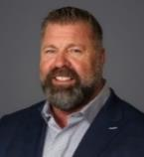


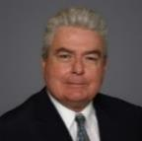

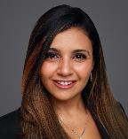

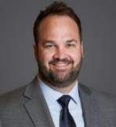
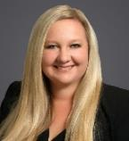
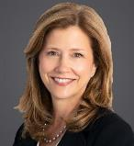
West Coast Occupational Safety Practice
Kevin D. Bland
Shareholder | Orange County
kevin.bland@ogletree.com
(949) 813-1120
Karen Tynan – Chair West Coast OSHA Practice
Shareholder | Sacramento
karen.tynan@ogletree.com
(707) 508-8476
Ursula L. Clemons
Special Counsel | Orange County
ursula.clemons@ogletree.com
(714) 800-7900
Eugene F. McMenamin
Of Counsel | Orange County
eugene.mcmenamin@ogletree.com
(714) 800-2308
James L. Shea
Of Counsel | Sacramento
james.shea@ogletree.com
(916) 840-3276
Jennifer Yanni
Of Counsel | Orange County
jennifer.yanni@ogletree.com
(714) 800-7914
Noel M. Hernandez
Associate | Las Vegas
noel.hernandez@ogletree.com
(702) 369-6802
Robert C. Rodriguez
Associate | Sacramento
robert.rodriguez@ogletree.com
(916) 840-3292
Nicole Naleway
Associate | Orange County
nicole.naleway@ogletree.com
(714) 800-7902
Kathy Fletcher
Of Counsel | Seattle
kathryn.fletcher@ogletree.com
(206) 876-5317

Slide 44
Questions?
Robert Rodriguez
500 Capitol Mall, Suite 2500 | Sacramento, CA 95814
Robert.rodriguez@ogletree.com | Cell Phone: 916.337.6958
Karen F. Tynan
500 Capitol Mall, Suite 2500 | Sacramento, CA 95814
karen.tynan@ogletree.com | Cell Phone: 707.508.8476

