Slide 1

Decoding the CCPA: What Grocers Need to Know
CCA Educational Foundation • March 28, 2023
Grow | Protect | Operate | Finance

Slide 2
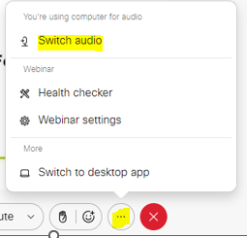
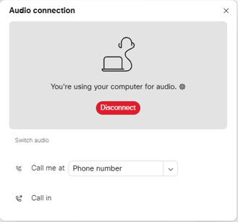
Can’t Hear the Program?
Click the three dots at the bottom of the screen, and select Switch Audio.
Select your preferred method of connection for the webinar.

Slide 3
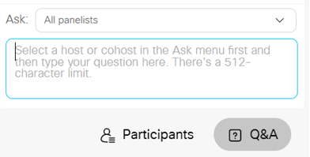
Questions during Program
Use the Q&A Box on the right side of your screen to send questions during the presentation.
Send questions to All Panelists

Slide 4
Webinar Disclosure
By hosting this Webinar, California Grocers Association (CGA) and the CGA Educational Foundation (CGAEF) are providing an opportunity for their members and attendees to obtain general information that may be of interest to your company. The Webinar is designed to provide practical and useful information on the subject matter covered. However, CGA /CGAEF is not engaged in rendering legal, accounting or other professional advice or services.
CGA/CGAEF does not review or approve the content of the webinar presented by guest speakers and others, and makes no representations or warranties about the accuracy or legality of any compliance or other recommendations provided during the webinar. If legal advice or other expert assistance is required, the services of a competent professional should be sought.

Slide 5

About Our Presenter
Peter Stockburger
Dentons San Diego Managing Partner 619.595.8018
peter.stockburger@dentons.com

Slide 6
Agenda
CCPA background – where we are today.
Regulatory / enforcement update.
CCPA deep dive – coverage, notices, data minimization, rights, loyalty programs, and contracting.
California Age-Appropriate Design Code Act – a new wrinkle.
Other states and federal law…what’s happening?
Questions and takeaways throughout.

Slide 7
US Privacy Landscape
Federal
HIPAA
State
Data breach
Fair Credit Reporting Act
HITECH
Consumer privacy laws
Health information
Insurance information
Cybersecurity
US Federal Healthcare Laws
US Federal Financial Laws
GLBA
Unfair Business
Biometric information
Children
Financial information
Children
FTC Act
COPPA

Slide 8
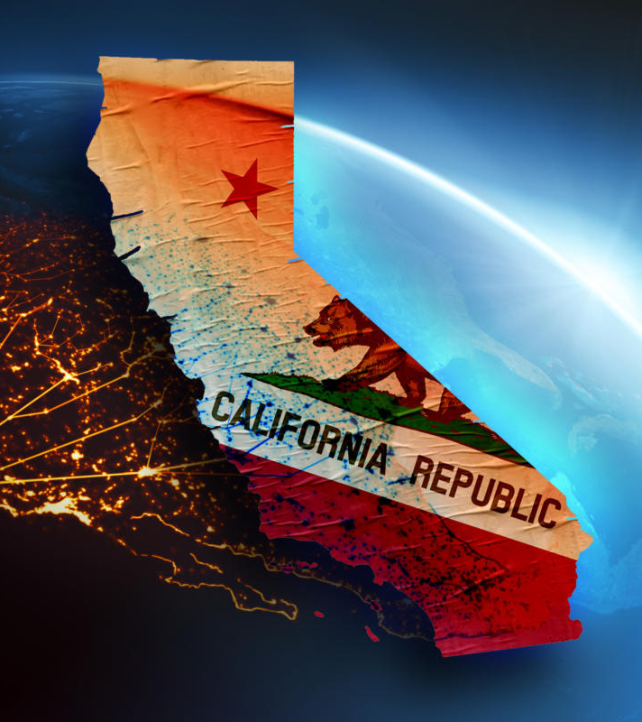
CCPA Background – Where Are We?
CCPA was drafted in 2018 and took effect on 1/1/20.
The AG began enforcing the law on 7/1/20.
No enforcement actions brought to date. Only a single publicly announced settlement. AG has announced various sweeps around loyalty programs, inferences, and mobile applications.
New amendment proposed to voters, the California Privacy Rights Act. Passed by 57%.
CPRA took effect 1/1/23, with new enforcement beginning 7/1/23.
New privacy agency taking over regulations and enforcement – the California Privacy Protection Agency.
Regulation and enforcement is ramping up…

Slide 9

Regulations & Enforcement
CCPA Regulations. Draft final released by CPPA on 2/24/23. OAL has 30 days to review. As of today, no final regulations.
California AG. The AG has continued to enforce the CCPA. Sephora settlement announced last fall. Mobile application enforcement sweep announced in January. What is next?
CPPA Gearing Up. The CPPA announced at their March hearing that they are staffing up, seeking additional funding, and keeping their eyes focused on enforcement.
Sky’s The Limit. The AG and CPPA have no cap on penalties they can seek. With $2,500 per violation and $7,500 per intentional violation, the risk can be significant.
New Rulemaking Is Underway. The new rules will address cybersecurity audits and automated decision making.

Slide 10

CCPA Deep Dive Who Is Covered?
Business Definition #1. For-profit, doing business in CA, collecting the personal information of CA residents and meeting one of three thresholds: (1) annual gross revenue above $25m USD; (2) certain processing of the personal information of more than 100k CA residents; or (3) certain processing of more than 25k CA residents and deriving 50% or more of gross annual revenue from “selling” personal information.
Business Definition #2. If your entity controls or is controlled by the above definition, shares common branding / trademarks, and “shares” personal information.
Business Definition #3. Joint ventures that meet certain ownership standards.
Business Definition #4. Those who voluntarily comply with the CCPA.
Consumer. CA residents under the CA tax code.

Slide 11

CCPA Deep Dive What Data Is Covered?
Personal Information. Information that identifies, relates to, describes, is reasonably capable of being associated with, or could reasonably be linked, directly or indirectly, with a particular “consumer” or “household.”
Examples. Identifiers (name, IP address, phone number), protected characteristics, commercial information, biometric information, geolocation data, and inferences derived.
Sensitive Personal Information. Information around traditionally sensitive data points (SSN, DL, etc.) but also new elements such as racial and ethnic origin, union membership, religious or philosophical beliefs, genetic data, biometric information, health information, and information about sex life or sexual orientation.

Slide 12
CCPA Deep Dive What Data Is Exempt?
HIPAA. HIPAA covered data is exempt, or data treated consistent with HIPAA. Employer health plans and other related HR data.
GLBA. GLBA covered data is exempt, which may impact several HR related service providers.
FCRA. FCRA covered data is exempt, which may impact several HR functions.
Publicly available information. The definition used to be limited to only government records. It now includes information: (1) lawfully obtained that is of a public concern; (2) information you have a reasonable basis to believe is lawfully made available to the general public by the consumer or from widely distributed media; or (3) information the consumer has provided to a third party without restrictions.
De-Identified Data. Information that cannot reasonably be used to infer information about or be linked to a particular individual. Organization must: (1) take reasonable measures to ensure data can’t be re-identified; (2) publicly commit to maintain de-identification; and (3) contractually obligate others not to re-identify.
Aggregate Data. Information that relates to a group or category of consumers from which individual identities have been removed.
HR & B2B Data. These data sets used to be exempt. That exemption expired in 2022, and now job applicant, employee, contractor, and business-to-business contact and communications are covered. Does your compliance program contemplate both?

Slide 13
CCPA Deep Dive Notice Requirements
Notice at Collection
A notice required to be provided at or before the point of collecting personal or sensitive personal information.
Must explain categories being collected, purpose for collection, and now retention periods for categories (with exceptions).
New rule – if notice is delivered digitally, does it link directly to the section in the privacy policy governing that collection? If not, there is direct risk under the CCPA regulations.
The cookie banner hook.
Privacy Policy
Not much changed from CCPA, but now includes new rights and disclosures.
Must affirmatively now state whether “sharing” or using “sensitive personal information” in policy.
Notice of Financial Incentive
Impacts many grocers and loyalty / discount programs.
Right of non-discrimination says a consumer cannot be denied a good or service, charged a different rate, or be provided a different level of quality of goods or services if the consumer exercises rights. Exceptions are financial incentives (i.e., loyalty programs) so long as certain notice is provided and opt-in consent is obtained.
“Financial incentive” is any program, benefit, or other offering for the collection, retention, or “sharing” of personal information. Price or service differences are types of “financial incentives.”
How is the consent obtained? Is it enforceable?
Does your loyalty / discount program have sufficient terms?

Slide 14

CCPA Deep Dive Financial Incentive Notice Requirements
A succinct summary of the financial incentive or price or service difference offered.
A description of the material terms of the financial incentive or price or service difference.
How the consumer can opt-in and opt-out.
A statement of the right to withdraw.
An explanation of how the price or service difference is reasonably related to the value of the consumer’s data, including:
(A) a good faith estimate of the value of the consumer’s data that forms the basis for offering the price or service difference; and
(B) a description of the method(s) the business uses to calculate the value of the data.

Slide 15
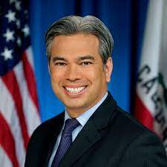
We may not always realize it, but these brick and mortar stores are collecting our data – and they’re finding new ways to profit from it. On Data Privacy Day, we’re issuing notices to businesses that operate loyalty programs and use personal information in violation of California’s data privacy law. (Jan. 2022)
Rob Bonta
California Attorney General

Slide 16

CCPA Deep Dive Data minimization – NEW
New rule. Companies can only collect, use, retain, or “share” consumer personal information that is “reasonably necessary and proportionate” to achieve: (1) the purpose for which it was collected or processed; or (2) another disclosed purpose that is “compatible” with the context in which it was collected.
Original purpose (1) must consider: (i) relationship between the consumer and business; (ii) the type, nature, and amount of personal information involved; (iii) the source of personal information and method for collection; (iv) the specificity, explicitness, and prominence of the disclosure; and (v) the degree to which the involvement of third parties is apparent to the consumer.
Secondary purpose (2) must consider: (i) the reasonable expectation of the consumer; (ii) the disclosed purpose; and (iii) the strength of connection between the secondary purpose and expectation of consumer.

Slide 17

CCPA Deep Dive Consumer Rights
Right of Access. Right to access information and specific pieces. What is a specific piece?
Right of Deletion. Right remains the same, with broad exceptions.
Right of Correction. New right. How do you verify the information is accurate to be correct?
Right to Opt-Out of the “Sale” or “Sharing” of Personal Information. Broad definition of “sale” occurring. What is cross-context behavioral advertising?
Right to Limit the Use of Sensitive Personal Information. Are you using sensitive personal information to derive a “characteristic” about individuals?
Right of Non-Discrimination. Loyalty programs, etc.

Slide 18

CCPA Deep Dive
Breaking Down “Selling” and “Sharing”
CCPA Today. California residents have the right to opt-out of the “sale” of personal information. Sale is any exchange for money or “valuable consideration.” Exemptions for “service providers.”
CCPA / AG Interpretation. The Sephora settlement shows a broad interpretation by the AG.
CPRA Changes – “Sharing”. CPRA says California residents also get a chance to opt-out of “sharing” PI. “Sharing” is defined as making available for “cross-context behavioral advertising” (i.e., retargeting).
Grey Areas. Are analytics a sale? What about SDK’s through mobile applications? This is a high profile and potentially high risk area of enforcement.

Slide 19
CCPA Deep Dive New Contracting Requirements
All Contracts
Must specify the personal information that is sold or disclosed by the business for a limited and specified purpose.
Must require the receiving party to comply with the CCPA, as applicable.
Must grant the business the right to take “reasonable and appropriate steps” to help ensure that the receiving party uses the personal information transferred in a manner consistent with the business’s obligations under the CCPA.
Requires the receiving party to notify the business in the event it cannot meet its obligations under the CCPA.
Requires the business to take “reasonable and appropriate steps” to stop and remediate unauthorized use of personal information.
Service Providers / Contractors
Contract must prohibit the receiving party from “selling” or “sharing” personal information.
Contract must prohibit the receiving party from retaining, using, or disclosing the personal information for any purpose other than that disclosed in the contract, or outside the business relationship.
Contract must prohibit the receiving party from “combining” the personal information it receives with any other personal information except to provide the underlying services.
Contract may allow the business to monitor the receiving party’s compliance with the contract through manual or automated scans, assessments, or other testing.

Slide 20
California Age-Appropriate Design Code Act
Background
Takes effect 7/1/24.
Requires a business that provides an online service, product, or feature “likely to be accessed by children” to abide by certain requirements. “Child” is under 18.
“Likely to be accessed by children” means it is reasonable to expect, based on the following “indicators” that the online service, product, or feature would be accessed by “children”:
The service, product, or feature is directed toward children as defined under COPPA;
The service, product, or feature is determined “based on competent and reliable evidence regarding audience composition” to be routinely access by a “significant number of children”;
The service, product, or feature has advertisements marketed to children;
The service, product, or feature has “design elements” that are “known to be of interest” to children, including, but not limited to, games, cartoons, music, and celebrities who appeal to children;
A “significant amount” of the audience is determined, based on internal research, to be children.
Requirements
Complete a data impact assessment;
Document any risk of “material detriment” to children and create a timed plan to mitigate said risk before the service, product, or feature is offered to children;
Provide a copy of the data impact assessment to the AG if requested;
Estimate the age of users with a reasonable level of certainty appropriate to the risks that arise from the service, product, or feature.
Configure all default privacy settings to a feature that offers a “high level of privacy”;
Provide clear information about practices;
Provide a “signal” when the child is being monitored;
Enforce terms;
Provide responsive tools to help report concerns.

Slide 21

Virginia Consumer Data Protection Act (VCDPA)
Passed in March 2021.
Effective 1/1/23, enforced 7/1/23.
Covered businesses are those that process 100k residents data annually, or process 25k annually and derive 50% or more of revenue from “selling” personal data.
Broad consumer rights and business obligations.
No private right of action. Enforced solely by Virginia AG.

Slide 22

Colorado Privacy Act (CPA)
Passed in June 2021.
Effective 7/1/23.
Covered businesses are those that process 100k residents' data annually, or process 25k annually and derive 50% or more of revenue from “selling” personal data.
Nearly identical to Virginia law relating to rights and obligations.
No private right of action.
Colorado AG enforces.
New rules adopted on 3/15.

Slide 23
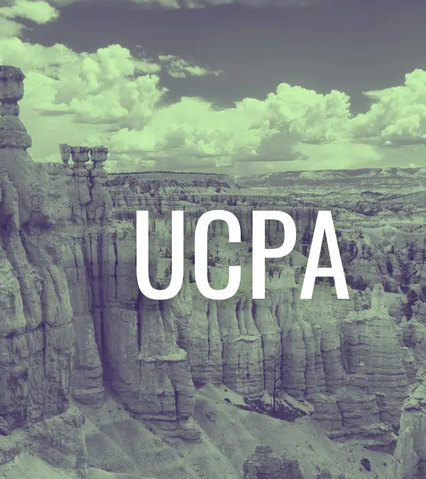
Utah Consumer Privacy Act (UCPA)
Signed 3/24/22.
Effective 12/31/23.
Covered businesses are those that have $25m or more in gross annual revenue and process 100k residents' data annually, or process 25k annually and derive 50% or more of revenue from “selling” personal data.
Similar features to CA, VA, and CO, with some differences.
No private right of action.
UT AG enforces, 30 days to cure.

Slide 24

Connecticut Data Privacy Act (CDPA)
Pending signature.
Effective 7/1/23.
Covered businesses are those that process 100k residents' data annually, or process 25k annually and derive 50% or more of revenue from “selling” personal data.
Similar features to other states, but some differences.
No private right of action.
CT AG to enforce beginning 1/1/25. 60 days to cure.

Slide 25

Iowa Privacy Act
Similar to Utah and other states.
Passed out of legislature last week.
Takes effect January 2025.
No private right of action.

Slide 26

Federal Developments
Dozens of pending bills to address consumer data privacy.
The American Data Privacy and Protection Act made it through the House Committee in the last Congress. What will happen now?
Substantial movement on updating the GLBA, and potential AI frameworks.
Numerous health, financial, and education related privacy bills as well. Bipartisan movement.

Slide 27
Key Takeaways
Understand Coverage & Make Strategic Decisions. Know whether you’re covered under the CCPA or other states and carefully examine ways to structure how you collect data in-person, over the telephone, and over your websites.
Understand Technical Needs. What is your digital advertising roadmap? What are you doing in the marketing and advertising space? Are you “selling” or “sharing”?
Increase Data Visibility. Mapping your processes, data, and people will help understand the scope of obligations.
Start Now On Updates. Even though we’re past January 1, the regulations taking effect is the perfect time to re-up compliance. Begin building out updates to your privacy policy, internal policies, and contractual updates. Watch use of session replay, Meta pixel, Google Analytics, chat bots, biometric tools, voice prints, and any other high-profile uses of data. Ensure low-hanging fruit such as privacy policies and cookie banners are regularly updated.
Watch Regulatory Changes. Draft regulations in California may have significant impact on planning. Stay engaged!
Don’t Sleep On Security. Align your organization with the CIS controls to maintain “reasonable” security!

Slide 28
Questions?

