Slide 1
Webinar: New Laws for 2023
Hosted by: CGA Educational Foundation
December 7, 2022

Slide 2
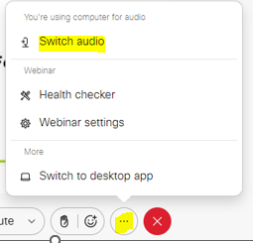
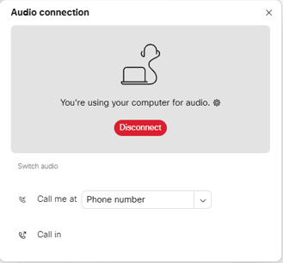
Can’t Hear the Program?
Click the three dots at the bottom of the screen, and select Switch Audio.
Select your preferred method of connection for the webinar.

Slide 3
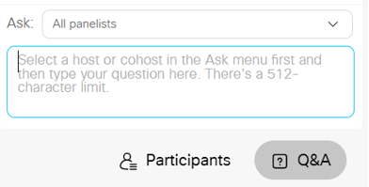
Questions During Program
Use the Q&A Box on the right side of your screen to send questions during the presentation.
Send questions to
All Panelists

Slide 4
Webinar Disclosure
By hosting this Webinar, California Grocers Association (CGA) and the CGA Educational Foundation (CGAEF) are providing an opportunity for their members and attendees to obtain general information that may be of interest to your company. The Webinar is designed to provide practical and useful information on the subject matter covered. However, CGA /CGAEF is not engaged in rendering legal, accounting or other professional advice or services.
CGA/CGAEF does not review or approve the content of the webinar presented by guest speakers and others, and makes no representations or warranties about the accuracy or legality of any compliance or other recommendations provided during the webinar. If legal advice or other expert assistance is required, the services of a competent professional should be sought.

Slide 5

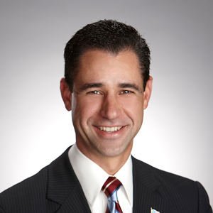
About Our Presenter
Louie Brown
Kahn, Soares & Conway, LLP
(916) 448-3826
lbrown@kscsacramento.com
www.ksclawyers.com

Slide 6
Kahn, Soares & Conway, LLP provides the information for the California Grocers Association Educational Foundation New Laws Seminar for informational purposes only. This general information is not a substitute for legal advice, and users should consult with legal counsel for specific advice. In addition, using this information does not create an attorney-client relationship with Kahn, Soares & Conway, LLP.

Slide 7
NEW LAWS
COVID Supplemental Paid Sick Leave
AB 1041 (Wicks) Employment Leave
AB 1949 (Low) Bereavement Leave
AB 2188 (Quirk) Cannabis
SB 1162 (Limon) Salaries & Wages
SB 1046 (Eggman) Compostable Bags
SB 1013 (Atkins) Bottle Bill
CalOSHA COVID Permanent Regulation

Slide 8
COVID Supplemental Paid Sick Leave
Expires December 31, 2022
Depending on the intensity of the winter spike, the Legislature could reinstate and make retroactive.

Slide 9
AB 1041- Employment Leave
Amends Section 12945.2 of the Government Code
Expands the class of people whom an employee may take leave to care to include a designated person
“Designated person” is defined as any individual related by blood or whose association with the employee is equivalent of a family relationship.
The designated person may be identified by the employee at the time to employee requests the leave.
An employee is limited to one designated person per 12-month period.

Slide 10
AB 1949 – Bereavement Leave
This bill makes it an unlawful employment practice to refuse to grant a request by an eligible employee to take up to 5 days of bereavement leave upon the death of a family member. Days need not be consecutive.
Family member is defined as spouse or a child, parent, sibling, grandparent, grandchild, domestic partner, or parent-in-law
The leave shall be completed within 3 months of the date of death.
In the absence of an existing policy, the bereavement leave may be unpaid. However, the employee may use certain other leave balances otherwise available to the employee, including accrued and available paid sick leave.

Slide 11
AB 1949 – cont.
The bill does not impact an employee covered by a CBA that provides for prescribed bereavement leave.

Slide 12
AB 2188 – Use of cannabis
Adds Section 12954 to the Government Code
On and after 1/1/2024, it is unlawful for an employer to discriminate against a person in hiring, termination, or otherwise penalize a person, if the discrimination is based upon the person’s use of cannabis off the job and away from the workplace.

Slide 13
AB 2188 – cont.
Does not prohibit the employer from discriminating in hiring, or otherwise penalize a person, based on scientifically valid preemployment drug screening conducted through methods that do not screen for nonpsychoactive cannabis metabolytes.

Slide 14
AB 2188 – cont.
The bill does not permit an employee to possess or be impaired by, or to use, cannabis on the job.
The bill does not apply to an employee in the building and construction trades.
The bill does not apply to applicants or employees hired for positions that require a federal government background investigation or security clearance.

Slide 15
SB 1162 – Salaries and Wages
On or before the second Wednesday of May 2023, and each year thereafter, an employer with 100 or more employees shall submit a pay data report to the State.
An employer with 100 or more employees hired through a labor contractor shall submit a separate pay data report for those employees.

Slide 16
SB 1162 cont.
The pay data report shall include:
  1. The number of employees by race, ethnicity and sex in each of the following job categories:
  Executive or senior level officials Mid-level managers
  Professionals Technicians
  Sales Administrative support
  Craft workers Operatives
  Laborers Service workers

Slide 17
SB 1162 cont.
The number of employees by race, ethnicity, and sex, whose annual earnings fall within each of pay bands used by the US Bureau of Labor Statistics
Within each job category, for each combination of race, ethnicity, and sex, the median and mean hourly rate.
Create a snapshot that counts all individuals employed during a single pay period between October 1 and December 31

Slide 18
SB 1162 cont.
For employers with multiple establishments, a report is required for each establishment.

Slide 19
SB 1162 cont.
Require an employer, upon request, to provide an employee the pay scale for the position in which the employee is currently employed.
Require an employer of 15 or more employees to include the pay scale in a job posting.
Maintain records of a job title and wage rate history for each employee.

Slide 20
SB 1046 – Compostable Bags
On or after 1/1/2025, a store is prohibited from providing a precheckout bag to a customer if the bag is not either a compostable bag or a recycled paper bag.
“Precheckout bag” means a bag provided to a customer before the customer reaches the point of sale, that is designed to protect a purchased item from damaging or contaminating other items.

Slide 21


SB 1046
Pre 2025
<<<<<<<<<<<
Post 2025
>>>>>>>>>>>

Slide 22
SB 1013 – Bottle bill
Adds wine and spirits to the redemption program on 1/1/2024.
Directs CalRecycle to adopt emergency regulations no later than 1/1/2024 establishing the guidelines for the creation of Dealer Cooperatives to address unserved zones starting in 2025.
Increases the convenience to a 1-mile radius
Starting 1/1/2025, dealers in unserved zones will either be required to join a Dealer Cooperative or take containers back in store.

Slide 23
SB 1013 cont.
This is just the start of the process. Stay tuned for more detailed information!

Slide 24
CalOSHA
Set to adopt ‘permanent’ 2-year COVID workplace regulation on December 15.
Emergency regulation expires 12/31/2022.
Does not include an extension of Exclusion Pay
Come closer to mirroring existing IIPP requirements
Pay attention to close contact changes

Slide 25
CalOSHA
https://www.dir.ca.gov/oshsb/COVID-19-Prevention-Non-Emergency.html

Slide 26

Questions?

Slide 27
Louie Brown
Kahn, Soares & Conway, LLP
916-448-3826
lbrown@kscsacramento.com
www.ksclawyers.com

