Slide 1



Hazard Pay Ordinances:
Interpretations and Compliance
Hosted by CGA Educational Foundation
Presented by
Anthony J. DeCristoforo (Sacramento)
Robert R. Roginson (Los Angeles)
.
www.ogletree.com
© 2021, Ogletree Deakins

Slide 2

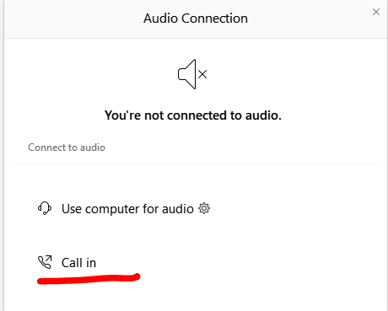
Can’t Hear the Program?
Click the telephone icon at the bottom of the screen.
Select Call In and information will appear to join the webinar via telephone.

Slide 3
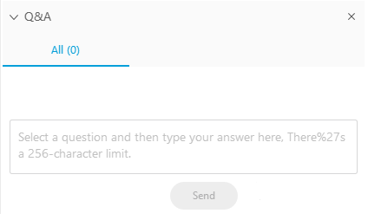
Questions During the Program
Please use the Q&A Box on the right side of your screen to send questions during the presentation.

Slide 4
Webinar Disclosure
By hosting this Webinar, California Grocers Association (CGA) and the CGA Educational Foundation (CGAEF) are providing an opportunity for their members and attendees to obtain general information that may be of interest to your company. The Webinar is designed to provide practical and useful information on the subject matter covered. However, CGA/ CGAEF is not engaged in rendering legal, accounting or other professional advice or services.
CGA/CGAEF does not review or approve the content of the webinar presented by guest speakers and others, and makes no representations or warranties about the accuracy or legality of any compliance or other recommendations provided during the webinar. If legal advice or other expert assistance is required, the services of a competent professional should be sought.

Slide 5


Speaker Introductions
Anthony J. DeCristoforo
Robert R. Roginson

Slide 6
Introduction
Rapid expansion of hazard pay
More than 40 jurisdictions have adopted or are considering hazard pay
Covered businesses must comply with ordinances in jurisdictions in which they have locations

Slide 7
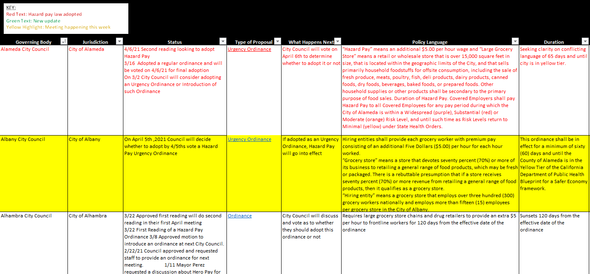
CGA Hazard Pay Tracker

Slide 8
Employer Coverage
Variances in the definition of “grocery store”
Number of employees – nationally/locally/per store
Percentage of revenue devoted to groceries
Percentage of sales floor dedicated to groceries
Other businesses
Drug retail stores

Slide 9
Employer Coverage
Exemptions for collective bargaining agreements
Some ordinances allow a CBA exemption if the agreement explicitly sets forth the waiver
Examples: Millbrae, Pomona, City of San Mateo
Some ordinances do not provide for such a waiver

Slide 10
Employee Coverage
Most ordinances cover all employees
Minimum number of hours worked
Examples: Irvine, City of L.A., City of San Mateo, San Leandro
Exposure to store patrons
Example: City of San Mateo

Slide 11
Employee Coverage
Managers/supervisors
Some ordinances exclude managers
Examples: Coachella, Costa Mesa, City of L.A., Montebello, West Hollywood
Some ordinances are silent
Cities will likely take the position that hourly workers are covered even if they supervise others

Slide 12
Amount of Pay
$4.00 or $5.00
Credit if wages were already increased due to
COVID-19 when ordinance took effect
Hazard pay not required for PTO/sick pay/vacation

Slide 13
Effective Dates
Standard under California Government Code is 30 days after final passage
Emergency/urgency ordinances
Examples
Upon publication pursuant to Charter – City of L.A.
Immediately – Long Beach, Santa Ana
Retroactively – South San Francisco

Slide 14
Expiration Dates
Some expire after a period of time
Example - City of L.A. – 120 days after effective date
Some expire on a specific date
Example - Santa Ana – 6/30/2021
Some expire when a specific condition is met
Example - Berkeley – when city returns to Yellow Tier

Slide 15
Wage Statements
Some ordinances require hazard pay to be separately delineated on covered employees’ wage statements
Examples - L.A. County, Santa Clara County

Slide 16
Notice and Posting Requirements
Some ordinances require employer to give notice to workers and/or post notice of the ordinance
Examples: Buena Park, Irvine, Long Beach, Oakland, San Jose

Slide 17
Recordkeeping
Some ordinances have recordkeeping requirements
Examples
Two years: Buena Park, Irvine, Long Beach, Santa Ana
Three years: Santa Clara County
Four years: L.A. County
Best practice: keep such records even if not specifically required by ordinance

Slide 18
Recordkeeping
If ordinance doesn’t apply, keep records re number of employees
Records demonstrating employer was already paying hazard pay
Examples: Oakland Dept. of Workplace and Employment Standards record requests, L.A. County Dept. of Consumer and Business Affairs

Slide 19
Hazard Pay Included in Overtime Calculation
Hazard pay constitutes wages under California and federal law
Must be included in calculation of the regular rate of pay for overtime purposes because it is payment for “hours worked”
Hazard pay should be included on itemized wage statements

Slide 20
Worker Protections/Retaliation
The ordinances prohibit retaliation against employees
Some expressly prohibit employers from reducing a covered employee’s compensation or reducing work hours
Employer must show that it would have taken same action regardless of the ordinance
Employers must proceed cautiously here:
Review specific retaliation provisions closely before reducing hours or otherwise limiting a worker’s earning capacity

Slide 21
Potential Options
Limiting hours worked or overtime
Reducing shift staffing
Price increases
Surcharges
Store closings

Slide 22
Enforcement
Employees can file civil lawsuits in court
Remedies
Unpaid hazard pay
Injunctive relief
Attorneys’ fees and costs
Some ordinances provide enhanced damages for willful violations or retaliation

Slide 23
Enforcement
Administrative enforcement by the local jurisdiction
Example: L.A. County wage enforcement order
Administrative fines for failing to pay hazard pay, posting requirements, wage statement violations, recordkeeping violations

Slide 24
Questions
Anthony J. DeCristoforo
anthony.decristoforo@ogletree.com
(916) 840-3141
Robert R. Roginson
robert.roginson@ogletree.com
(213) 457-5873

