Slide 1
MRNA COVID-19 Vaccination
Clinical Considerations
Hosted by: CGA Educational Foundation
Presenter: Sarah Kidd, MD MPH

Slide 2
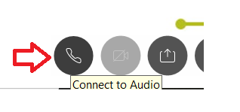
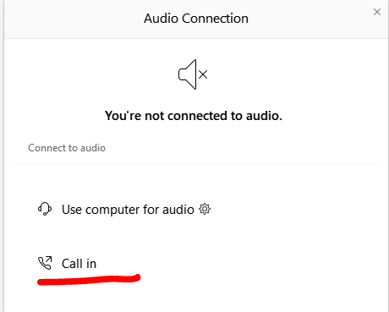
Can’t Hear the Program?
Click the telephone icon at the bottom of the screen.
Select Call In and information will appear to join the webinar via telephone.
2

Slide 3
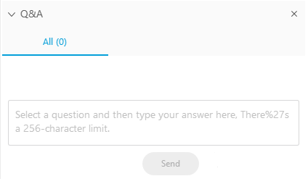
Questions During the Program
Please use the Q&A Box on the right side of your screen to send questions during the presentation.
3

Slide 4
Webinar Disclosure
By hosting this Webinar, California Grocers Association (CGA) and the CGA Educational Foundation (CGAEF) are providing an opportunity for their members and attendees to obtain general information that may be of interest to your company. The Webinar is designed to provide practical and useful information on the subject matter covered. However, CGA/CGAEF is not engaged in rendering legal, accounting or other professional advice or services.
CGA/CGAEF does not review or approve the content of the webinar presented by guest speakers and others, and makes no representations or warranties about the accuracy or legality of any compliance or other recommendations provided during the webinar. If legal advice or other expert assistance is required, the services of a competent professional should be sought.
4

Slide 5

About our Presenter
Dr. Sarah Kidd
Medical Officer
Centers for Disease Control and Prevention (CDC)
skidd@cdc.gov
5

Slide 6
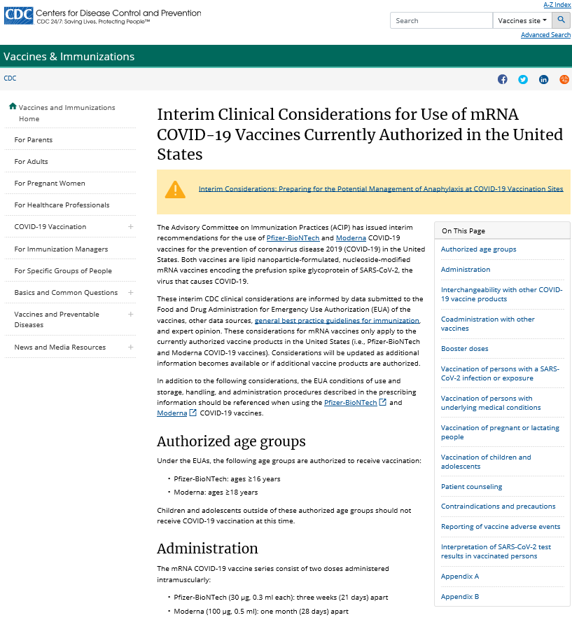
Clinical considerations for mRNA COVID-19 vaccines
Recommendations apply to both Pfizer-BioNTech and Moderna COVID-19 vaccines
Guidance may change as further information becomes available
https://www.cdc.gov/vaccines/covid-19/info-by-product/clinical-considerations.html
6

Slide 7
Dosing and administration
Authorized age groups:
Pfizer-BioNTech: ≥ 16 years
Moderna: ≥ 18 years
Administration: two-dose series administered intramuscularly
Pfizer-BioNTech: three weeks apart
Moderna: four weeks apart
mRNA vaccines are not interchangeable with each other or other COVID-19 vaccines
mRNA vaccines should be administered alone, with a minimum interval of 14 days before or after administration with any other vaccines
7

Slide 8
Strategies to improve 2nd dose compliance
Providing COVID-19 vaccination record cards to vaccine recipients, asking recipients to bring their card to their appointment for the second dose, and encouraging recipients to make a backup copy
Encouraging vaccine recipients to enroll in VaxTextSM, a free text message-based platform to receive COVID-19 vaccination second-dose reminders.
Recording each recipient’s vaccination in the immunization information system (IIS).
Recording vaccine administration information in the patient’s medical record.
Making an appointment for the second dose before the vaccine recipient leaves.
https://www.cdc.gov/vaccines/covid-19/reporting/vaxtext/index.html
8

Slide 9
Persons with a history of SARS-CoV-2 infection
Vaccination should be offered to persons regardless of history of prior symptomatic or asymptomatic SARS-CoV-2 infection
Vaccination should be deferred until recovery from acute illness (if person had symptoms) and criteria have been met to discontinue isolation
Viral or serologic testing for acute or prior infection, respectively, is not recommended for the purpose of vaccine decision-making
9

Slide 10
Persons with underlying medical conditions
Vaccine may be administered to persons with underlying medical conditions who have no contraindications to vaccination
Clinical trials demonstrate similar safety and efficacy profiles in persons with underlying medical conditions, including those that place them at increased risk for severe COVID-19, compared to persons without comorbidities
https://www.cdc.gov/coronavirus/2019-ncov/need-extra-precautions/people-with-medical-conditions.html
10

Slide 11
Immunocompromised persons
Persons with HIV infection, other immunocompromising conditions, or who take immunosuppressive medications or therapies might be at increased risk for severe COVID-19
Data not currently available to establish safety and efficacy of vaccine in these groups
These individuals may still receive COVID-19 vaccine unless otherwise contraindicated
Individuals should be counseled about:
Unknown vaccine safety and efficacy profiles in immunocompromised persons
Potential for reduced immune responses
Need to continue to follow all current guidance to protect themselves against COVID-19
https://www.cdc.gov/coronavirus/2019-ncov/need-extra-precautions/people-with-medical-conditions.html
11

Slide 12
Pregnant women
COVID-19 and pregnancy
Increased risk of severe illness (ICU admission, mechanical ventilation and death)
Might be an increased risk of adverse pregnancy outcomes, such as preterm birth
There are limited data on the safety of COVID-19 vaccines in pregnant women
If a woman is part of a group (e.g., healthcare personnel) who is recommended to receive a COVID-19 vaccine and is pregnant, she may choose to be vaccinated.
https://www.cdc.gov/coronavirus/2019-ncov/need-extra-precautions/pregnancy-breastfeeding.html
12

Slide 13
Pregnant women
Considerations for vaccination:
Level of COVID-19 community transmission (risk of acquisition)
Personal risk of contracting COVID-19 (by occupation or other activities)
Risks of COVID-19 to her and potential risks to the fetus
Efficacy of the vaccine
Known side effects of the vaccine
Lack of data about the vaccine during pregnancy
13

Slide 14
Post-Vaccination Symptoms
Before vaccination, providers should counsel vaccine recipients about expected local and systemic post-vaccination symptoms
Depending on vaccine product, age group, and dose:
80-89% of clinical trial participants reported ≥1 local reaction (e.g., pain or swelling at injection site; swollen lymph nodes on same side as vaccinated arm)
55-83% of clinical trial participants reported ≥1 systemic reaction (e.g., fever, fatigue, muscle aches, headache, chills)
Most are mild-moderate in severity, occur within first 3 days of vaccination, and resolve within 1-2 days of onset
More frequent and severe following the second dose and among younger age groups
https://www.cdc.gov/vaccines/covid-19/info-by-product/pfizer/reactogenicity.html
https://www.cdc.gov/vaccines/covid-19/info-by-product/moderna/reactogenicity.html
14

Slide 15
Contraindications to mRNA COVID-19 vaccination
Pfizer-BioNTech and Moderna COVID-19 vaccines
Contraindications to either of the mRNA COVID-19 vaccines:
Severe allergic reaction (e.g., anaphylaxis) after a previous dose of an mRNA COVID-19 vaccine or any of its components
Immediate allergic reaction of any severity to a previous dose of an mRNA COVID-19 vaccine or any of its components (including polyethylene glycol [PEG])*
Immediate allergic reaction of any severity to polysorbate (due to potential cross-reactive hypersensitivity with the vaccine ingredient PEG)*
* These persons should not receive mRNA COVID-19 vaccination at this time unless they have been evaluated by an allergist-immunologist and it is determined that the person can safely receive the vaccine (e.g., under observation, in a setting with advanced medical care available).
15

Slide 16
Precautions to mRNA COVID-19 vaccines
Pfizer-BioNTech and Moderna COVID-19 vaccines
Any immediate allergic reaction to any other vaccine (i.e., non-mRNA COVID vaccine) or injectable therapy
Unknown risks of developing a severe allergic reaction should be balanced against the benefits of vaccination
Deferral of vaccination and/or consultation with an allergist-immunologist may be considered
16

Slide 17


Observation period following vaccination
Persons with a precaution to vaccination or a history of anaphylaxis (due to any cause)
All other persons
30 minutes
15 minutes
17

Slide 18
Summary: Triage of persons presenting for mRNA COVID-19 vaccination
CONTRAINDICATION TO VACCINATION
PRECAUTION TO VACCINATION
MAY PROCEED WITH VACCINATION
ALLERGIES
History of the following are contraindications to receiving either of the mRNA COVID-19 vaccines*:
Severe allergic reaction (e.g., anaphylaxis) after a previous dose of an mRNA COVID-19 vaccine or any of its components
Immediate allergic reaction‡ of any severity to a previous dose of an mRNA COVID-19 vaccine or any of its components^ (including polyethylene glycol)#
Immediate allergic reaction of any severity to polysorbate^#
ACTIONS
Do not vaccinate#
Consider referral to allergist-immunologist
ALLERGIES
Among persons without a contraindication, a history of:
Any immediate allergic reaction‡ to other vaccines or injectable therapies*
ACTIONS
Risk assessment
30-minute observation period if vaccinated
Consider deferral of vaccination for further risk assessment and possible referral to allergist-immunologist
ALLERGIES
Among persons without a contraindication or precaution, a history of:
Allergy to oral medications (including the oral equivalent of an injectable medication)
History of food, pet, insect, venom, environmental, latex, etc., allergies
Family history of allergies
ACTIONS
30-minute observation period: Persons with a history of anaphylaxis (due to any cause)
15-minute observation period: All other persons
* Polyethylene glycol (PEG) and polysorbate are common excipients in many vaccines, injectable therapies, and other products. Persons with a known (diagnosed) allergy to PEG, another mRNA vaccine component, or polysorbate, have a contraindication to vaccination. Persons with a reaction to a vaccine or injectable therapy that contains multiple components, one of which is PEG, another mRNA vaccine component or polysorbate, but in whom it is unknown which component elicited the immediate allergic reaction have a precaution to vaccination.
‡ Immediate allergic reaction to a vaccine or medication is defined as any hypersensitivity-related signs or symptoms consistent with urticaria, angioedema, respiratory distress (e.g., wheezing, stridor), or anaphylaxis that occur within four hours following administration.
^ See Appendix B for a list of ingredients. Note: Polyethylene glycol (PEG), an ingredient in both mRNA COVID-19 vaccines, is structurally related to polysorbate and cross-reactive hypersensitivity between these compounds may occur. Information on ingredients of a vaccine or medication (including PEG, a PEG derivative, or polysorbates) can be found in the package insert.
# These persons should not receive mRNA COVID-19 vaccination at this time unless they have been evaluated by an allergist-immunologist and it is determined that the person can safely receive the vaccine (e.g., under observation, in a setting with advanced medical care available).
18

Slide 19
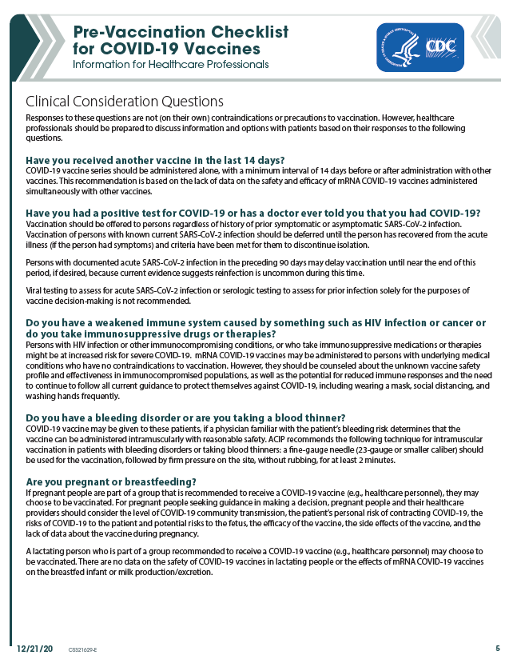
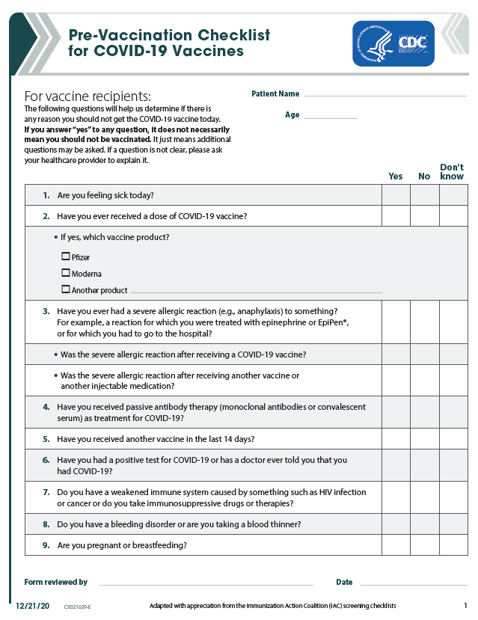
Additional tools to identify persons with contraindications and precautions to vaccination
https://www.cdc.gov/vaccines/covid-19/downloads/pre-vaccination-screening-form.pdf
19

Slide 20
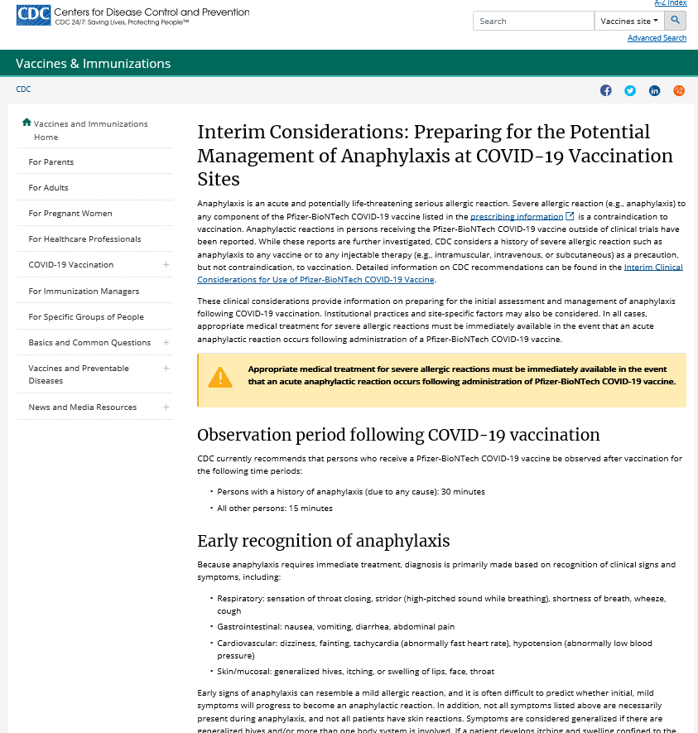
Interim considerations: Preparing for the potential management of anaphylaxis at COVID-19 vaccination sites
20
https://www.cdc.gov/vaccines/covid-19/info-by-product/pfizer/anaphylaxis-management.html

Slide 21
Recommended medications and supplies for the management of anaphylaxis at COVID-19 vaccination sites
Should be available at all sites | Include at sites where feasible
Epinephrine prefilled syringe or autoinjector* | Pulse oximeter
H1 antihistamine (e.g., diphenhydramine)† | Oxygen
Blood pressure cuff | Bronchodilator (e.g., albuterol)
Timing device to assess pulse | H2 antihistamine (e.g., famotidine, cimetidine)
 | Intravenous fluids
 | Intubation kit
 | Adult-sized pocket mask with one-way valve (also known as cardiopulmonary resuscitation (CPR) mask)
*COVID-19 vaccination sites should have at least 5 doses of epinephrine on hand at any given time.
†Antihistamines may be given as adjunctive treatment and should not be used as initial or sole treatment for anaphylaxis. Additionally, caution should be used if oral medications are administered to persons with impending airway obstruction.
https://www.cdc.gov/vaccines/covid-19/info-by-product/pfizer/anaphylaxis-management.html
21

Slide 22



Key messages
Preparing for the potential management of anaphylaxis at COVID-19 vaccination sites
Early recognition of anaphylaxis symptoms
Prompt treatment with epinephrine
Activation of emergency medical services
22
https://www.cdc.gov/vaccines/covid-19/info-by-product/pfizer/anaphylaxis-management.html

Slide 23



Active Safety Monitoring for COVID-19 Vaccines
V-safe is a new CDC smart-phone based monitoring program for COVID-19 vaccine safety
Uses text messaging and web surveys to check-in with vaccine recipients after vaccination
Participants can report any side effects or health problems after COVID-19 vaccination
Includes active telephone follow-up by CDC for reports of significant health impact
https://www.cdc.gov/coronavirus/2019-ncov/vaccines/safety/vsafe.html
23

Slide 24
Public health recommendations for vaccinated persons
Protection from vaccine is not immediate; vaccine is a 2-dose series and will take 1 to 2 weeks following the second dose to be considered fully vaccinated
Vaccinated persons should continue to follow all current guidance to protect themselves and others, including:
Wearing a mask
Staying at least 6 feet away from others
Avoiding crowds
Washing hands often
Following CDC travel guidance
Following any applicable workplace or school guidance
https://www.cdc.gov/coronavirus/2019-ncov/index.html

Slide 25
Quarantine recommendations for vaccinated persons who are not inpatients or residents in health care settings
Vaccinated persons with an exposure to someone with suspected or confirmed COVID-19 are not required to quarantine if they meet all of the following criteria:
Are fully vaccinated (i.e., ≥2 weeks following receipt of the second dose in a 2-dose series, or ≥2 weeks following receipt of one dose of a single-dose vaccine)
Are within 3 months following receipt of the last dose in the series
Have remained asymptomatic since the current COVID-19 exposure
Vaccinated persons who develop symptoms should be evaluated for COVID-19, including SARS-CoV-2 testing, if indicated
These recommendations will be updated when more data become available and additional COVID-19 vaccines are authorized

Slide 26
Additional resources

Slide 27
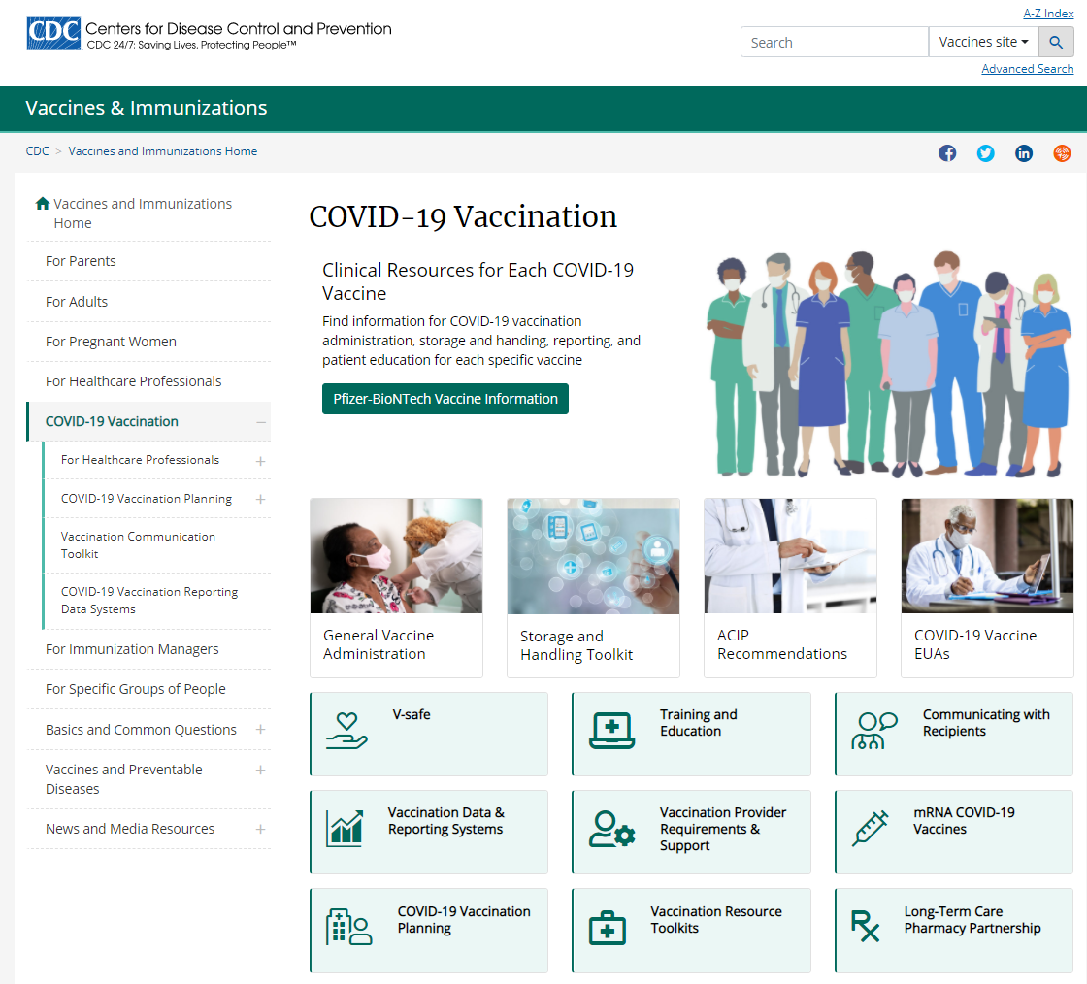
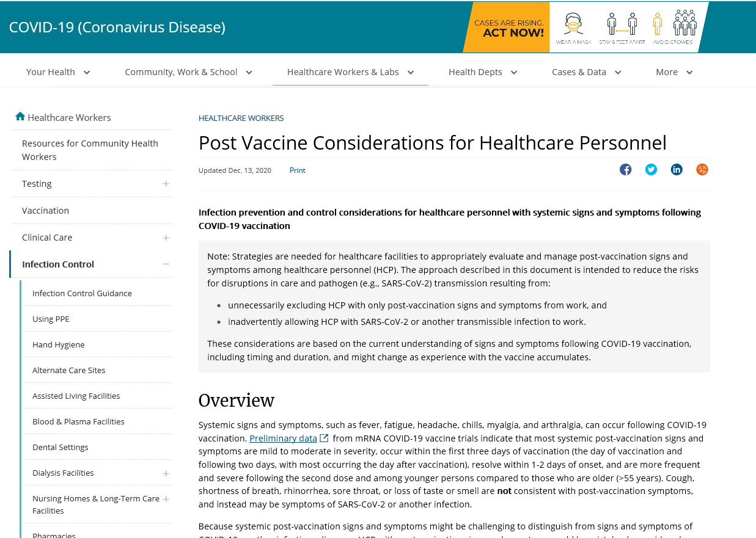
CDC Resources
Infection prevention and control recommendations for persons with post-vaccination symptoms
Healthcare personnel
Long-term care facility residents
Learn more with CDC’s COVID-19 vaccine tools and resources. Find information for COVID-19 vaccination administration, storage, reporting, patient education, and more.
COVID-19 Vaccination: https://www.cdc.gov/vaccines/covid-19/index.html
For Healthcare Professionals: https://www.cdc.gov/vaccines/covid-19/hcp/index.html
27

Slide 28

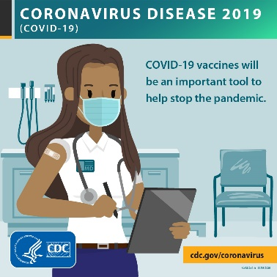
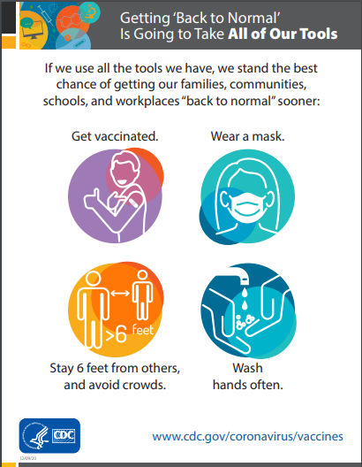
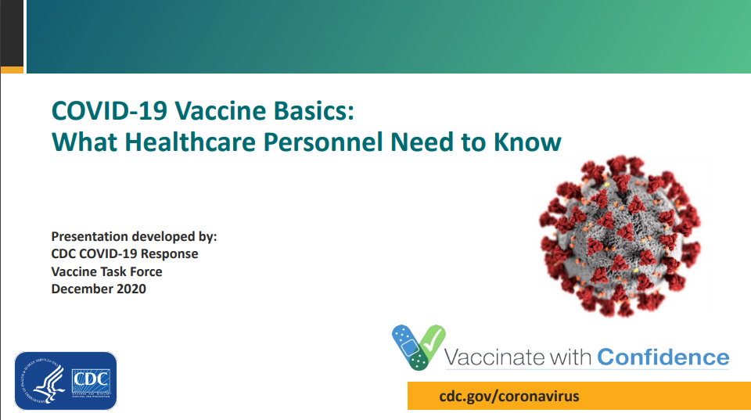
COVID-19 vaccine communication resources
Engaging in Effective COVID-19 Vaccine Conversations
https://www.cdc.gov/vaccines/covid-19/hcp/engaging-patients.htm
Toolkit for Medical Centers, Clinics, and Clinicians
https://www.cdc.gov/vaccines/covid-19/health-systems-communication-toolkit.html
More toolkits coming soon
Long-term care facilities
Health departments
Community-based organizations
Employers of essential workers
28

Slide 29

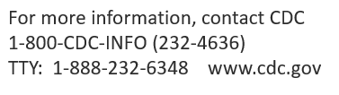
Questions?

