Slide 1
Webinar: New Laws for 2021
Hosted by CGA Educational Foundation December 2, 2020

Slide 2
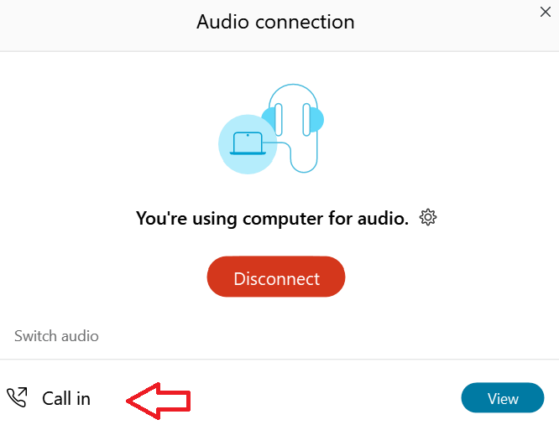
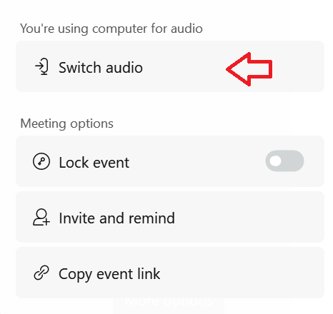
Can’t Hear the Program?
Click the three ellipses at the bottom of the screen and select Switch Audio. Highlight the ‘Call in’ option pictured below, click View and information will appear to join the webinar via telephone.

Slide 3

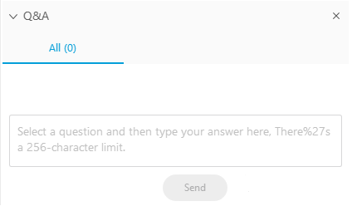
Questions During the Program
Please use the Q&A Box on the right side of your screen to send questions during the presentation.

Slide 4
Webinar Disclosure
By hosting this Webinar, California Grocers Association (CGA) and the CGA Educational Foundation (CGAEF) are providing an opportunity for their members and attendees to obtain general information that may be of interest to your company. The Webinar is designed to provide practical and useful information on the subject matter covered. However, CGA /CGAEF is not engaged in rendering legal, accounting or other professional advice or services.
CGA/CGAEF does not review or approve the content of the webinar presented by guest speakers and others, and makes no representations or warranties about the accuracy or legality of any compliance or other recommendations provided during the webinar. If legal advice or other expert assistance is required, the services of a competent professional should be sought.

Slide 5

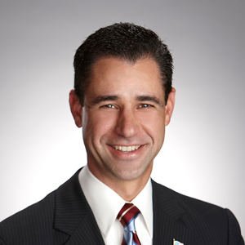
About Our Presenter
Louie Brown
Kahn, Soares & Conway, LLP
916-448-3826
lbrown@kscsacramento.com

Slide 6
NEW LAWS
AB 685 COVID19 Notification
AB 979 Corporate Boards: Underrepresented Communities
AB 1963 Human Resources – Mandated employers
SB 973 Pay Data Reporting
SB 1196 Price Gouging
Cal OSHA COVID-19 Emergency Regulations

Slide 7
AB 685 (Reyes)
COVID-19 Employer Notification
EFFECTIVE: January 1, 2021

Slide 8
AB 685
Requires employers to notify employees who may have been exposed to COVID-19 and to report workplace outbreaks to the local health department.
Requires the California Department of Public Health (CDPH) to publicly report information on workplace outbreaks.
Authorizes Cal/OSHA to enforce COVID-19 hazards as an imminent hazard to provide immediate protection for workers.

Slide 9
AB 685
Upon identifying a COVID-19 case in the workplace, you need to provide the following information:
Notice to your employees and the employer of subcontracted workers that they may have been exposed to COVID-19.
Information about benefits & options
A disinfection & safety plan

Slide 10
AB 685
You must report COVID-19 outbreaks to the local health department. For non-healthcare workplaces,
Outbreak is defined as 3 or more COVID-19 cases among workers at the same worksite within a 14-day period.
You also must continue to notify the local health department of additional COVID-19 cases identified among workers at the worksite.

Slide 11
AB 685
A COVID-19 case is someone who:
Has a positive viral test for COVID-19
Is diagnosed with COVID-19 by a licensed health care provider,
Is ordered to isolate for COVID-19 by a public health official, OR
Dies due to COVID-19, as determined by a public health department.

Slide 12
AB 685
What information should I report to the local health department?
Information about the worksite – name of company/institution, business address, and North American Industry Classification System (NAICS) industry code.
Names and occupations of workers with COVID-19.
Additional information requested by the local health department as part of their investigation.

Slide 13
AB 685
https://www.cdph.ca.gov/Programs/CID/DCDC/Pages/COVID-19/Employer-Questions-about-AB-685.aspx
https://www.cdph.ca.gov/Programs/CID/DCDC/Pages/COVID-19/Employer-Guidance-on-AB-685-Definitions.aspx#

Slide 14
AB 979 (Holden)
Corporate Boards: Underrepresented Communities
EFFECTIVE: January 1, 2021

Slide 15
AB 979
No later than 12/31/2021, a publicly held domestic or foreign corporation whose principal executive offices are in California shall have at least one director from an underrepresented community on its board.

Slide 16
AB 979
No later than 12/31/2022, a publicly held domestic or foreign corporation with principal executive offices located in California shall comply as follows:
If its number of directors is ≥ 9, at least 3 directors from underrepresented communities.
If its number of directors is ≥ 4 but < 9, at least two directors from underrepresented communities.
If its number of directors is ≤ 4 , at least 1 director from an underrepresented community.

Slide 17
AB 979
“Director from an underrepresented community” means an individual who self-identifies as Black, African American, Hispanic, Latino, Asian, Pacific Islander, Native American, Native Hawaiian, or Alaska Native, or who self-identifies as gay, lesbian, bisexual, or transgender.
“Publicly held corporation” means a corporation with outstanding shares listed on a major United States stock exchange.

Slide 18
AB 1963 (Chu)
Human Resources – Mandated Reporter
EFFECTIVE: January 1, 2021

Slide 19
AB 1963
A human resource employee of a business with 5 or more employees that employs minors is added to the list on mandated reporters.
Human Resource Employee is the employee or employees designated by the employer to accept complaints of misconduct, under the California Fair Employment and Housing Act.

Slide 20
AB 1973
Child Abuse and Neglect Reporting Act requires a mandated reporter to report whenever they, in their professional capacity or within the scope of their employment has knowledge of or observed a child whom the mandated reporter knows or reasonably suspects has been the victim of child abuse or neglect.

Slide 21
AB 1973
Failure by a mandated reporter to report an incident of known or reasonably suspected child abuse or neglect is a misdemeanor punishable by up to 6 months confinement, by a fine of $1,000, or both.

Slide 22
SB 973 (Jackson)
Pay Data Reporting
EFFECTIVE: January 1, 2021

Slide 23
SB 973
On or before March 31, 2021 and every March 31 thereafter, a private employer with 100 or more employees, and that is required to file an annual Employer Information Report (EEO-1) under Federal law, shall submit pay data to the Department of Fair Employment and Housing.

Slide 24
SB 973 – Pay Data Report
The number of employees by race, ethnicity, and sex in each of the following job categories:
(A) Executive or senior level officials and managers.
(B) First or mid-level officials and managers.
(C) Professionals.
(D) Technicians.
(E) Sales workers.
(F) Administrative support workers.
(G) Craft workers.
(H) Operatives.
(I) Laborers and helpers.
(J) Service workers.

Slide 25
SB 973
For purposes of establishing the numbers required to be reported an employer shall:
create a “snapshot” that counts all of the individuals in each job category by race, ethnicity, and sex, employed during a single pay period of the employer’s choice between October 1 and December 31 of the “Reporting Year.”
calculate the total earnings, as shown on the IRS Form W-2, for each employee in the “snapshot,” for the entire “Reporting Year,” regardless of whether or not an employee worked for the full calendar year.

Slide 26
SB 973
Any individually identifiable information submitted to the department pursuant to this section shall be considered confidential information and not subject to disclosure pursuant to the California Public Records Act.

Slide 27
SB 1196 (Umberg)
Price Gouging
EFFECTIVE: January 1, 2021

Slide 28
SB 1196
Expands California Price Gouging laws to make it crime for a person or business that “did not charge a price for the goods or services immediately prior to the proclamation or declaration of emergency to charge a price that is more than 50% greater than the cost to vendor as defined in Section 17026 of the Business and Professions Code”

Slide 29
B&P § 17026. “Cost” as applied to production includes the cost of raw materials, labor and all overhead expenses of the producer.
“Cost” as applied to distribution means the invoice or replacement cost, whichever is lower, of the article or product to the distributor and vendor, plus the cost of doing business by the distributor and vendor and in the absence of proof of cost of doing business a markup of 6 percent on such invoice or replacement cost shall be prima facie proof of such cost of doing business.

Slide 30
SB 1196
Expands definition of State of Emergency and Local Emergency to include pandemics or epidemic disease outbreaks.

Slide 31
Cal OSHA COVID-19 Emergency Regulations EFFECTIVE: November 29, 2020

Slide 32
The regulation includes several important definitions:
“COVID-19 exposure” is defined as being within six feet of a COVID-19 case for a cumulative total of 15 minutes or greater in any 24-hour period within or overlapping with the “high-risk exposure period” regardless of the use of face coverings.
“Exposed workplace” is defined as any work location, working area, or common area at work used or accessed by a COVID-19 case during the high-risk period, including bathrooms, walkways, hallways, aisles, break or eating areas, and waiting areas. After January 1, 2021, the regulation incorporates the definition of “worksite” from AB 685.

Slide 33
“High-risk exposure period” is defined as the following time period:
For a person that develops COVID-19 symptoms: from two days before they first develop symptoms until 10 days after symptoms first appeared, and 24 hours have passed with no fever and symptoms have improved; or
For a person who tests positive, but is asymptomatic: from two days before until ten days after the specimen for their first positive test for COVID-19 was collected.

Slide 34
A “COVID-19 outbreak” applies to a place of employment if it has been identified by a local health department as the location of a COVID-19 outbreak or when there are three or more COVID-19 cases in an exposed workplace within a 14-day period. The outbreak definition applies until there are no new COVID-19 cases detected in a workplace for a 14 day period.
A “major COVID-19 outbreak” applies to any place of employment where there are 20 or more COVID-19 cases in an exposed workplace within a 30-day period. This major outbreak definition applies until there are no new COVID-19 cases detected in the workplace for a 14-day period.

Slide 35
Employee Testing
If there is an outbreak at the workplace, or employees have been exposed at the workplace, the employer must provide COVID-19 testing at no cost, during their working hours, to all employees who had potential COVID-19 exposure at the workplace. COVID-19 testing must be conducted as follows:
All employees exposed must be immediately tested for COVID-19, and then tested again one week later.
If there is an outbreak at the workplace, after the two COVID-19 tests, employers must provide continuous COVID-19 testing of employees who remain at the workplace at least once per week, or more frequently if recommended by the local health department, until the outbreak has ceased.

Slide 36
Physical Distancing & Face Coverings
All employees at the worksite must be separated by at least six feet, except where an employer can demonstrate that six feet of separation is not possible, and except for momentary exposure while individuals are in movement.
Employers must also provide face coverings and ensure they are worn by employees over the nose and mouth when indoors, when outdoors and less than six feet away from another person, and where required by orders from the CDPH or local health department.

Slide 37
Exclusion of Employees from the Workplace
When an employee tests positive for COVID-19, the employer must ensure the employee, and all employees exposed to COVID-19 are excluded from the workplace for 14 days after the last known COVID-19 exposure to an individual that tested positive or died due to COVID-19. The employer cannot allow exposed employees to return to the workplace early, even if they test negative for COVID-19.

Slide 38
While these employees are excluded from the workplace, and are otherwise able and available for work, the employer must
continue and maintain an employee’s earnings, seniority, and all other employee rights and benefits, including the employee's right to their former job status, as if the employee had not been removed from their job.
Employers may use employer-provided employee sick leave benefits and consider benefit payments from public sources in determining how to maintain earnings, rights and benefits, where permitted by law and when not covered by workers’ compensation.
The employer is not required to maintain these benefits if the employer demonstrates the COVID-19 exposure is not work related.

Slide 39
COVID Outbreak & Major COVID Outbreak at the Workplace
If there is an outbreak at the workplace, the employer must conduct an investigation of the workplace to identify and abate any COVID-19 hazards. This investigative review must be updated every thirty days that the outbreak continues.

Slide 40
The employer must also contact the local health department immediately, but not longer than 48 hours after the employer knows, or with diligent inquiry would have known of the outbreak .
The employer must provide to the local health department the total number of COVID-19 cases and for each COVID-19 case, the name, contact information, occupation, workplace location, business address, hospitalization and/or fatality status, and North American Industry Classification System code of the workplace of the COVID-19 case

Slide 41
In buildings or structures with mechanical ventilation, filter recirculated air with Minimum Efficiency Reporting Value (MERV) 13 or higher efficiency filters if compatible with the ventilation system. If MERV-13 or higher filters are not compatible with the ventilation system, employers shall use filters with the highest compatible filtering efficiency.
The employer must determine the need for a respiratory protection program or changes to an existing respiratory protection program.
The employer must evaluate whether to halt some or all operations at the workplace until COVID-19 hazards have been corrected.

Slide 42
Minimum Wage SB 3 (2016)
Minimum wage increases for business with 26 or more employees: * On January 1, 2019 to $12 per hour * On January 1, 2020 to $13 per hour * On January 1, 2021 to $14 per hour * On January 1, 2022 to $15 per hour
Minimum wage increases for business with 25 or fewer employees: * On January 1, 2019 to $11 per hour * On January 1, 2020 to $12 per hour * On January 1, 2021 to $13 per hour * On January 1, 2022 to $14 per hour * On January 1, 2023 to $15 per hour

Slide 43
SB 778 – Sexual Harassment Prevention Training clean up
All employees must receive training by January 1, 2021. Employers of 50 or more employees have an existing and ongoing obligation to train new supervisory employees within six months of assuming their supervisory position.
Beginning January 1, 2021, new supervisory employees in workplaces of 5 or more employees must be trained within six months of assuming their supervisory position, and new nonsupervisory employees must be trained within six months of hire. Employees must be retrained once every two years.

Slide 44

Workplace Harassment Prevention Training
Trainings for Supervisors and Non-Supervisory Employees
English & Spanish courses available
Meets requirements of CA law
100% online with immediate reporting
Customized to the Grocery Industry
Rates as low as $8 and $3 per employee
Contact foundation@cagrocers.com for more details.

Slide 45

Questions?

Slide 46
Louie Brown
Kahn, Soares & Conway, LLP
916-448-3826
lbrown@kscsacramento.com
www.ksclawyers.com

Slide 47
Kahn, Soares & Conway, LLP provides the information for the California Grocers Association Educational Foundation New Laws Seminar for informational purposes only. This general information is not a substitute for legal advice, and users should consult with legal counsel for specific advice. In addition, using this information does not create an attorney-client relationship with Kahn, Soares & Conway, LLP.

