Slide 1

Meeting Compliance & Food Safety Challenges During the COVID-19 Pandemic & Beyond
Hosted by: CGA Educational Foundation
Webinar July 22, 2020

Slide 2

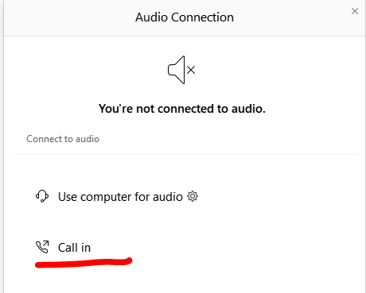
Cant Hear the Program?
Click the telephone icon at the bottom of the screen.
Select Call In and information will appear to join the webinar via telephone.

Slide 3
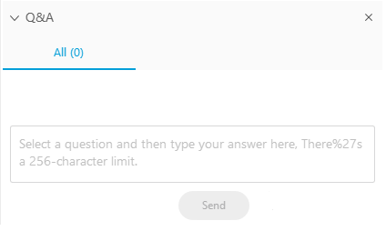
Questions During the Program
Please use the Q&A Box on the right side of your screen to send questions during the presentation.

Slide 4
Webinar Disclosure
By hosting this Webinar, California Grocers Association (CGA) and the CGA Educational Foundation (CGAEF) are providing an opportunity for their members and attendees to obtain general information that may be of interest to your company. The Webinar is designed to provide practical and useful information on the subject matter covered. However, CGA /CGAEF is not engaged in rendering legal, accounting or other professional advice or services.
CGA/CGAEF does not review or approve the content of the webinar presented by guest speakers and others, and makes no representations or warranties about the accuracy or legality of any compliance or other recommendations provided during the webinar. If legal advice or other expert assistance is required, the services of a competent professional should be sought.

Slide 5



Presenters
Rachel Goeriz, Ph.D.
Exponent
Managing Scientist
Chemical Regulation & Food Safety
(301) 291-2539
rgoeriz@exponent.com
exponent.com/professionals/g/goeriz-rachel
Alecia E. Cotton
Rogers Joseph O’Donnell
Attorney
415.956.2828
acotton@rjo.com
rjo.com/attorneys/alecia-e-cotton/
Jon-Erik W. Magnus
Rogers Joseph O’Donnell
Attorney
415.956.2828
jmagnus@rjo.com
www.rjo.com/attorneys/jon-erik-w-magnus/

Slide 6
Goals
Discuss relevant law, science, and guidance necessary to address COVID-19 risks
Suggest ways to implement a uniform program
Identify ways to foster a culture that facilitates a safe retail environment

Slide 7
Program Overview
COVID-19: An overview of the virus and its pathology
Applicable laws and sources of guidance
Identify elements of a COVID-19 response plan
Enforcement issues
Questions

Slide 8



Customer Health & Safety
An investment in health and safety is a customer retention strategy.
“The ability to deliver on health and safety efforts is now the most important aspect of the customer experience, and it will be for some time.”
“We found that 62% of shoppers would stop shopping at a
retailer not taking health and safety seriously.”
– Nick Mercurio, IPSOS June 2020
Top retailers in the Ipsos survey:
Whole Foods
Costco
Trader Joes

Slide 9

COVID-19 Overview

Slide 10
The Virus: SARS-CoV-2
Severe acute respiratory syndrome coronavirus 2
RNA virus
Lipid envelope
Highly transmissible compared to similar illnesses
  Infects cells deep within lungs
    Replicates in nasal passages and upper airway
  Viral shedding a few days before symptom onset
  High viral load at the beginning of illness onset
Source: Petersen et al. Comparing SARS-CoV-2 with SARS-CoV and influenza pandemics. The Lancet. July 3, 2020.

Slide 11
The Illness: COVID-19
Broad clinical spectrum; may appear 2–14 days after exposure
  Asymptomatic carriers
  Presymptomatic people
  can be infectious
Fatality increases sharply with age
Transmission occurs mainly person-to-person through talking, breathing, coughing, or sneezing.
Symptoms
Fever/chills | Loss taste/smell
Cough | Sore throat
Shortness breath | Congestion/runny nose
Fatigue | Nausea/vomiting
Muscle/body aches | Diarrhea
Headache

Slide 12
Federal Agencies: Transmission
No documented cases of COVID-19 transmission by food or food packaging
From FDA: “We are not aware of any reports at this time of human illnesses that suggest COVID-19 can be transmitted by food or food packaging.”
FDA position “adopted” by California Department of Public Health
From CDC: “No evidence suggesting handling food or consuming food is associated with COVID-19 … However, possible to get COVID-19 through touching surface and then mouth/nose/eyes.”

Slide 13
Distance + Time
Hygiene
Clean
Risk Reduction

Slide 14
Distance + Time Risk Ranking
 | Maximum Distance Between People (feet)
Exposure time (min) | >6 | 3–6 | <3
<1 | Low | Low | Med
1–5 | Med | Med | High
>5 | Med | High | High

Slide 15
Hygiene
Wash hands
Don’t touch face
Cover coughs and sneezes
Stay home when sick

Slide 16
Cleaning
Physical
Removes
Sanitizing
Chemical
Reduces
Disinfecting
Chemical
Kills

Slide 17
Disinfectants for Use Against SARS-CoV-2
U.S. Environmental Protection Agency List N: Disinfectants for Use Against SARS-CoV-2
  Must meet specific criteria to be approved for use against SARS-CoV-2
Must use according to label
  Contact time – time visibly wet

Slide 18

Applicable Law and Guidance

Slide 19
COVID-19 Response
Workplace Safety
COVID-19 Specific Response
Food Safety and Sanitation
(Cal. Health and Safety Code)
California Retail Food Code
Wholesale Food Processors
Local Health Dept.
Local COVID-19 Health Orders
(Cal. Health and Safety Code)
CAL/OSHA Requirements
Grocers, especially those with fresh food and prepared food areas, are responsible to know and address all of these requirements.
USEPA/FDA/USDA
State Health Orders/
Executive Orders
Food processing laws unlikely to apply to most grocers.

Slide 20


Volume Problem
Law and guidance potentially applicable to grocery stores is voluminous. Some laws are closer to guidance, and some guidance is closer to law.
Amount of paper required to land a ship on the Moon: Margaret Hamilton, director of software engineering for NASA, standing next to a stack of paper containing the code for Apollo 11’s flight software.
Amount of paper required to run a grocery store in a pandemic:
Scale representation of applicable San Francisco’s COVID-19 heath orders, guidance, CAL/OSHA requirements, etc. …
This Photo is licensed under CC BY-NC.
This Photo is licensed under CC BY-SA-NC.

Slide 21

Law vs. Guidance
Cal/OSHA guidance documents often include the following:
This guidance does not impose new legal obligations. It contains information for employers operating grocery stores on ways to update their IIPPs to prevent the spread of COVID-19 in the workplace …
SF Department of
Public Health example:
Order of the Health Officer (SIP)
Directives of the Health Officer
(Authorized and enforceable under Health and Safety Code)
vs.
“Advisories” and “Recommendations”
This Photo is licensed under CC BY-SA.

Slide 22

Language Interpretation
Documentation of response – issue was evaluated to determine possibility or feasibility.
Uncertain | Certain
If possible | Shall
When/whenever possible | Required
To the extent possible
If feasible
Where feasible
Where … difficult
Possible: being within the limits of ability, capacity, or realization; being what may be conceived, be done, or occur according to nature, custom, or manners.
Feasible: capable of being done or carried out; capable of being used or dealt with successfully.

Slide 23





Useful Resources for Guidance
https://www.cdc.gov/coronavirus/2019-nCoV/index.html
https://www.usda.gov/coronavirus
https://www.fda.gov/emergency-preparedness-and-response/
counterterrorism-and-emerging-threats/coronavirus-disease-2019-covid-19
https://www.dir.ca.gov/dosh/coronavirus/Health-Care-General-Industry.html
These websites should be bookmarked, and we recommend also including your local health departments as applicable.
https://www.who.int/emergencies/diseases/novel-coronavirus-2019

Slide 24
Plan of Attack
There is no “one size” fits all solution
Smaller Businesses | Larger businesses
Comply with local health orders | Identify jurisdictions to track
 | Build a master list of requirements
 | Identify difficult compliance areas
 | Build a standardized program

Slide 25
Plan of Attack: Keys to Success
Dedicate employees and resources to track the various requirements and update internal documentation
Compliance with emphasis on requirements that can be confirmed with visual inspection
  e.g., posting signage/SDP, distance markers, regulating crowds
Document compliance or good faith effort

Slide 26
Different Sources: Similar Obligations
Education and Training
CAL/OSHA
(Labor Code)
Obligations in response to COVID-19
Local Health Orders
Physical Measures and Precautions
Reporting
and
Enforcement
Retail Food Code/
Local Health Code

Slide 27

Response Plan

Slide 28

Positive COVID-Test Result
Health orders require a daily symptom check/health screening for employees before they enter the facility and require that any symptomatic employee be sent home. Employers are advised to have a plan in place for both suspected and confirmed COVID cases.
Response plan should consider:
  Employee quarantine and
  isolation measures
  Contact tracing to identify other
  potential cases
  Health department involvement
  Facility cleaning
  Public relations
  Privacy issues

Slide 29

Positive COVID-Test Result: Keys to Success
A tale of two positive test results, comparing a small and large employer’s response
Public disclosure
Employee discourse
Contact tracing
Employee quarantine
Testing (including on-site testing)
Deep facility clean
Additional training
Employee pledge
Revised shift schedule
Notice to health department

Slide 30
Training
To include:
  Virus information
  Disease prevention
  Social distancing protocols
  Actions in event COVID-19+ test
Training topics vary by jurisdiction
Cal/OSHA and CRFC have their own requirements for employee training
  Cal/OSHA adds additional training topics such as claiming sick-leave benefits

Slide 31
Training: Keys to Success
Employers have multiple and broad obligations to educate employees.
  Prepare one educational packet that addresses all:
    Health orders
    Cal/OSHA requirements
    CRFC
Frequency of initial training and refresher should be specified.
All training events should be documented.
  Certain jurisdictions require daily review of safety protocols.

Slide 32
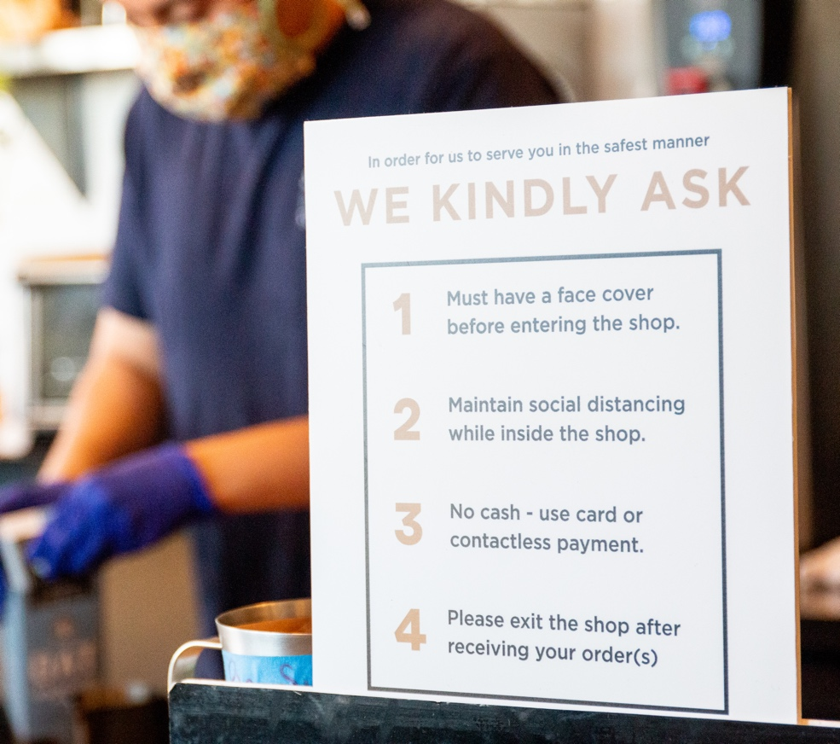
Signage
Employers have broad responsibilities for:
  Customer- and employee-facing signage
Facilities must post:
  Social distancing protocols
  Signage regarding maximum number allowed
  in facility
  Requirements for entry
  Marking 6-foot intervals
Certain jurisdictions require additional postings (SF/SD)
SD requires social distancing protocols to be similar to the form attached to health orders (allows a multi-jurisdiction template).

Slide 33


Signage: Key to Success
Signage should be
  Prominently placed
  Straightforward
Larger health departments have free materials

Slide 34
Food Preparation
California Retail Food Code:
Single-use nonlatex gloves shall be worn when contacting food
Separate sinks for handwashing and food preparation
Protect food from sources of contamination
During food preparation, wash produce to remove soil and other contaminants
“Food shall be prepared with suitable utensils and on surfaces that, prior to use, have been cleaned, rinsed, and sanitized” as specified in Section 114117 to prevent cross-contamination.
Key to Success:
Adhere to California Retail Food Code

Slide 35
Cleaning Food-Contact and High-Touch Surfaces
California Retail Food Code
Cal/OSHA
Equipment, utensils, and surfaces should be cleaned and sanitized including:
At any time during the operation when contamination may have occurred
Before/between raw foods of animal origin
Between raw and ready-to-eat foods
Before using/storing thermometer
If used with potentially hazardous food …
at least every 4 hours/non-hazardous every 24 hours
More frequently clean and disinfect
  Commonly touched surfaces and objects
  Surfaces in food handling and prepping areas
All tools, equipment and controls should be cleaned between shifts or between users, whichever is more frequent
  Coordinate cleaning product use with the USDA and/or FDA if used in food production areas. (Industry Guidance: Food Packing and Processing – July 2)

Slide 36
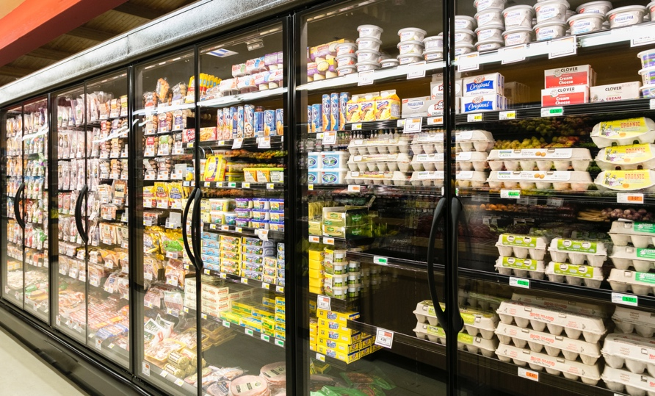
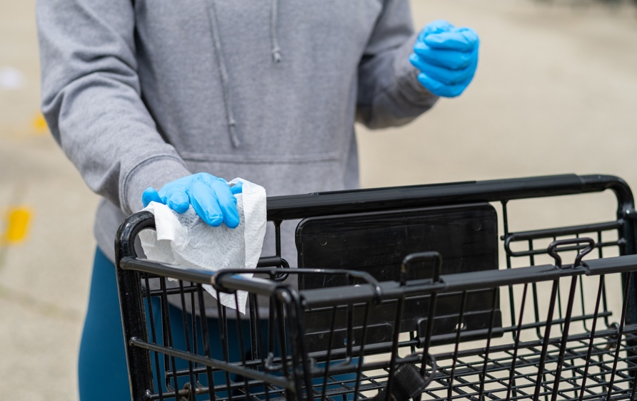
Facility Cleaning, Sanitizing, and Disinfecting
Dedicated employees to oversee
  (i) Cleaning/disinfecting and (ii) monitoring and re-stock of cleaning supplies
  Ensure “additional sanitization and disinfection” (LA/SD) or “at all times to continuously clean and sanitize” high-touch surfaces (SF)
Dedicated operational time for cleaning and decontamination throughout facility
Disinfect
  Break rooms, bathrooms, and other common areas frequently, on a regular, predetermined schedule
  Shopping carts and baskets after each use (dedicated employee – SF) (by employee or by making wipes available – LA)
Sanitize/disinfect all high-touch surfaces throughout store
Frequent cleaning and disinfection of recycling areas

Slide 37
Facility Cleaning, Sanitizing and Disinfecting (continued)
Cal/OSHA:
  Where possible, do not clean floors by sweeping or other methods that can disperse pathogens into the air.
  Use a vacuum with a HEPA filter wherever possible.

Slide 38

Facility Cleaning, Sanitizing, and Disinfecting:
Keys to Success
Dedicated operational time and staff
Comprehensive checklist/schedule with emphasis on high-touch areas
Ensure that appropriate cleaners, sanitizers and U.S. EPA approved disinfectants are used
Ensure that cleaning supplies are readily available
Evaluate touchless technology for plumbing and soap dispensing
Prepare cleaning and disinfection plan if confirmed COVID-19 case

Slide 39
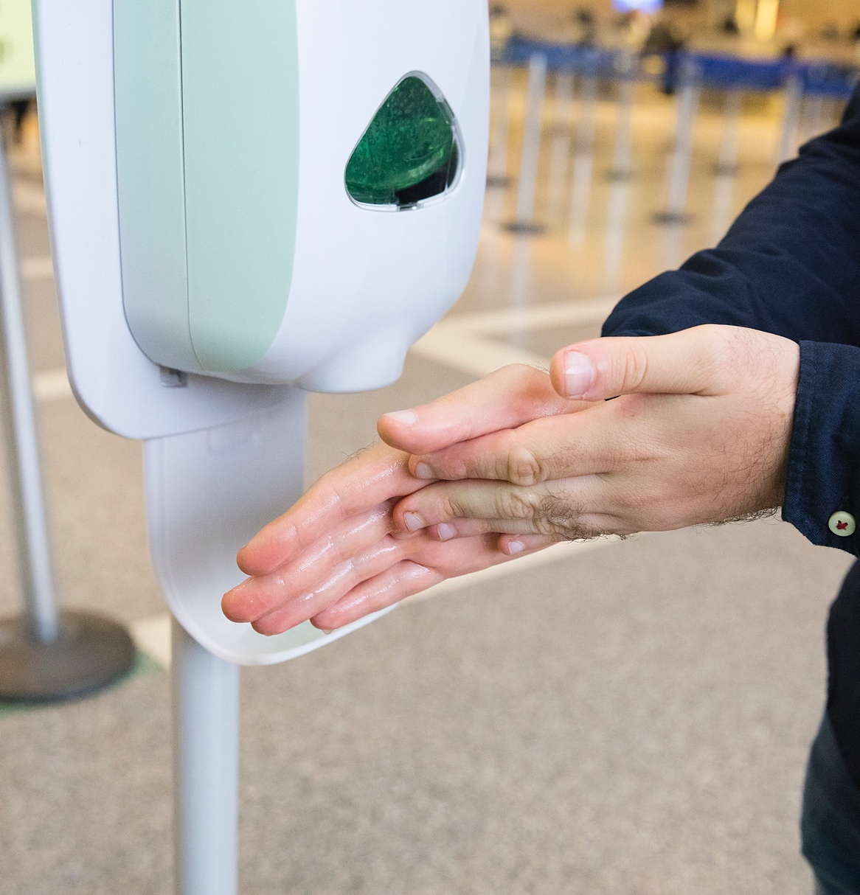
Hand Hygiene
Frequent handwashing with soap and water for at least 20 seconds, or using hand sanitizer that contains at least 60% alcohol
  Must provide handwashing station, hand sanitizer, soap and water, and/or disinfecting wipes to customers and employees
Examples of when to wash hands:
  Start and end of each shift
  After sneezing, coughing
  When changing tasks
  After touching face, hair, or other areas of the body
  Before putting on gloves
Allow time for employees to wash hands every
30 minutes (SD)
No double duty sinks (CRFC at § 113953.)

Slide 40

Hand Hygiene: Keys to Success
Ensure that employees have ample opportunity for hand washing.
Ensure that employees have training regarding the need for frequent handwashing.
Where handwashing is not readily available, sanitizer and/or gloves are available.

Slide 41
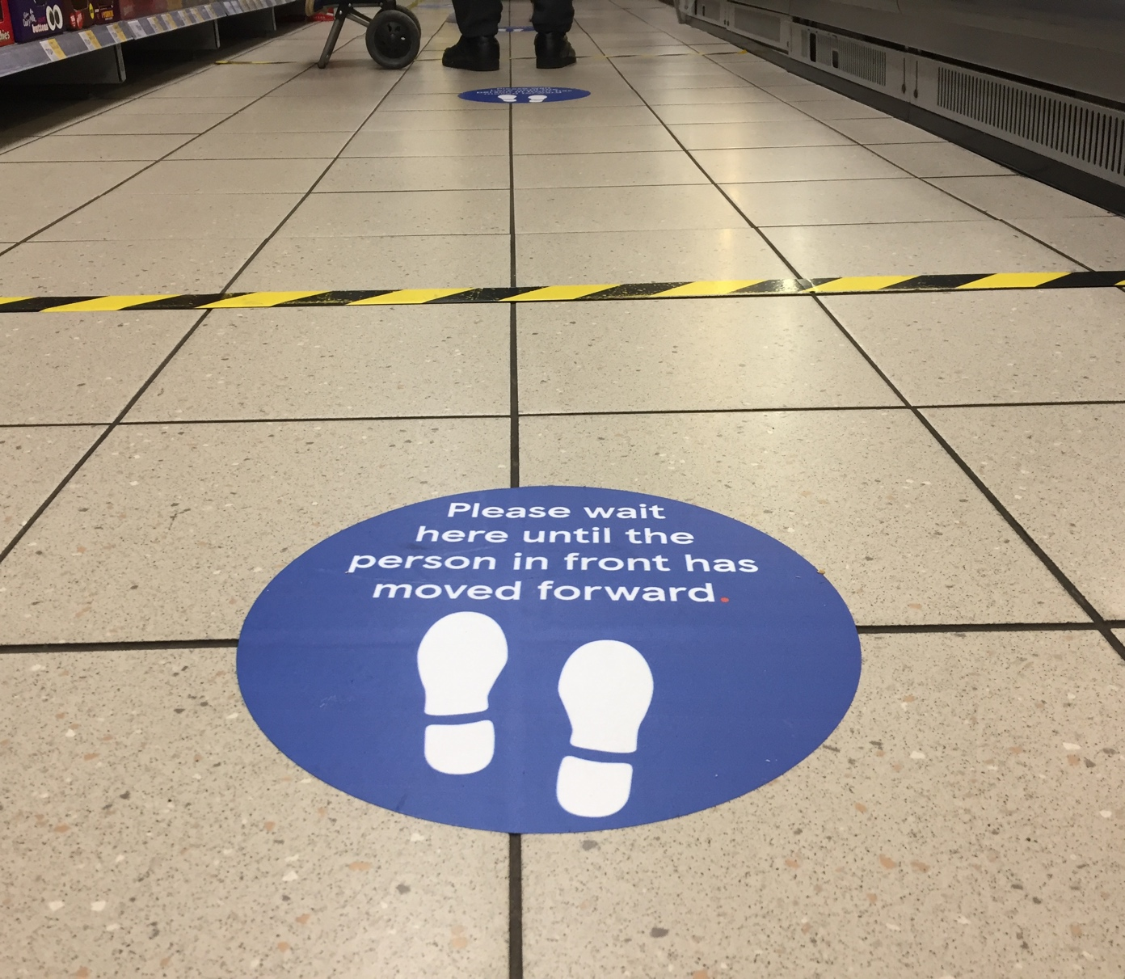
Physical Measures
Predetermine and limit the number of individuals inside facility.
  Assign personnel to monitor.
Queue spacing – marking floor.
Separate operational areas and access to those area.
Contactless payment (based on feasibility).
Consider:
  Sensitive population hours
  Technology assisted transactions

Slide 42

Physical Measures (continued)
Install physical barriers where separation difficult.
  LA Health Order requirement
  SF “when possible”
Rearrange facility to promote social distancing.
  General seating; pharmacy;
  break room
Shift and break staggering versus “podding” or “cohorting.”

Slide 43
Physical Measures: Cal/OSHA
Use every-other checkout stand.
Physical barriers to separate packing or processing workers from each other, if feasible.
Portable high-efficiency air cleaners, facility HVAC/air filter upgrades, and increased number of air exchanges.

Slide 44
Physical Measures: Keys to Success
Regularly review practices and identify areas of improvement
  Based on: traffic flow, “problem areas,” advances in science
Facilitate spacing between employees and between employees and customers:
  Mark spacing in any areas where customers are inclined to congregate while waiting for service
  Review areas for additional protective measures (e.g., barriers)
  Consider “active management” of any congested areas
Assess employee schedule design to allow for staggering within a “pod” or “cohort.”
Evaluate HVAC design and/or need for installation of air cleaners – especially in areas of low air circulation and potential crowding.

Slide 45
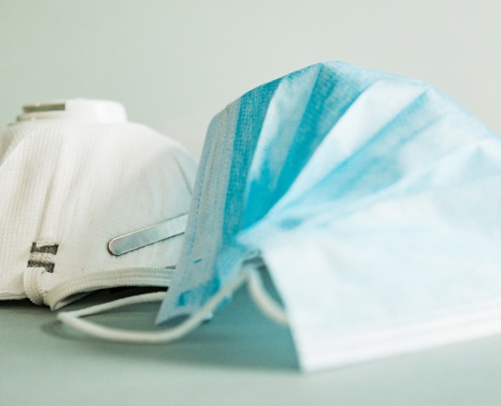


Gloves, Face Covering & PPE
Face Covering Use
State and Local Health Orders
Glove and PPE Use
Health Orders & Cal/OSHA
Face covering for employees and customers
  Some jurisdictions require
    Employer provide
    Use by customers for entry and enforcement
Adequate glove supply and hand sanitizer
  Especially when limited access to hand washing
Job-specific PPE
  Dishwashers
  Employees performing
    Temperature checks
    Recycling
    Food processing

Slide 46
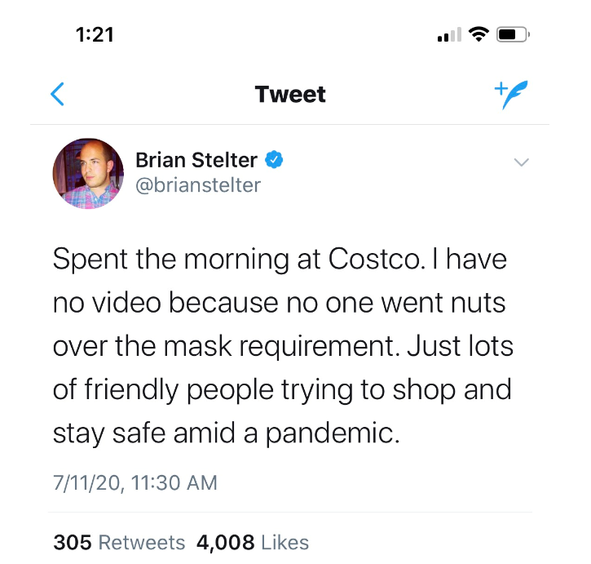
Gloves, Face Coverings & PPE: Keys to Success
Post clear policies for face coverings.
Make available to employees at no cost.
Identify areas where additional PPE required.
Ensure proper training for use.
Have an accommodation policy to address ADA claims:
  Shop for a customer
  Supply mask
Have a protocol for unruly customers.

Slide 47

Self Service Areas
Health orders prohibit self serve
stations including:
  Bulk food bins
  Disposable utensils, coffee lids, condiments
  Hot food/salad bars
  Yogurt dispensers
Soda dispensers for to-go orders allowed in certain jurisdictions.
Samples prohibited by jurisdiction.
Self-serve produce (SF Exhibit A to Health Officer Directive No. 2020-07):
  Prevent handling/sampling/smelling produce without purchase
  Selection by visual examination only
  Post signage

Slide 48
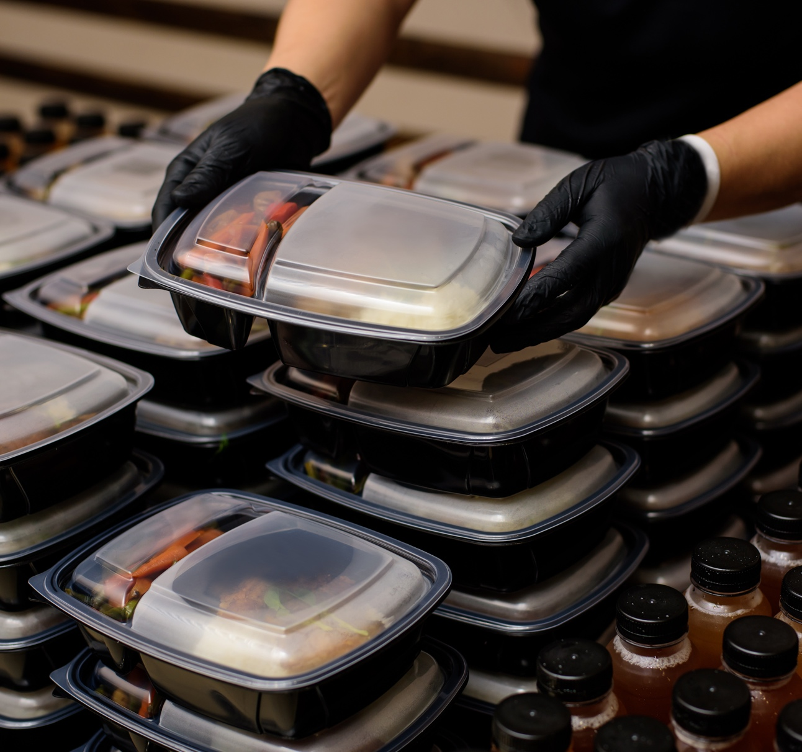
Self Service Areas: Keys to Success
Utensils, condiments, and other to-go items are prepacked and supplied by employee with customer order.
Self-service, bars, dispensers, should be discontinued or attended by employee.
Employee-manned self-serve areas should be marked for physical distancing.

Slide 49
Reusable Bags
Health Orders
Cal/OSHA
Customers are prohibited from using own shopping bags (SD).
Customers who bring their own bags must bag their own groceries, or if an employee bags groceries gloves should be changed after handling customer bags (LA).
Bags cannot be placed on conveyor belts or anywhere outside shopping cart.
No employee-bag contact.
Customers bag own groceries.
Customers can’t bag groceries in checkout if not able to be physically distant.
Increase frequency of disinfection in bagging areas used by customers.

Slide 50
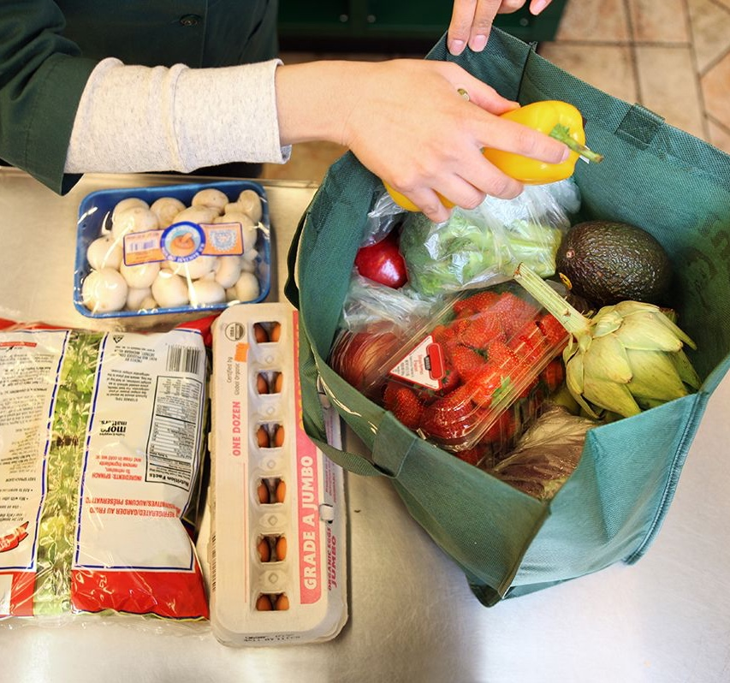
Reusable Bags: Keys to Success
Clear and concise signage for customers re: bag policy.
Allowing customers to use own bags takes time and creates increased need for cleaning (high-touch surface) and potential contact.
  Mark checkout area to allow space for self bagging.
Check jurisdiction for reusable bag suspension.
This Photo is licensed under CC BY

Slide 51
Tips for a Successful Safety and Health Program
Distance + Time
Hygiene
Clean
Risk Reduction
Universal Safety
Culture
Distance
Time
Hygiene
Clean/Sanitize/Disinfect

Slide 52

Enforcement

Slide 53

Enforcement
Enforcement authority
  Local health departments/district attorneys (health orders and CRFC)
  Cal/OSHA
  Update on recent enforcement activities
  What to do when faced with an enforcement action

Slide 54

How are You Going to Prepare?

Slide 55
Questions?
Rachel Goeriz, Ph.D.
Exponent
Managing Scientist
Chemical Regulation & Food Safety
(301) 291-2539
rgoeriz@exponent.com
exponent.com/professionals/g/goeriz-rachel
Alecia E. Cotton
Rogers Joseph O’Donnell
Attorney
415.956.2828
acotton@rjo.com
rjo.com/attorneys/alecia-e-cotton/
Jon-Erik W. Magnus
Rogers Joseph O’Donnell
Attorney
415.956.2828
jmagnus@rjo.com
www.rjo.com/attorneys/jon-erik-w-magnus/

Slide 56

Thank You!

