Slide 1
COVID-19: Impacts on Workers’ Compensation
Elizabeth B. Stallard
Hosted by: CGA Educational Foundation
June 11, 2020

Slide 2
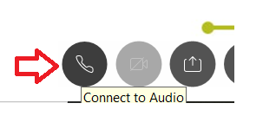
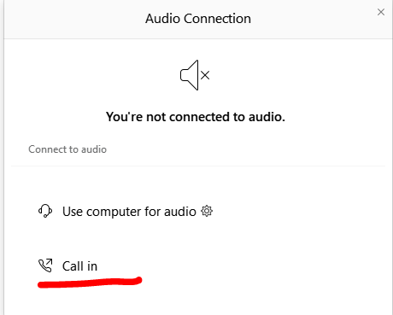
Can’t Hear the Program?
Click the telephone icon at the bottom of the screen.
Select Call In and information will appear to join the webinar via telephone.

Slide 3
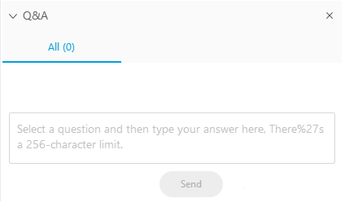
Questions During Program
Please use the Q&A Box on the right side of your screen to send questions during the presentation.

Slide 4
Webinar Disclosure
By hosting this Webinar, California Grocers Association (CGA) and the CGA Educational Foundation (CGAEF) are providing an opportunity for their members and attendees to obtain general information that may be of interest to your company. The Webinar is designed to provide practical and useful information on the subject matter covered. However, CGA /CGAEF is not engaged in rendering legal, accounting or other professional advice or services.
CGA/CGAEF does not review or approve the content of the webinar presented by guest speakers and others, and makes no representations or warranties about the accuracy or legality of any compliance or other recommendations provided during the webinar. If legal advice or other expert assistance is required, the services of a competent professional should be sought.

Slide 5
Today’s Discussion
How does workers’ compensation traditionally address communicable diseases?
What is Executive Order N-62-20, and how does it change existing standards?
Can you rebut the presumption - and if yes, how?
What is the likely impact on your business?

Slide 6
WC and Communicable Diseases
WC is for injuries that arise out of and in the course of employment.
Generally non-occupational diseases (influenza, common cold) are not compensable.
Causation Issue: Proving illness arose out of employment.
Employee’s burden to prove.

Slide 7
When Has This Burden Been Satisfied?
When employment subjects employee to an increased risk compared to that of the general public.
Something connected to employment (business trip, increased workplace exposure)
Even if the disease also in the community
When the immediate cause of the injury is an intervening human agency or instrumentality of the employment.
Example: Employer-mandated vaccinations.

Slide 8
Executive Order N-62-20
Announced May 6, 2020
Provides that any COVID-19-related illness of an employee shall be presumed to arise out of and in the course of the employment for purposes of awarding workers’ compensation benefits if all of the following requirements are satisfied:
(a) The employee tested positive for or was diagnosed with COVID19 within 14 days after a day that the employee performed labor or services at the employee’s place of employment at the employer’s direction;
(b) The day referenced in subparagraph (a) on which the employee performed labor or services at the employee’s place of employment at the employer’s direction was on or after March 19, 2020;
(c) The employee’s place of employment referenced in subparagraphs (a) and (b) was not the employee’s home or residence; and
(d) Where subparagraph (a) is satisfied through a diagnosis of COVID-19, the diagnosis was done by a physician who holds a physician and surgeon license issued by the California Medical Board and that diagnosis is confirmed by further testing within 30 days of the date of the diagnosis.

Slide 9
E.O. Interplay With Federal Legislation
Where an employee has paid sick leave benefits specifically available in response to COVID-19, those benefits shall be used and exhausted before any temporary disability benefits or benefits under Labor Code section 4850 are due and payable.
FFCRA benefits are set to expire December 31, 2020.

Slide 10
Executive Order N-62-20
Presumption applies to dates of injury occurring through 60 days following the date of the Order (July 5, 2020)
Note: there are ongoing legislative efforts for certain occupations.
Imposes a quicker fuse to reject claims: Claims are presumed compensable if liability is not rejected within 30 days after the date the claim form is filed, unless rebutted by evidence only discovered subsequent to the 30-day period.
Standard timing is 90 days. (L.C. 5402.)

Slide 11
How Do You Rebut the Presumption?
E.O. confirms the presumption is disputable and may be controverted by other evidence.
However, the E.O. provides no indication as to what such “evidence” might be.
Also remember you do not have much time, especially when you consider the risk of pandemic-related delays.

Slide 12
How Do You Rebut the Presumption?
Challenge one of the 4 qualifying requirements.
Timing of work and diagnosis
Telework
Establish another cause for the illness.
Employee’s activities outside of work
People who live with the employee
Comply with workplace public health guidelines.
S&W liability

Slide 13
What Does This All Mean For You?
Imposes a standard that is easier for employees to satisfy.
Increases cost to have and administer WC coverage.
Most cases will not become significant claims. However, we know that some people have become seriously ill and even died.
True impact depends on the course of the pandemic and further legislative action.

Slide 15
Elizabeth B. Stallard
916 520 5238
estallard@downeybrand.com

