Slide 1


Workplace Safety and Cal/OSHA Compliance Amid COVID-19 Pandemic
Presented by:
Karen Tynan and Kevin Bland

Slide 2

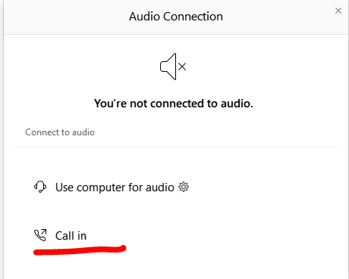
Can’t Hear the Program?
Click the telephone icon at the bottom of the screen.
Select Call In and information will appear to join the webinar via telephone.

Slide 3
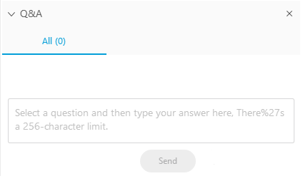
Questions During Program
Please use the Q&A Box on the right side of your screen to send questions during the presentation.

Slide 4
Webinar Disclosure
By hosting this Webinar, California Grocers Association (CGA) and the CGA Educational Foundation (CGAEF) are providing an opportunity for their members and attendees to obtain general information that may be of interest to your company. The Webinar is designed to provide practical and useful information on the subject matter covered. However, CGA /CGAEF is not engaged in rendering legal, accounting or other professional advice or services.
CGA/CGAEF does not review or approve the content of the webinar presented by guest speakers and others, and makes no representations or warranties about the accuracy or legality of any compliance or other recommendations provided during the webinar. If legal advice or other expert assistance is required, the services of a competent professional should be sought.

Slide 5

Karen Tynan & Kevin Bland

Slide 6
Agenda
Present Situation
Potentially Applicable Regulations to COVID-19 Pandemic
Section 3203 – Injury Illness Prevention Plan
Section 3380 – Personal Protective Devices
Cal/OSHA Guidance and Recommendations
Frequently Asked Questions (FAQs)

Slide 7
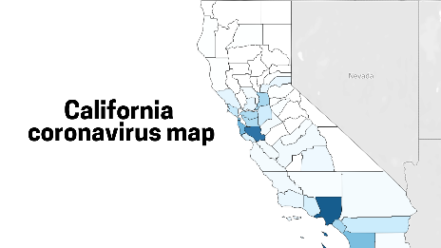
TODAY
California OSHA offices remain open with limited capability, including:
Responding to queries and complaints
Advising employers as needed on COVID-19
Permits via phone conference
Informal Settlement Conferences via phone
Posting advice and guidance online

Slide 8
Section 3203 – Injury Illness Prevention Plan
Very familiar to California employers.
California’s version of the general duty clause.
Requires employers to “establish, implement and maintain an effective Injury and Illness Prevention Program.”
There are some specific provision under Section 3203 that may apply to the COVID-19 pandemic.

Slide 9
Section 3203 – Injury Illness Prevention Plan
Inspections shall be made to identify and evaluate work place hazards:
Whenever new substances, processes, procedures, or equipment are introduced to the workplace that represent a new occupational safety and health hazard; and
Whenever the employer is made aware of a new or previously unrecognized hazard.
OUR HAZARD IS COVID-19

Slide 10
Section 3203 – Injury Illness Prevention Plan
When a hazard is discovered, there should be “methods and/or procedures for correcting unsafe or unhealthy conditions, work practices and work procedures in a timely manner based on the severity of the hazard.”
“When an imminent hazard exists which cannot be immediately abated without endangering employee(s) and/or property, remove all exposed personnel from the area except those necessary to correct the existing condition. Employees necessary to correct the hazardous condition shall be provided the necessary safeguards.”

Slide 11
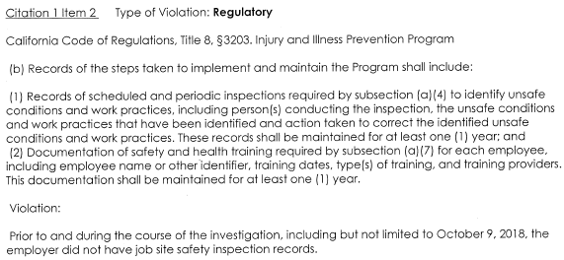
Section 3203 – IIPP Recordkeeping!

Slide 12
Section 3203 Action Items Discussion
Identify COVID-19 risks in the workplace
Take action to minimize COVID-19 hazards
Personnel and their work processes;
Frequent, open, and honest communication with employees;
Workplace(s);
Cleaning;
Training;
Continuous monitoring of Cal/OSHA, CDC, Orders,
Continuous evaluation and improvement of this work.
Assessment of results.
Recordkeeping!

Slide 13
Section 3203 Take Away
“COVID-19 is a workplace hazard that I must deal with. I am going to identify hazard and ways that the virus can be transmitted at work. I will improve my procedures and processes to make sure that we minimize the COVID-19 risks in our workplace. We will train out employees so that they understand the virus, appreciate the risks associated with the work that they do, recognize how to minimize risks and address the hazards, and follow procedures that will help all workers avoid COVID-19.”

Slide 14
Section 3380 – Personal Protective Devices
The employer shall assess the workplace to determine if hazards are present, or are likely to be present, which necessitate the use of personal protective equipment (PPE). If such hazards are present, or likely to be present, the employer shall:
Select, and have each affected employee use, the types of PPE that will protect the affected employee from the hazards identified in the hazard assessment;
Communicate selection decisions to each affected employee; and,
Select PPE that properly fits each affected employee.

Slide 15
Section 3380 – Personal Protective Devices
The employer shall verify that the required workplace hazard assessment has been performed through a written certification that identifies the workplace evaluated; the person certifying that the evaluation has been performed; the date(s) of the hazard assessment; and, which identifies the document as a certification of hazard assessment.
Action Item: Document your hazard assessment and any actions taken with PPE including selection of PPE, communication to employees, training, and evaluation of how well the PPE is working for employees.

Slide 16
Section 3380 – Personal Protective Devices
Guidance for hazard assessment can be found in Appendix A.
https://www.dir.ca.gov/title8/3380.html
A few items of guidance implicated by COVID-19 pandemic:
Do not rely on PPE alone. Consider administrative and engineering controls.
Survey. Conduct a walk-through survey of the areas in question. The purpose of the survey is to identify sources of hazards to workers and co-workers.
Sources. During the walk-through survey, the safety person should observe potential sources of the virus. Pay attention to the layout of workplace and location of co-workers to achieve required social distancing.

Slide 17
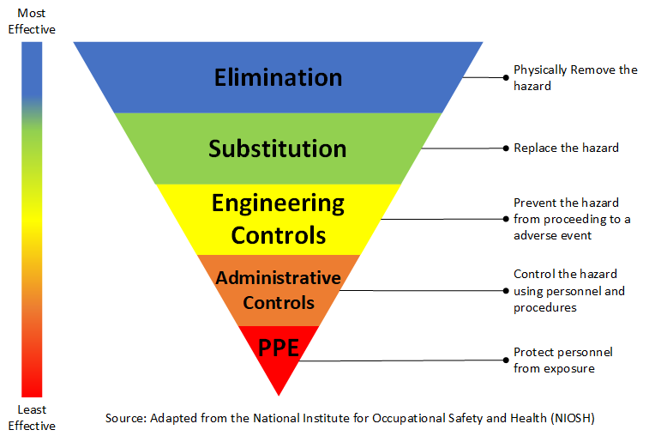
SHORT SIDEBAR ON HIERARCHY OF CONTROLS

Slide 18
Section 3380 – Personal Protective Devices
Training. The employer shall provide training to each employee who is required by this section to use PPE. Each such employee shall be trained to know at least the following:
When PPE is necessary;
What PPE is necessary;
How to properly don, doff, adjust, and wear PPE;
The limitations of the PPE; and,
The proper care, maintenance, useful life and disposal of the PPE.

Slide 19
Cal/OSHA Guidance for General Industry
Employers and employees should review their own health and safety procedures as well as the recommendations and standards detailed below to ensure workers are protected.
Cal/OSHA recommends employers not covered by the ATD Standard follow recommendations from the Centers for Disease Control and Prevention (CDC).
https://www.dir.ca.gov/dosh/coronavirus/General-Industry.html

Slide 20
Cal/OSHA Guidance for General Industry
The CDC guidelines include infection prevention measures which include:
Actively encouraging sick employees to stay home
Sending employees with acute respiratory illness symptoms home immediately
Providing information and training to employees on:
Cough and sneeze etiquette
Hand hygiene
Avoiding close contact with sick persons
Avoiding touching eyes, nose, and mouth with unwashed hands
Avoiding sharing personal items with co-workers (i.e. dishes, cups, utensils, towels)
Providing tissues, no-touch disposal trash cans and hand sanitizer for use by employees
Performing routine environmental cleaning of shared workplace equipment and furniture (disinfection beyond routine cleaning is not recommended)

Slide 21
Cal/OSHA Guidance for General Industry
All employers must have an IIPP to protect employees from workplace hazards. Employers are required to determine if COVID-19 infection is a hazard in their workplace. If it is a workplace hazard, then employers must:
Implement measures to prevent or reduce infection hazards, such as implementing the CDC recommended actions
Provide training to employees on their COVID-19 infection prevention methods

Slide 22
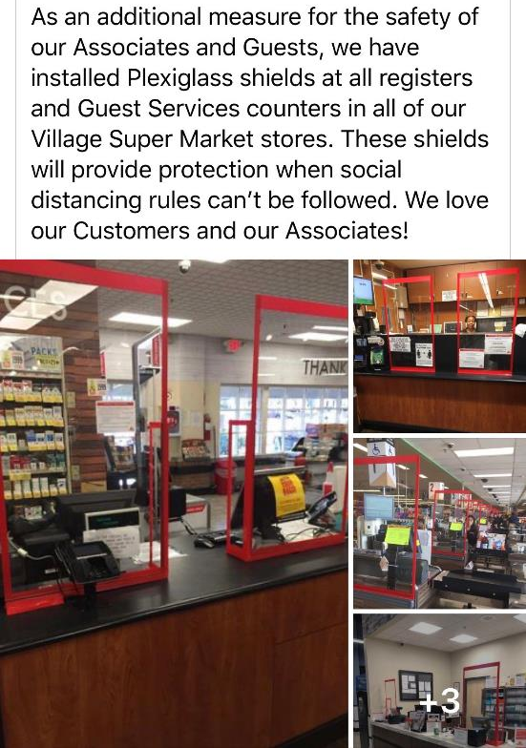


Slide 23
Cal/OSHA Guidance
REMEMBER
Regardless of COVID-19 risk, all employers must provide washing facilities that have an adequate supply of suitable cleansing agents, water and single-use towels or blowers (title 8 sections 1527, 3366, 3457 and 8397.4).

Slide 24
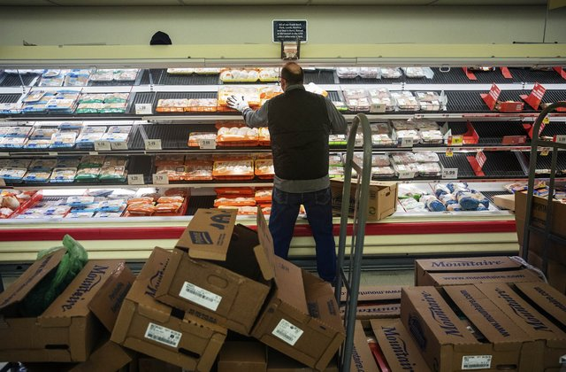

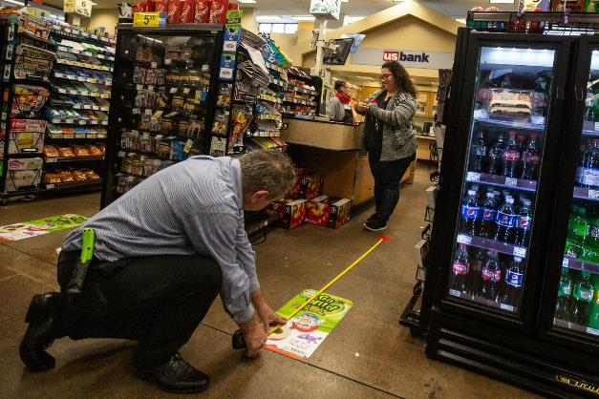
FREQUENTLY ASKED QUESTIONS

Slide 25
FAQ 1
Q. Are there any Cal/OSHA requirements that must be followed when an employee is diagnosed with COVID-19?
Yes.
First, ensure that the infected employee stays away from the workplace.
Second, evaluate areas where the employee worked, including with whom the employee made contact, what equipment was used, etc.
Then - Notify other workers.
Sanitize the work area.
Consult with medical and safety professionals as needed.

Slide 26
FAQ 2
Q. May an employee refuse to come to work due to a fear of becoming infected with COVID-19?
A. Employees may be protected from retaliation under California Law in certain circumstances when they refuse to perform work as directed. Specifically, California Labor Code section 6311 states: “No employee shall be laid off or discharged for refusing to perform work in the performance of which this code, including Section 6400 [which generally requires a “safe and healthful” workplace], any occupational safety or health standard or any safety order of the division or standards board will be violated, where the violation would create a real and apparent hazard to the employee or his or her fellow employees….”
BE CAREFUL - While each situation is different, a generalized fear of contracting COVID-19 is not likely to justify a work refusal in most cases. Specific facts such as a lack of required PPE, lack of sanitation, improper procedures, could tip the scales.

Slide 27
FAQ 3
Q. May an employer refuse an employee’s request to wear self-provided respiratory protection and/or gloves?
A. Yes, if such PPE are not otherwise required by the CDC’s guidance or Cal/OSHA’s regulations, or if the employer determines that the employee’s use of respiratory protection or gloves in and of themselves presents a hazard to the employee (e.g., if they interfere with the employee’s ability to work safely).
NOTE THAT ADVICE ON FACE COVERINGS AND MASKS ARE CHANGING AND EVOLVING. STAY UP TO DATE.

Slide 28
FAQ 4
Q. How do we apply these rules to contractors and vendors?
Cal/OSHA regulations govern your workplace for your workers …. Meaning, you are responsible for your employees
However, hazards created by contractors and vendors being on your work site must be evaluated and addressed.
Consider: Evaluating the hazards from independent contractors on your premises. Understand your possible 3rd party liability with these contractors. Do not underestimate the impact that customers, vendors, and other contractors can have in your workplace.

Slide 29
FAQ 5
Q. Are employers required to record an employee’s COVID-19 diagnosis?
Maybe.
Employers are required under Cal/OSHA’s recordkeeping regulation (8 CCR 14300, et seq.) to record illnesses that are “work related” and meet one of the recording criteria, which include days away from work, job transfer, and medical treatment. A work-related illness that meets these criteria must be recorded on the employer’s Cal/OSHA Form 300, and a Form 301 must also be completed.

Slide 30
FAQ 6
Q. Are employers required to report an employee’s COVID-19 diagnosis?
A. Employers may be required to report an employee’s coronavirus infection to Cal/OSHA if:
The infection is work-related (e.g., the infection was contracted in a place of employment or in connection with any employment); and
The infected employee is hospitalized as an in-patient, or dies without hospitalization.
If the answer to both questions are yes, the hospitalization/death must be reported to Cal/OSHA “immediately,” which means “as soon as practically possible but not longer than 8 hours after the employer knows or with diligent inquiry would have known of the death or [hospitalization].” However, “if the employer can demonstrate that exigent circumstances exist, the time frame for the report may be made no longer than 24 hours after the incident.”

Slide 31
Additional Resources
https://ogletree.com/solutions/coronavirus-covid-19-resource-center/
https://ogletree.com/solutions/practice-areas/workplace-safety-and-health/
https://www.dir.ca.gov/dosh/coronavirus/Health-Care-General-Industry.html
https://www.osha.gov/SLTC/covid-19/

Slide 32
Contact Information
Karen Tynan
Karen.tynan@Ogletree.com
707.508.8476
Sacramento
Kevin Bland
Kevin.bland@Ogletree.com
949.813.1120
Orange County

Slide 33
Questions?
Kevin Bland
Ogletree, Deakins, Nash, Smoak & Stewart, P.C.
Park Tower
695 Town Center Drive
Suite 1500
Costa Mesa, CA 92626
Cell: 949.813.1120
Kevin.bland@ogletree.com
Karen Tynan
Ogletree, Deakins, Nash, Smoak & Stewart, P.C.
500 Capital Mall
Suite 2500
Sacramento, CA 95814
Cell: 707.508.8476
Karen.tynan@ogletree.com

