Slide 1
Webinar: New Laws for 2020
Hosted by CGA Educational Foundation

Slide 2
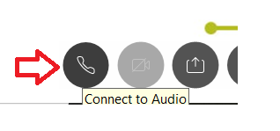
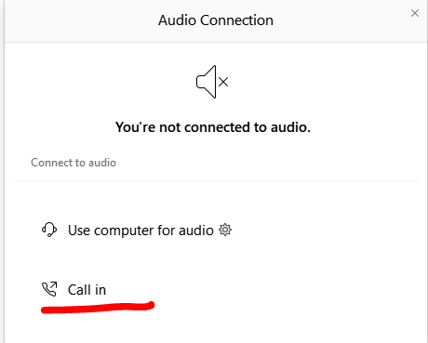
Can’t Hear the Program?
Click the telephone icon at the bottom of the screen.
Select Call In and information will appear to join the webinar via telephone.

Slide 3
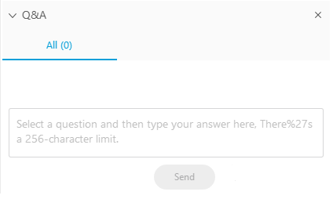
Questions During Program
Please use the Q&A Box on the right side of your screen to send questions during the presentation.

Slide 4

Louie A. Brown Jr.
Kahn, Soares & Conway, LLP
916-448-3826
lbrown@kscsacramento.com

Slide 5
Webinar Disclosure
By hosting this Webinar, California Grocers Association (CGA) and the CGA Educational Foundation (CGAEF) are providing an opportunity for their members and attendees to obtain general information that may be of interest to your company. The Webinar is designed to provide practical and useful information on the subject matter covered. However, CGA /CGAEF is not engaged in rendering legal, accounting or other professional advice or services.
CGA/CGAEF does not review or approve the content of the webinar presented by guest speakers and others, and makes no representations or warranties about the accuracy or legality of any compliance or other recommendations provided during the webinar. If legal advice or other expert assistance is required, the services of a competent professional should be sought.

Slide 6
New Laws for 2020
AB 5: Worker status: employees and independent contractors
AB 9: Employment discrimination: Statute of Limitations Extension of Complaint Filing
AB 51: Employment Discrimination: Elimination of Mandatory Arbitration Agreements
AB 673: Failure to Pay Wages

Slide 7
New Laws for 2020 cont.
AB 1554: Employers: Notice of deadlines with flexible spending accounts
SB 142: Lactation Accommodation
SB 188: Discrimination: Adds hairstyles to protected classes

Slide 8
Updates
Paid Family Leave
Minimum Wage
Sexual Harassment Training

Slide 9
AB5 – Independent Contractors
Legislative intent is to ensure workers who are currently misclassified as independent contractors have basic employment law protections
Presumption of an employment relationship unless the employer satisfies Three Prong “ABC Test”, with certain exemption.
Effective 1/01/2020 except in very limited circumstances

Slide 10
Three-Prong Dynamex “ABC Test”:
A - The person is free from the control and direction of the hiring entity in connection with the performance of the work, both under the contract for the performance of the work and in fact.
B - The person performs work that is outside the usual course of the hiring entity’s business.
C - The person is customarily engaged in independently established trade, occupation, or business of the same nature as that involved in the work performed.

Slide 11
Business to business exception if ALL of the following apply:
The business service provider is free from the control and direction of the contracting business entity in connection with the performance of the work, both under the contract for the performance of the work and in fact.
The business service provider is providing services directly to the contracting business rather than to customers of the contracting business.
The contract with the business service provider is in writing.

Slide 12
Business to business continued:
If the work is performed in a jurisdiction that requires the business service provider to have a business license or business tax registration, the business service provider has the required business license or business tax registration.
The business service provider maintains a business location that is separate from the business or work location of the contracting business.
The business service provider is customarily engaged in an independently established business of the same nature as that involved in the work performed.

Slide 13
Cont.
The business service provider actually contracts with other businesses to provide the same or similar services and maintains a clientele without restrictions from the hiring entity.
The business service provider advertises and holds itself out to the public as available to provide the same or similar services.
The business service provider provides its own tools, vehicles, and equipment to perform the services.
The business service provider can negotiate its own rates.
Consistent with the nature of the work, the business service provider can set its own hours and location of work.

Slide 14
AB 5
With Respect to Wage Orders, declaratory of existing law
Employer cannot reclassify an individual who was an employee on 1/01/2019 to an independent contractor.
The new “ABC” standard shall not apply to workers’ compensation until 7/01/2020

Slide 15
AB 9 – Statute of Limitations
Extends the time to file a complaint with the DFEH from one year to three years.
Complaint is deemed filed upon completion of an intake form with DFEH
Also allows for a person who first obtained knowledge of the unlawful practice after the time limitation has run, to have 90 more days to file

Slide 16
AB 51 – Mandatory Arbitration Agreements
Effective 1/01/2020, employers will no longer be able to compel workers into Arbitration for state discrimination claims or those brought under the California Labor Code
Prohibits employers from requiring employees/prospective employees to waive any right, forum, or procedure under FEHA/Labor Code as a condition of employment. Employer cannot retaliate against employees who refuse to waive such rights.

Slide 17
AB 673 – Unpaid Wage penalties
Authorizes an employee the right to recover penalties for late payment of wages through PAGA
Damages are $100 for each initial violation; for each “subsequent violation or intentional violation” $200 for each failure to pay
Additionally, employers are liable for 25% of the amount withheld for certain Labor Code violations
Employees seeking wages owed can either bring an action to recover statutory penalties OR seek to enforce civil penalties under PAGA, but not both for the same violation

Slide 18
AB 1554 – FSA deadlines
An employer shall notify an employee who participates in a flexible spending account, including, but not limited to, a dependent care flexible spending account, a health flexible spending account, or adoption assistance flexible spending account, of any deadline to withdraw funds before the end of the plan year.
Notice shall be by two different forms, one of which may be electronic.

Slide 19
SB 142 – Lactation Accomodation
Provides for new lactation space to:
Be safe, clean and free of hazardous materials
Be shielded from view and free from intrusion
Contain a place to sit and a surface for a breast pump and personal items
Have access to electricity or battery capable of powering breast pump
Be close to the employee’s work area; and include a sink with running water and a refrigerator or cooler for storing milk
Be an area that is not a bathroom

Slide 20
Requires new policies to accommodate those with lactation needs including provisions that include:
An Employee’s right to request lactation accommodation
The process for requesting the accommodation
Obligation to respond in writing if it cannot accommodate
The Employee’s right to file a complaint with the Labor Commissioner for any violation
All managers and supervisors must be trained on the need to accommodate and what that means.

Slide 21
SB 188 – CROWN Act
Create a Respectful and Open Workplace for Natural Hair – CROWN.
Expands the definition of “Race or Ethnicity” under FEHA to include traits historically associated with race including protective hairstyles.

Slide 22
UPDATES

Slide 23
Paid Family Leave
Effective 7/01/2020 paid family leave is increased from 6 to 8 weeks.
A person may receive SDI to care for a seriously ill family member or to bond with a minor child within one year of birth or placement.

Slide 24
Minimum Wage
Effective 1/1/2020 – minimum wage is $12 per hour for employers with 25 employees or less and $13 per hour for employers with 26 or more employees.

Slide 25
SB 778 – Sexual Harassment Training clean up
Extends the deadline for most employers to comply with the new harassment training requirements to 1/01/2021
Provides additional time after the DFEH training materials are published to determine if employers will use them or create their own
Confirms that employers who conduct appropriate harassment training in 2019 will not be required to do it again for two years

Slide 26

Workplace Harassment Prevention Training
Trainings for Supervisors and Non-Supervisory Employees
Meets requirements of CA law
100% online with immediate reporting
Customized to the Grocery Industry
Rates as low as $8 and $3 per employee
Spanish versions coming in 2020
Contact foundation@cagrocers.com for more details.

Slide 27

Questions?

Slide 28
Louie A. Brown Jr.
Kahn, Soares & Conway, LLP
916-448-3826
lbrown@kscsacramento.com

